Slide 1
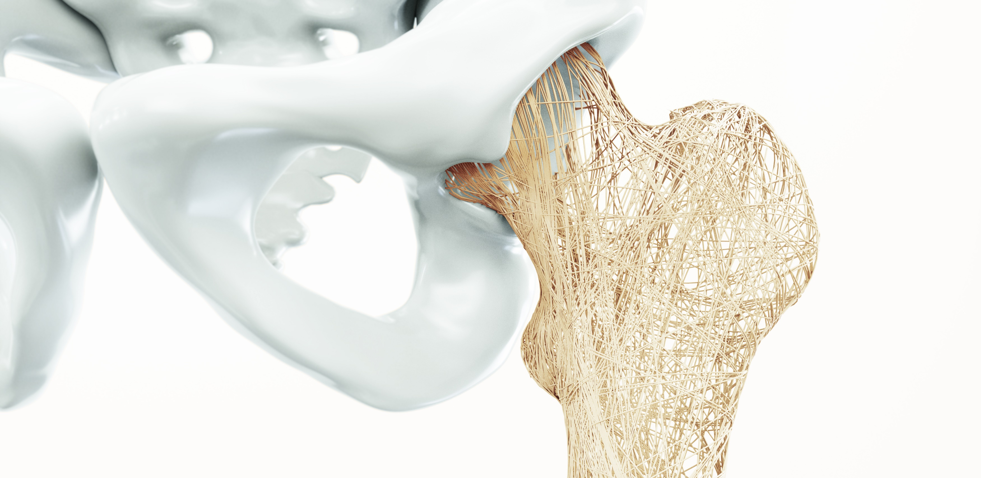
A PRIMARY CARE GUIDE TO
KEY CLINICAL QUESTIONS IN OSTEOPOROSIS MANAGEMENT

Slide 2

Presenter Disclosure
Presenter - [presenter name]
Relationships with financial sponsors:
Grants/Research Support:
Speakers Bureau/Honoraria:
Consulting Fees:
Patents:
Other:

Slide 3
Disclosure of Financial Support
This program has received financial support from Amgen Canada in the form of an educational grant.
This program has received in-kind support from Amgen Canada in the form of logistical support.
Potential for conflict(s) of interest:
[Presenter] has received [payment/funding, etc.] from [organization supporting this program AND/OR organization whose product(s) are being discussed in this program].
Amgen Canada developed, licenses, distributes and benefits from the sale of a product that will be discussed in this program

Slide 4
Mitigating Potential Bias
The Canadian Heart Research Centre (CHRC) and the Canadian Centre for Professional Development in Health and Medicine (CCPDHM) assesses conflict of interest with its instructors, planners, managers and other individuals who are in a position to control the content of CME activities. All relevant conflicts of interest that are identified are thoroughly vetted by the CHRC and CCPDHM for fair balance, scientific objectivity of studies utilized in this program, and patient care recommendations. The CHRC and CCPDHM is committed to providing its learners with high quality CME activities and related materials that promote improvements or quality in healthcare and not a specific proprietary business interest of a commercial interest.
The speaker had provided a full disclosure in advance of the program. The scientific content of the program is evidence based and all content related to pharmacotherapy is within product label. The program has been peer reviewed and is nationally accredited by the College of Family Physicians of Canada.
[Presenter] has provided his disclosure information at the start of this presentation.

Slide 5
Accreditation Statement
This one-credit-per-hour Group Learning program has been certified by the College of Family Physicians of Canada and the Provincial Chapter for up to X Mainpro+ credits.

Slide 6

Program Development
This program was planned by the Canadian Centre for Professional Development in Health and Medicine, a not-for-profit academic organization to achieve scientific integrity, objectivity, and balance.
This program has received an educational grant and in-kind support from Amgen Canada

Slide 7

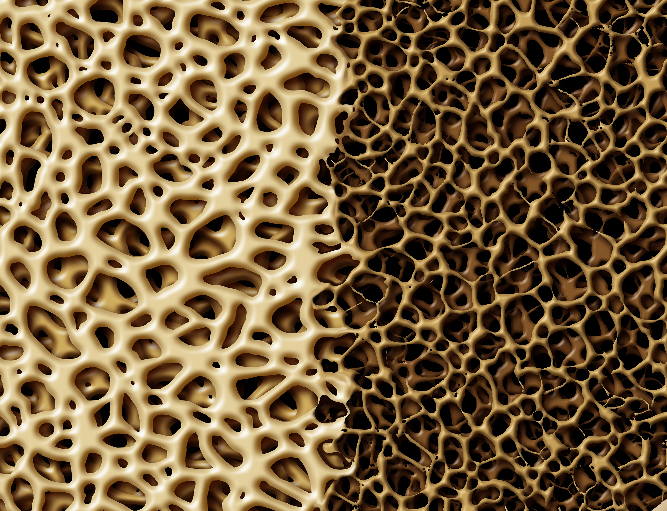


Clinical Questions
1
What parameters indicate a diagnosis of osteoporosis?
How does this differ from assessment of fracture risk?
2
How can we best explain the
impact of osteoporosis to our patients?
3
How do we evaluate fracture risk in postmenopausal women with a view to identifying women who would benefit from osteoporosis pharmacotherapy?
4
How do we evaluate fracture risk in older men, and what are the therapeutic options?
5
Do patients on glucocorticoid require osteoporosis pharmacotherapy?
6
What is the risk of fracture in patients on aromatase inhibitor therapy?
7
Do patients on androgen deprivation therapy require osteoporosis pharmacotherapy?
8
Do proton pump inhibitors cause bone loss?
9
When patients are treated with SSRI, do they have an increase in the risk of fracture?
10
How long do osteoporosis patients need to be treated?

Slide 8
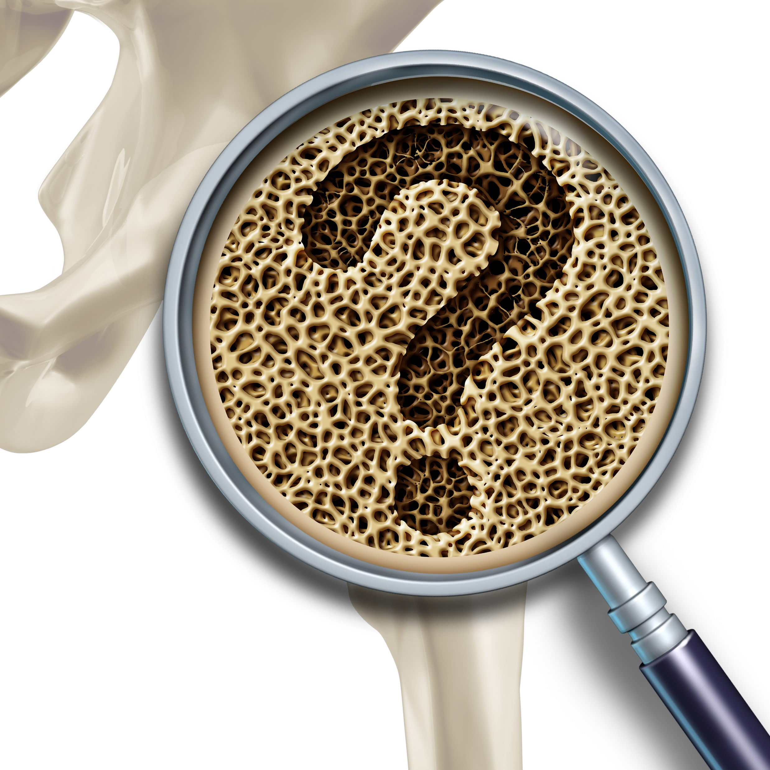
Clinical Question 1
What parameters indicate a diagnosis of osteoporosis?
How does this differ from assessment of fracture risk?

Slide 9

Learning Objectives
Upon completion of this module, participants will be better able to:
Perform risk assessments and screening for all patients at high risk for fracture
Explain the factors that determine osteoporotic fracture risk

Slide 10

Clinical Question 1
What parameters indicate a diagnosis of osteoporosis?
How does this differ from assessment of fracture risk?
Clinical osteoporosis can be diagnosed by a fragility fracture, in particular a spine fracture or a hip fracture. In addition, a bone mineral density T score at spine, total hip, femoral neck, or one third radius of -2.5 or less would be a densitometric definition of osteoporosis. Other single fragility fractures might be incorporated into the FRAX algorithm for evaluation of future fracture risk. Frequent fragility fractures may also qualify a patient for a diagnosis of osteoporosis.

Slide 11
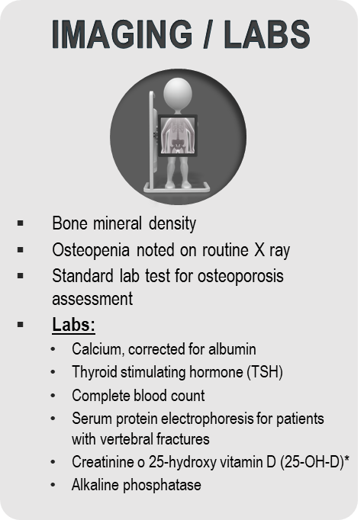
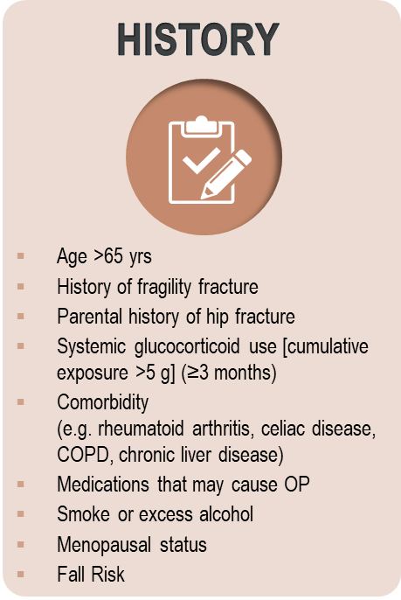
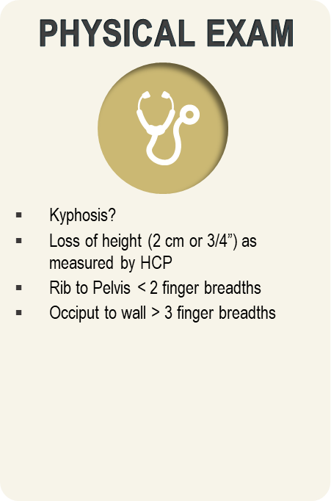
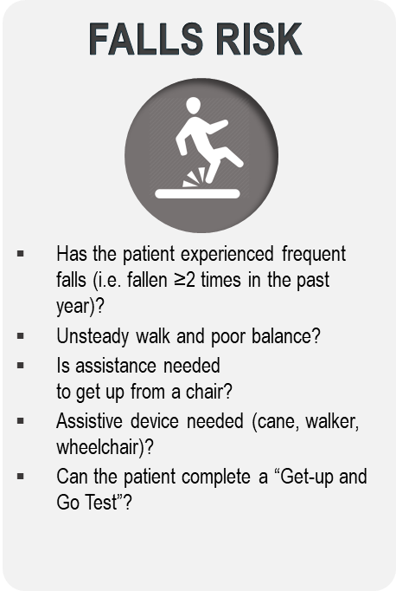
Checklist for Fracture and
OP Risk Factors
DEFINITION OF A FRAGILITY FRACTURE:* A fracture that occurs spontaneously or following a minor trauma such as:
Fall from a standing height (i.e. on the ice)
Fall from a sitting position
Fall from a supine position (bed or reclining deck chair < 1 metre high)
Fall after having missed 1 to 3 steps in a staircase
After a movement outside of the typical plane of motion or coughing
*Fragility fracture includes all bones, except skull and face, patella, hands and feet, cervical spine.
Osteoporosis Canada 2016. Checklist for Risk of Broken Bones and Osteoporosis. Accessed July 8th 2016. http://www.osteoporosis.ca/osteoporosis-and-you/diagnosis/risk-factors/.
Bessette L,et al. Contemp Clin Trials. 2008;29:194-210. Brown JP, et al. J Bone Miner Res. 2007;23(Suppl 1):M350.
Notes:
Animated Slide
Key Points:
The checklists are an easy way to assess patient risk for osteoporosis. If a patient answers yes to one of more items in each section they should be fully assessed for fracture risk and presence of osteoporosis.
Checklist for Risk of Broken Bones and Osteoporosis
DEFINITION OF A FRAGILITY FRACTURE:
The ROCQ results demonstrated that fragility fractures were often not appropriately recognized and linked to osteoporosis by either patients or their healthcare practitioners
It is important to fully understand the definition of the fragility fracture
Get-up-and-Go-Test:
References:
1. Osteoporosis Canada 2016. Checklist for Risk of Broken Bones and Osteoporosis. Accessed July 8th 2016. http://www.osteoporosis.ca/osteoporosis-and-you/diagnosis/risk-factors/
2. Bessette L, et al. Recognizing osteoporosis and its consequences in Quebec (ROCQ): Background, rationale, and methods of an anti-fracture patient health-management programme. Contemp Clin Trials 2008; 29:194-210.
3. Brown JP, et al. Validation of a clinical definition of fragility fracture. J Bone Miner Res. 2007;23(Suppl 1):M350.

Slide 12
Women >50 and Osteoporosis¹
1 in 3 women will suffer from an osteoporotic fracture during their lifetime¹
Over 80% of all fractures in Canada after age 50 are osteoporotic¹
Osteoporotic fracture incidence in women over 50 years of age¹
22% of women over 50 experience a wrist fracture
27% experience a vertebral fracture
15% experience a hip fracture
7% experience a pelvic fracture
29% experience other fractures including clavicle, humerus, femur, tibia/fibula, and hands/fingers
Almost 50% of fractures occur at the spine or hip and are associated with significant morbidity and mortality.²⁻⁶
1. Burge R, et al. J Bone Miner Res. 2007;22:465-475; 2. Watts NB, et al. Endocr Pract. 2010;16:1-37. 3. Hajcsar EE, et al. CMAJ. 2000;163:819-822.;
4. Cooper C. Am J Med. 1997:103:12S-19S; 5. Jean et al. JBMR. 2013; 28:360-71. 6. Papaioannou A, et al. CMAJ. 2010;182:1864-1873.

Slide 13
Fragility Fracture Increases Risk of
Hip Fracture
Morbidity
Hip fracture
Excess morbidity associated with fracture event
Fragility fractures: wrist
humerus, pelvis, vertebrae
Wrist fracture
Morbidity attributable to ageing alone
50
60
70
80
90
Age
Adapted from Kanis JA, & Johnell O. J Endocrinol Invest 1999;22(8):583-8.
Notes:
Key Point:
Wrist fractures are usually the first fragility fracture, with vertebral fractures occurring next.
Preventative Therapy Is Effective and Safe.
Reference:
Kanis JA, Johnell O. The burden of osteoporosis. J Endocrinol Invest. 1999;22(8):583-8.

Slide 14
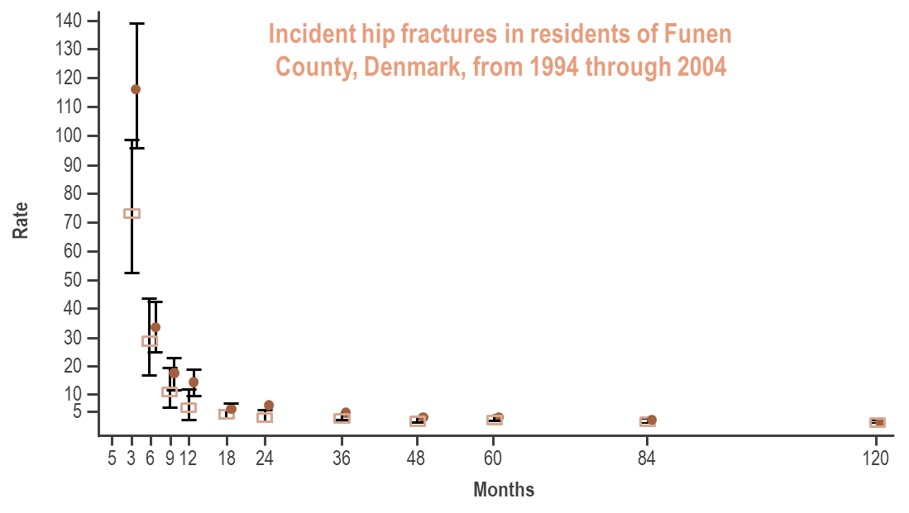
Risk Of Sustaining A Second Hip Fracture is High During First 12 Months Following First Hip Fracture
Period estimates of incidence of second hip fracture for men (square) and women (circle) by time from first fracture. Values are poisson regression-based estimates and 95% CI of rate per 1000 person years (py).
Nymark T, et al. Osteoporos Int. 2006;17:1353-1357.
Notes:
Months after 1st fracture

Slide 15
In Patients at Imminent Risk, Absolute Cumulative Fracture Risk Remains Elevated Over Time
Cumulative Risk of Subsequent Fracture
Increasing absolute cumulative risk
Imminent risk
Cumulative risk of subsequent fracture
Follow-up (years)
Analysis of a large Medicare sample of women ≥ 65 years old with an incident clinical fracture.
Balasubramanian A, et al. Presented at: ASBMR annual meeting; October 16-18, 2016; Atlanta, GA.

Slide 16
BMD Alone is Not an Indicator of Fracture Risk BMD vs. Osteoporotic Fracture Rates/Number
60
BMD Distribution
450
Fracture Rate
Number of Fractures
400
50
350
40
300
250
Fracture Rate Per 1000 Person-Years
Number of Fractures
30
200
20
150
100
10
50
0
0
>1.0
1.0 to 0.5
0.5 to 0.0
0.0 to -0.5
-0.5 to -1.0
-1.0 to -1.5
-1.5 to -2.0
-2.0 to -2.5
-2.5 to -3.0
-3.0 to -3.5
< -3.5
BMD T-scores
Adapted from Siris ES, et al. (2001) JAMA 286, 2815-22.

Slide 17
Several Factors Contribute to Long-Term Fracture Risk
Prior fracture¹⁻⁵
Recent fracture
Any history of fracture
Female sex
Asian or white ethnicity
Family history of hip fracture or osteoporosis
Small frame
Certain comorbid conditions (e.g., RA, COPD, Parkinson’s)
Age⁵
Risk Factors for Future Fracture
Low BMD⁵
Low BMI
Calcium/vitamin D deficiency
Estrogen deficiency
Inadequate physical activity
Excessive alcohol intake
Tobacco smoking
Frequent falling and other fall-related risk factors
Use of certain medications (e.g., glucocorticoids)
Other genetic / nonmodifiable risk factors^{5,6}
Other potentially modifiable risk factors⁵
BMD = bone mineral density; BMI = body mass index; COPD = chronic obstructive pulmonary disease; RA = rheumatoid arthritis
1. Kanis JA, et al. Bone. 2004;35:375-382. 2. Kanis JA, et al. Lancet. 2002;359:1929-1936. 3. Black DM, et al. J Bone Miner Res. 1999;14:821-828. 4. Eisman JA, et al. J Bone Miner Res. 2012;27:2039-2046.
5. Cosman F, et al. Osteoporos Int. 2014;25:2359-2381. 6. US Department of Health and Human Services. Bone health and osteoporosis: a report of the surgeon general. 2004. Rockville, MD.

Slide 18
Additional Factors for Fracture Risk
Age, Sex
Fragility Fracture after age 40
Fall History ≥2 Times in past year
Medications
Comorbidities
Alcohol Intake ≥3 drinks per day
Caffeine Intake
Nutrition (balanced diet with adequate Ca2+ and vit D)
Physical Activity or Inactivity
Hormonal Status
Ethnicity: Caucasian, Asian and Hispanics have a higher fracture risk
Cauley JA. Clin Orthop Relat Res. 2011;469(7):1891–1899.

Slide 19
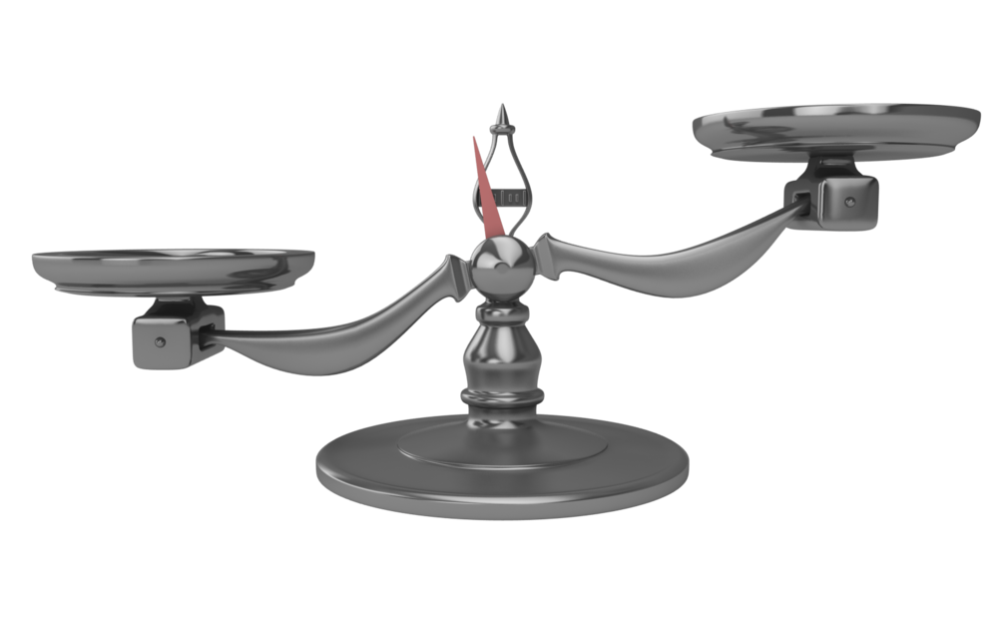
Relationship between BMD and Fracture Risk is Strongly Dependent on Clinical Risk Factors
BMD
CLINICAL RISK FACTORS
Fracture Risk
Bates DW, et al. JAMA 2002;288(15):1898-1900; Geusens P, et al. (2011). Medscape. Accessed June 30, 2016 at www.medscape.org/viewarticle/747951_2.
Notes:
Key Point:
http://www.medscape.org/viewarticle/747951_2

Slide 20
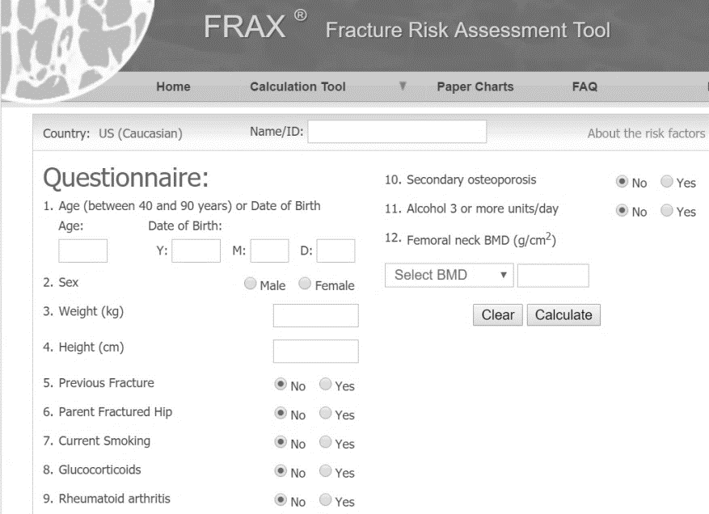
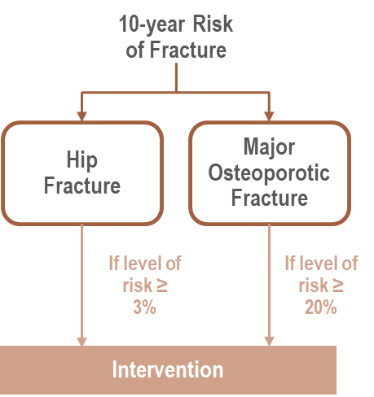

Long-Term Fracture Risk Can Be Quantified Using FRAX® or Other Risk-Assessment Tools
FRAX® provides a conservative estimate of 10-year fracture risk but does not necessarily identify patients with shorter-term risk who require urgent intervention (pharmacological) to prevent subsequent fractures¹⁻³
Input¹
Calculator¹
Output¹
Age
Gender
BMD
Fracture History
Other Characteristics
Smoking
Alcohol use
Rheumatoid arthritis
Glucocorticoids use
Etc
FRAX® is a registered trademark of Professor J.A. Kanis. University of Sheffield.
BMD = bone mineral density; FRAX = fracture risk assessment tool.
1. FRAX. https://www.shef.ac.uk/FRAX/. Accessed March 15, 2018. 2. Kanis JA, et al. Osteoporos Int. 2011;22:2395-2411. 3. Silverman SL, et al. Curr Osteoporos Rep. 2010;8:192-197
.

Slide 21
Clinical Question 2
In order for our osteoporosis patients to understand the balance of risks and benefits, it is crucial for them to understand the impact of osteoporotic fractures on their quality of life.
How can we best explain the impact of osteoporosis to our patients?

Slide 22
Learning Objectives
Upon completion of this module, participants will be better able to:
Describe the morbidity, mortality and economic burden of illness associated with osteoporosis in Canada
Explain the factors that determine osteoporotic fracture risk
Communicate to patients the impact of osteoporotic fractures on their quality of life and the actions they can take to reduce risk

Slide 23
Clinical Question 2
How can we best explain the impact of osteoporosis to our patients?
Osteoporotic fractures begin to occur in women in their 60s. Early fractures include vertebral fractures with consequences of kyphosis, back pain, and disfigurement. Later in life, hip fractures and other major fractures create dependency and frailty with frequent institutionalization. Patients need to understand that fragility fractures are frequent in elderly patients, deteriorate our seniors’ quality of life and can be effectively prevented.

Slide 24
Secondary Fracture Prevention: Consensus Clinical Recommendations from a Multistakeholder Coalition
Communicate 3 simple messages to people aged 65 years or older with a hip or vertebral fracture (as well as to their family/caregivers) consistently throughout the fracture care and healing process:
MESSAGE 2
MESSAGE 1
MESSAGE 3
Breaking bones means they may suffer declines in mobility or independence—for example, have to use a walker, cane, or wheelchair, or move from their home to a residential facility, or stop participating in favorite activities—and they will be at higher risk of dying prematurely;
Their broken bone likely means they have osteoporosis and are at high risk for breaking more bones, especially over the next 1-2 years;
Most importantly, there are actions they can take to reduce their risk, including regular follow-up with their usual health care provider as for any other chronic medical condition.
Kiel DP et al. JBMR 2019

Slide 25

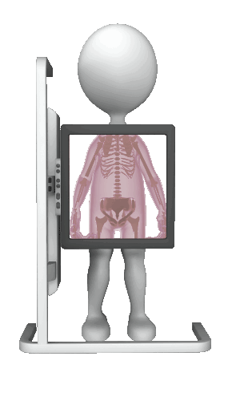
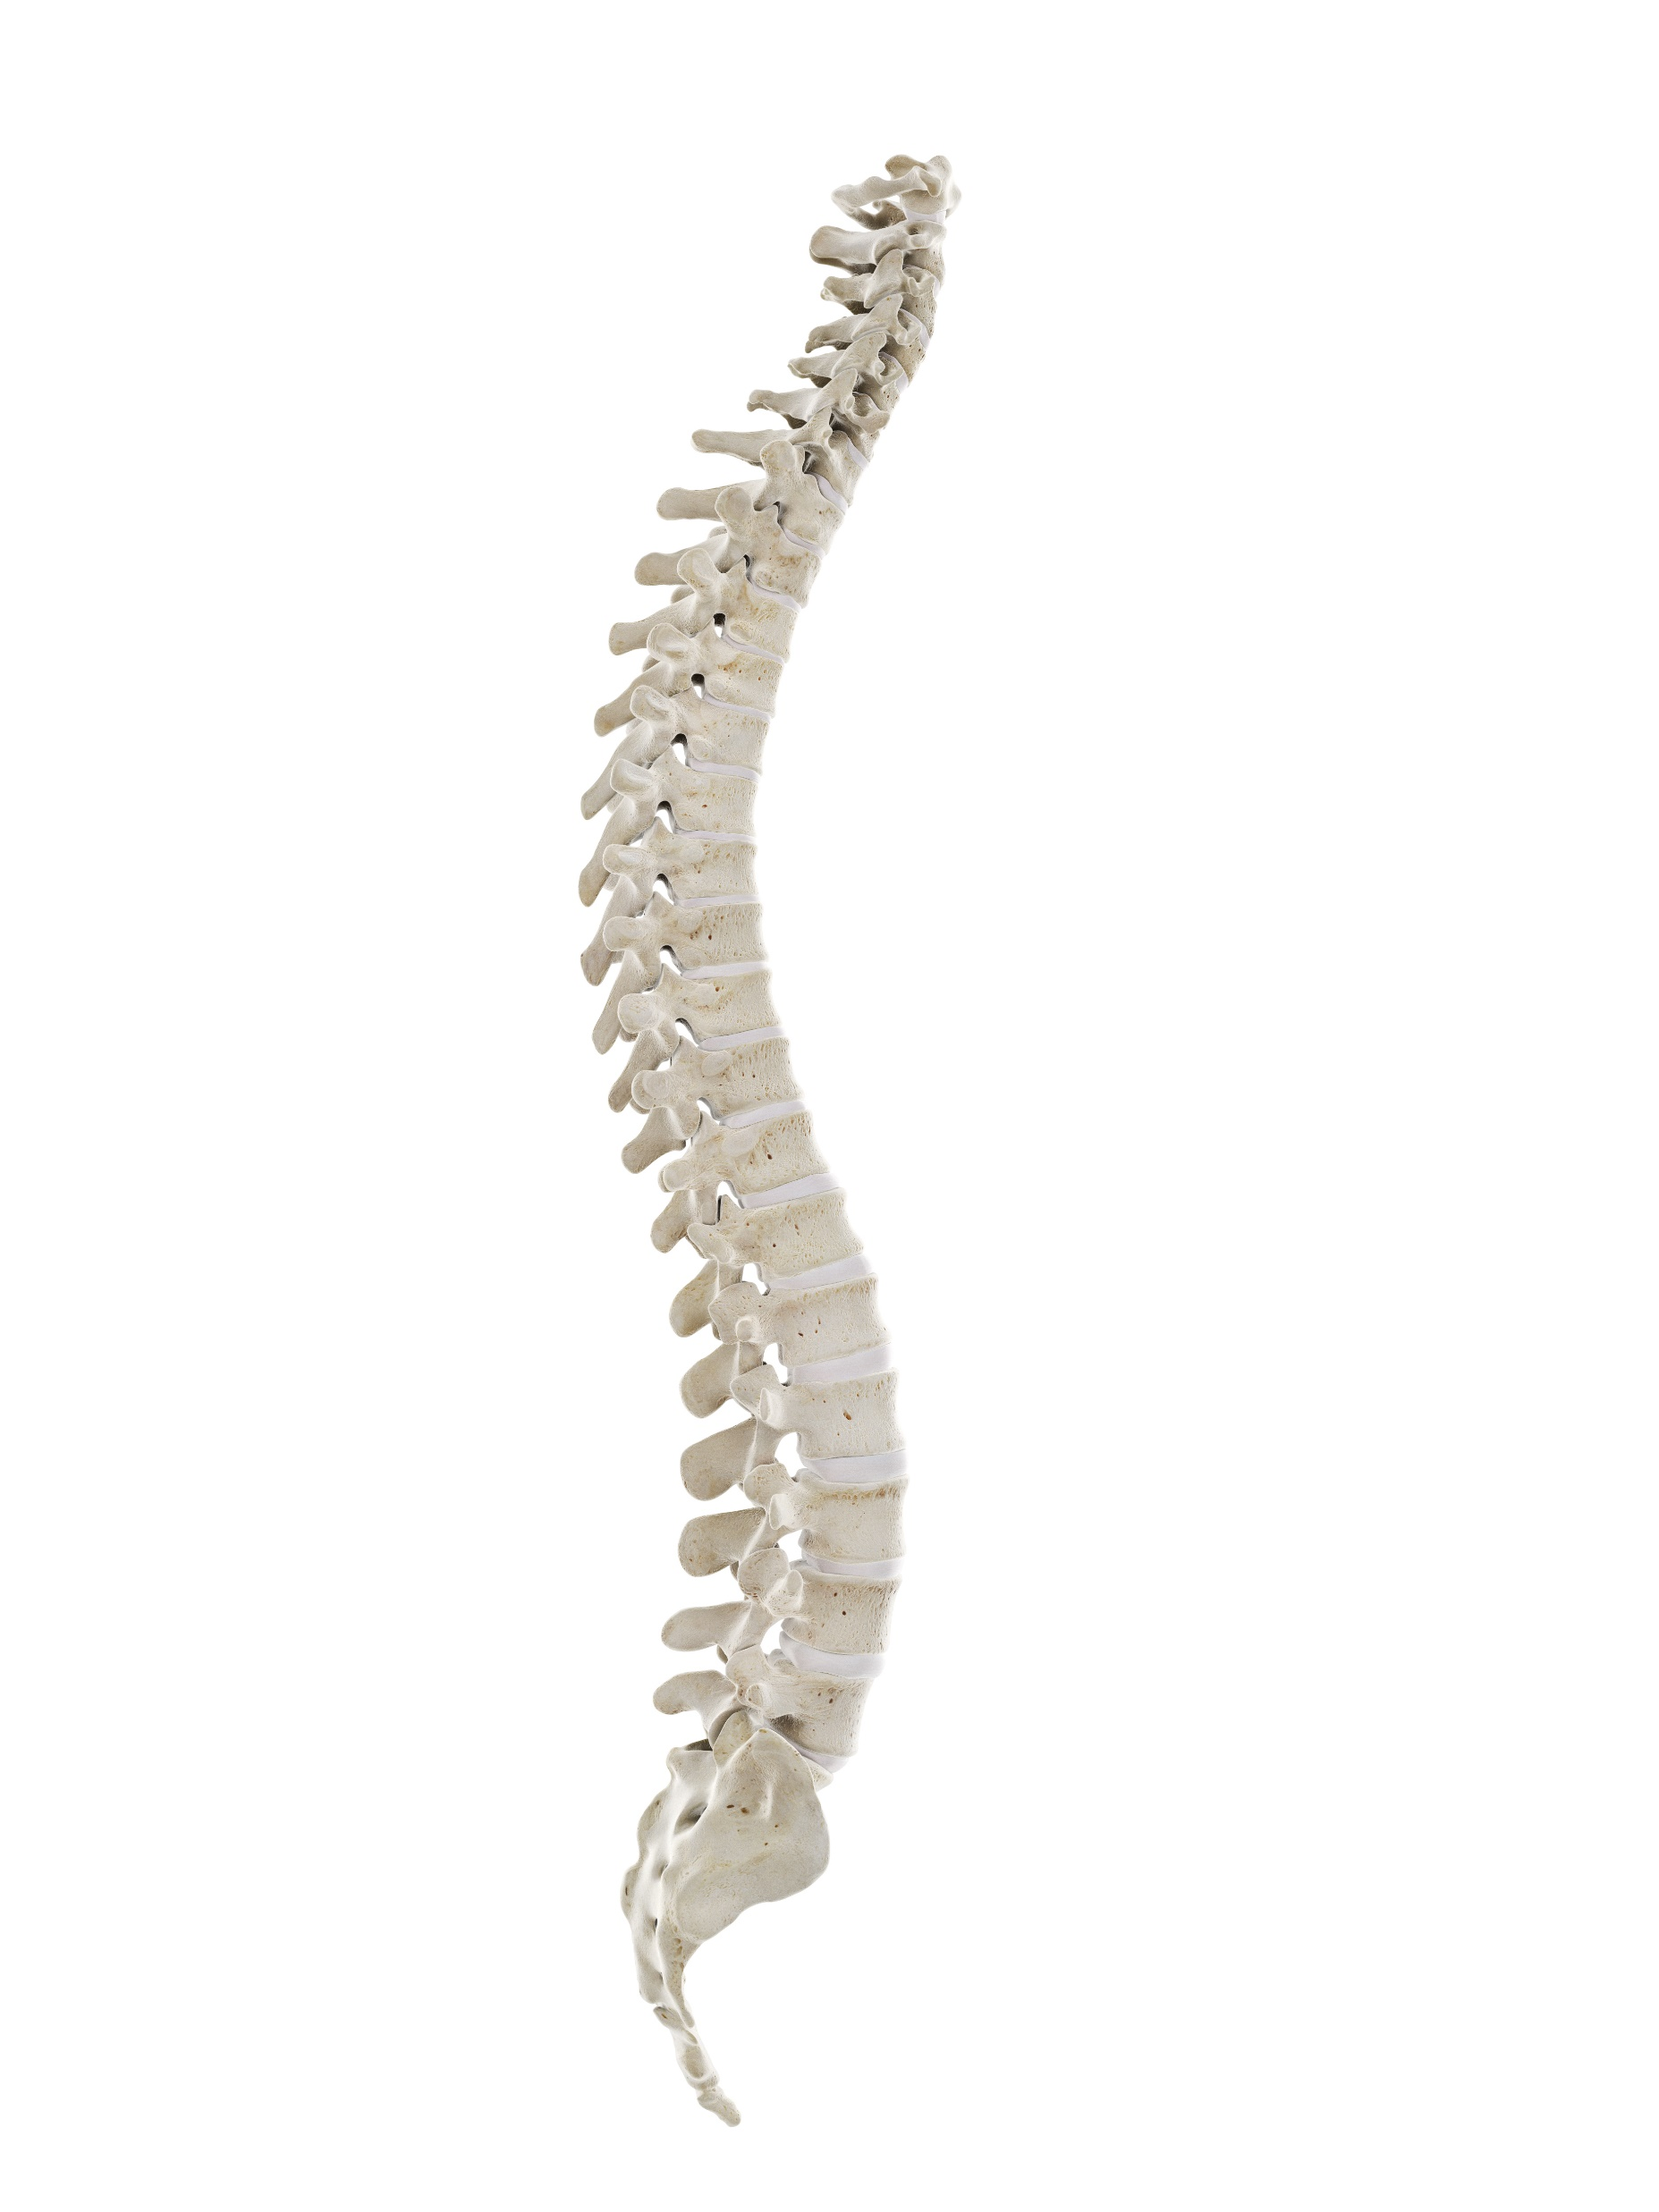





Additional Factors for Fracture Risk
Each year in CANADA
there are about
30,000
hip fractures – and
many more Canadians
suffer OSTEOPOROTIC
FRACTURES affecting
the spine, wrist,
shoulder, and pelvis.
1 in 3
hip fracture patients
RE-FRACTURE AT 1 YEAR.
20%
The risk of
suffering
A SECOND
spine
fracture
within
the year
following
the first
one
Over 1 in 2
will suffer another fracture
WITHIN 5 YEARS.
1 in 3
women
Several effective medications can REDUCE FRACTURE RISK by 30–70% within one year after treatment
will suffer from an
OSTEOPOROTIC
FRACTURE during
their lifetime
1 in 5
men
Adapted from http://www.osteoporosis.ca/wp-content/uploads/Osteo-Annual-Report-2012-2013Web-Version.pdf?utm_source=Home+Page&utm_medium= Featured+Post&utm_campaign=Annual+Report+2012+2013 Accessed May 12, 2017. 5. Papaioannou A, et al. (2010). CMAJ, 182:1864-1873

Slide 26
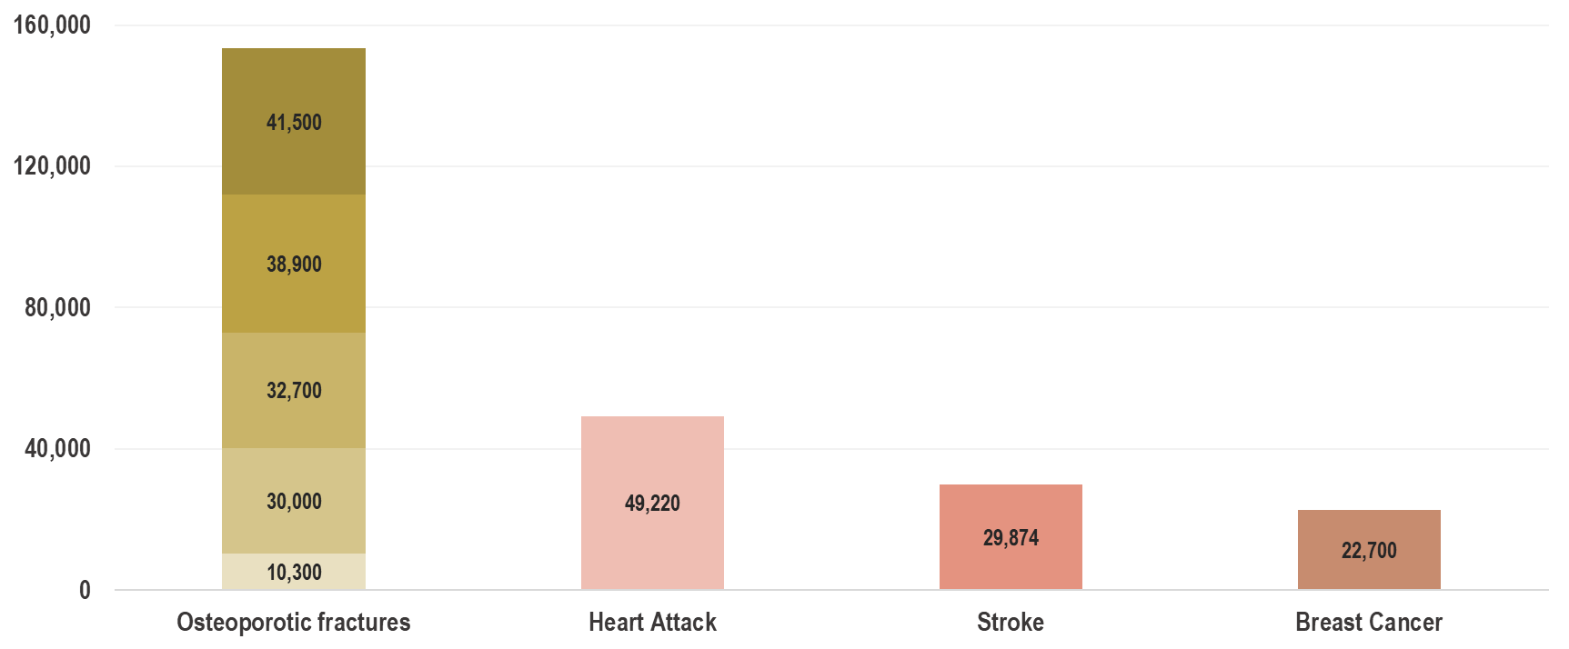
Fractures from Osteoporosis are more Prevalent than Heart Attack, Stroke and Breast Cancer Combined¹
Prevalence in Canadian Women
153,400
Annual incidence of common diseases
*Canadian hip fractures from (1); Non-hip fracture data extrapolated from (2).
†Other represents non-osteoporotic fractures sites (humerus, clavicle, hands/fingers, patella, tibia, fibula).²
1. Leslie WD, et al. Osteoporos Int 2010; 21:1317‐1322; 2. Burge J, et al. J Bone Miner Res 2007;22:465-475;
3. Canadian Institute for Health Information (2009) Health Indicators; 4. Canadian Cancer Society 2009.

Slide 27
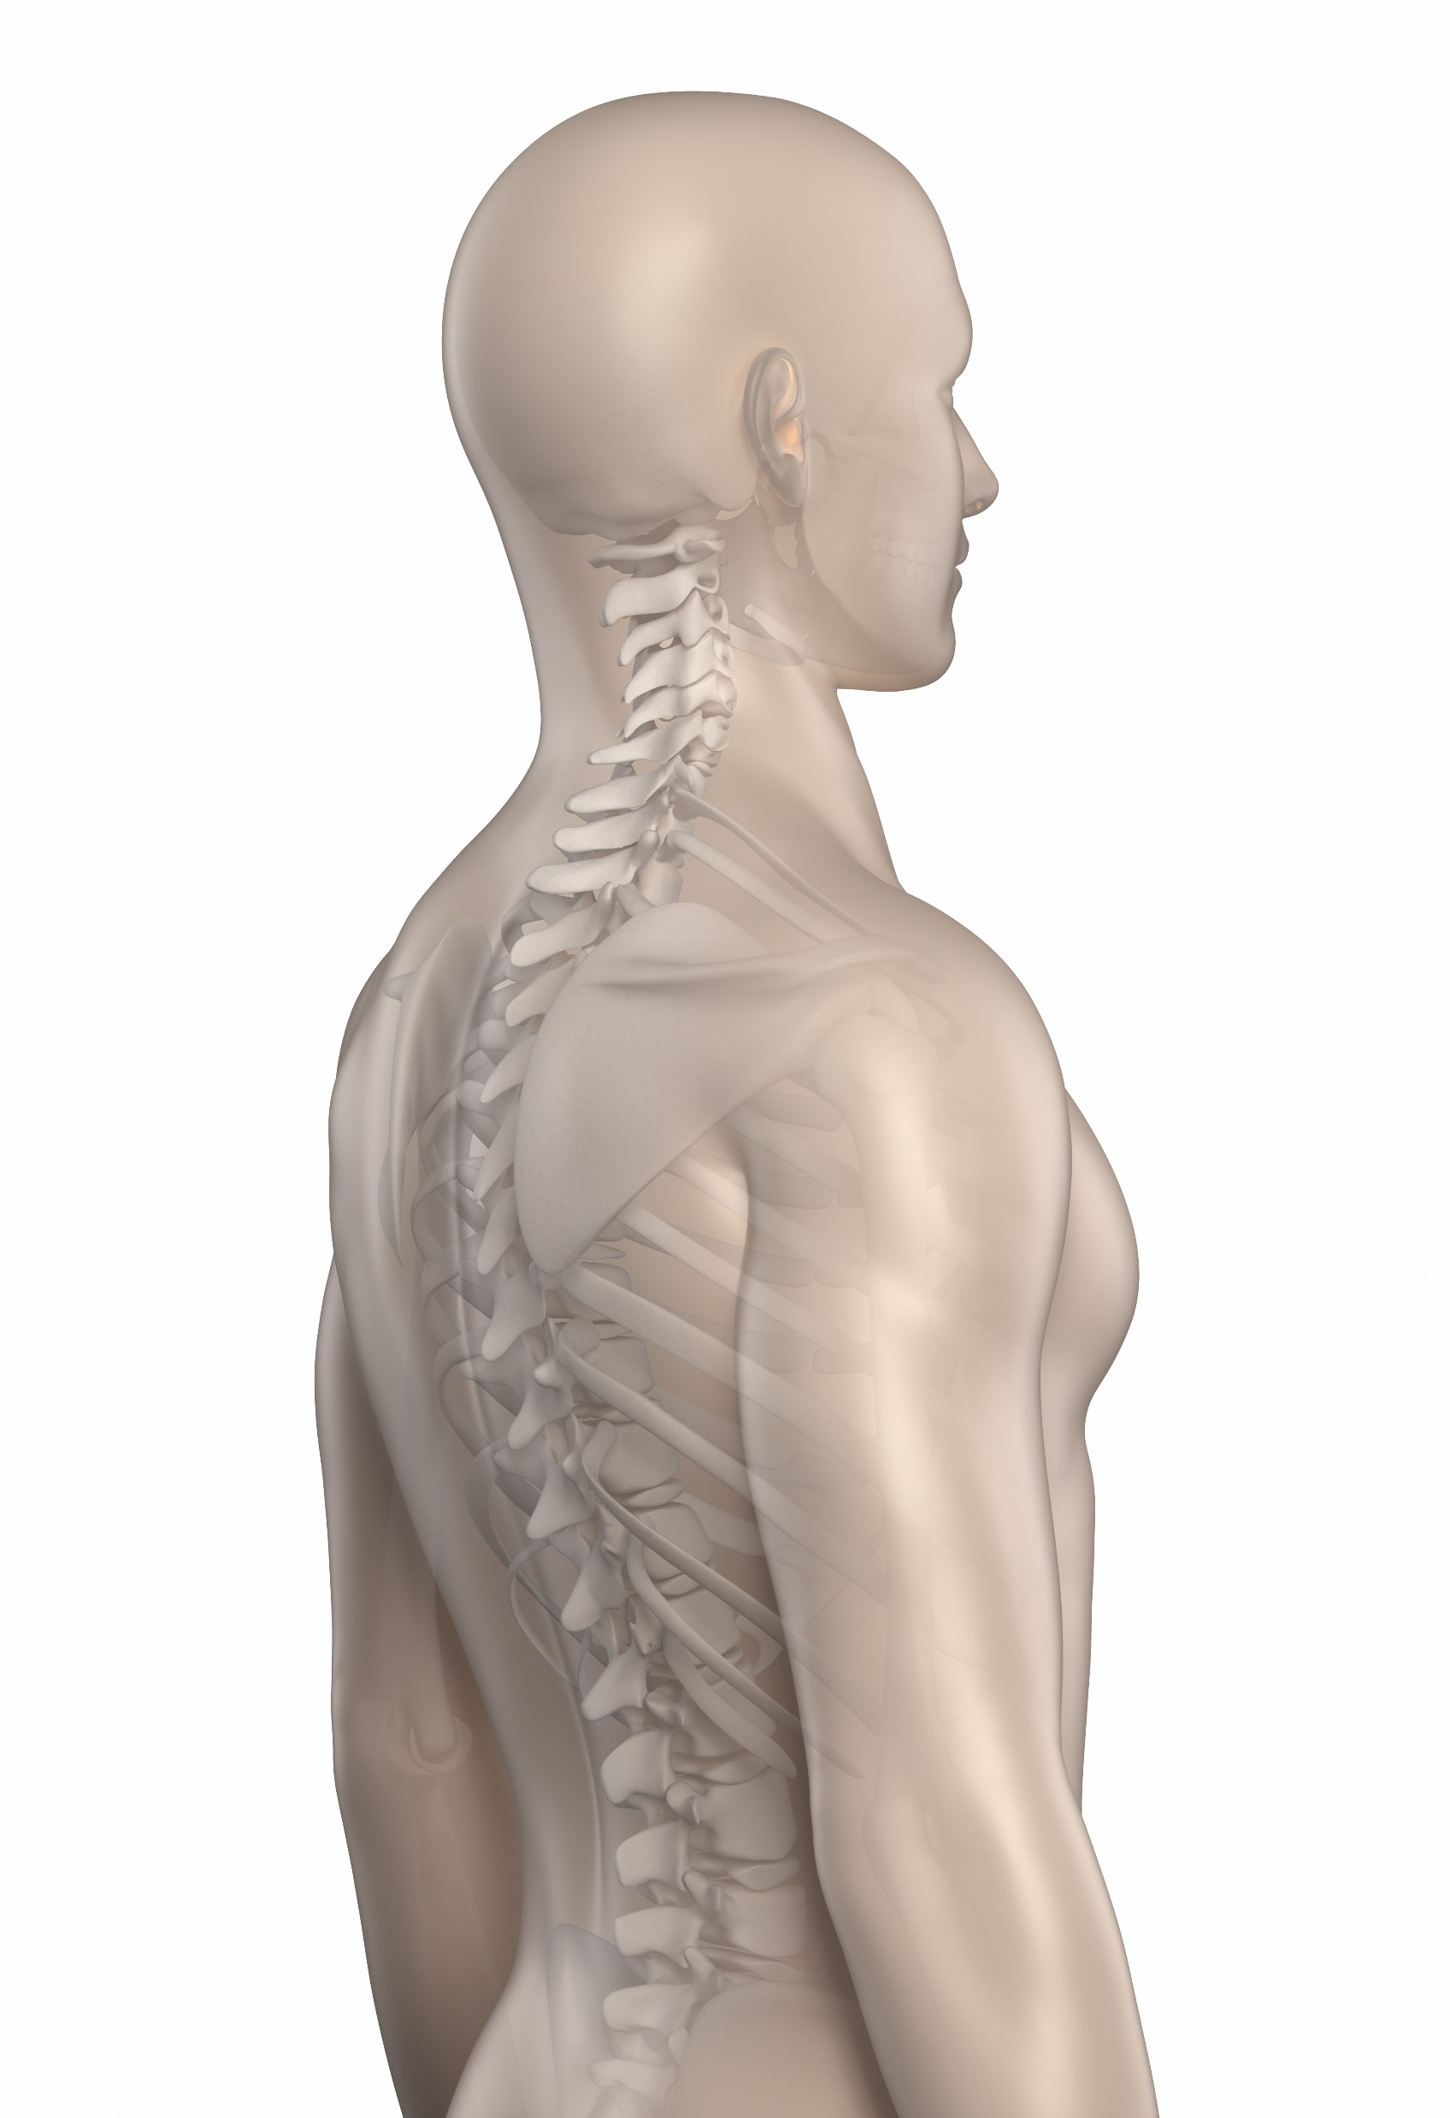
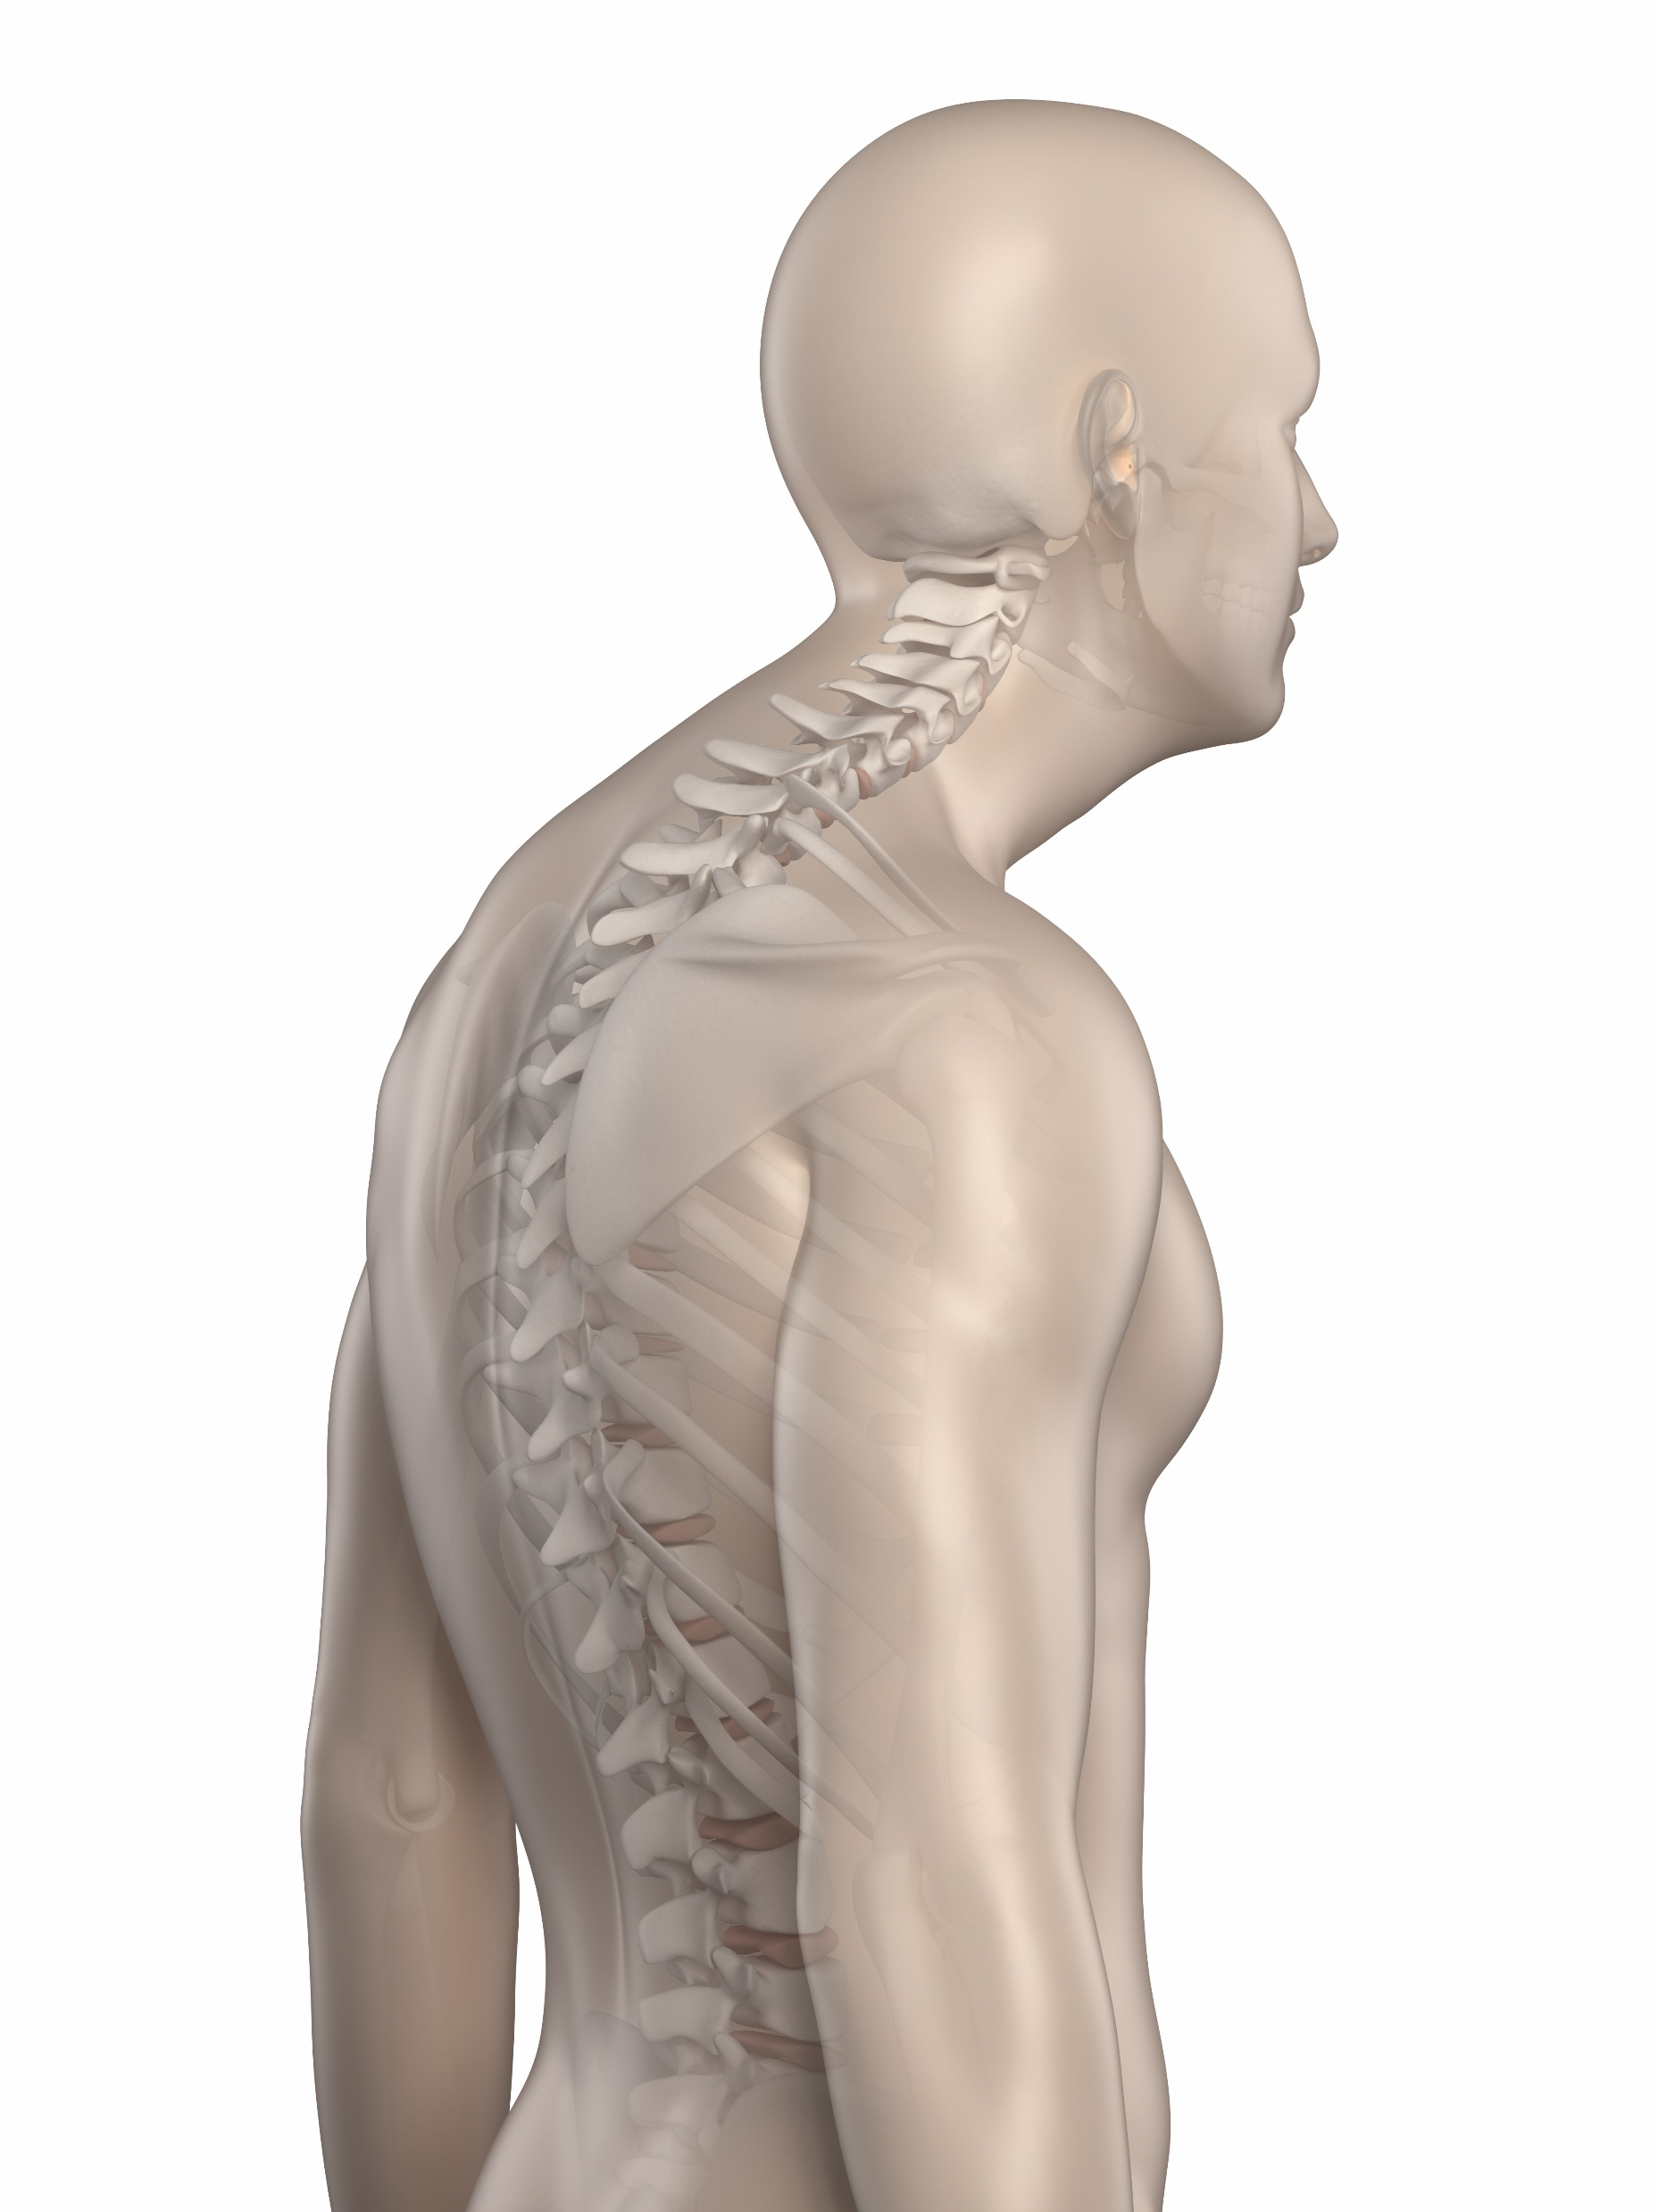
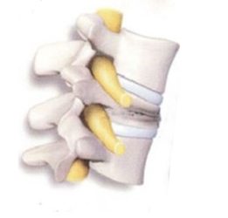
What is the best way to explain osteoporosis to your patients?
Younger patients fear disfiguring kyphosis; vertebral fractures occur early in osteoporosis
17% of women over age 65 have a vertebral fracture, mostly undetected.
HEALTHY SPINE
SPINE AFFECTED BY KYPHOSIS
As vertebrae collapse, the spine curves forward abnormally
Shoulders may be rounded
A healthy spine is curved to position the head directly over the hips
Back appears hunched
Abnormal posture can cause slight curvature by loosening the spinal ligaments

Slide 28
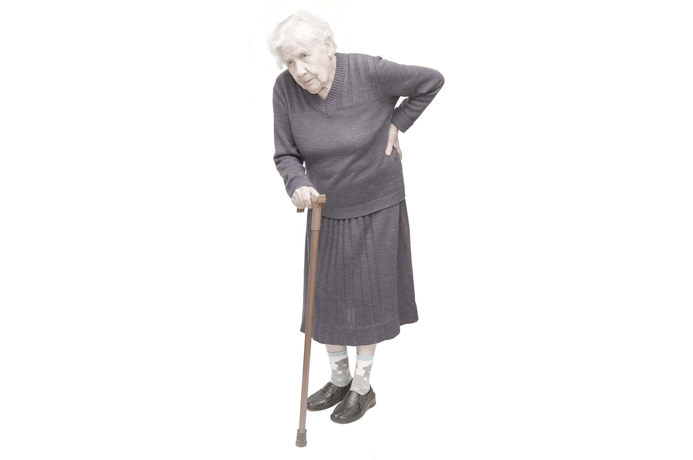
What is the best way to explain osteoporosis to your patients?
Older patients fear the deterioration in quality of life with hip fracture; hip fractures occur later in life

Slide 29
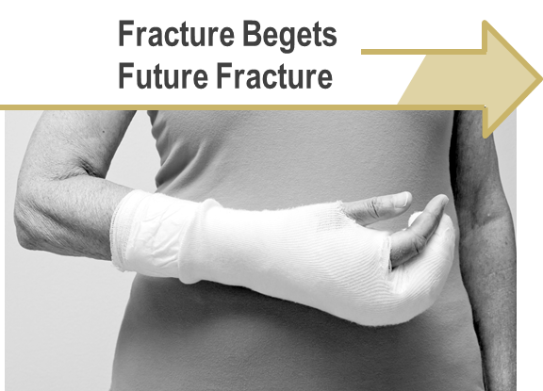
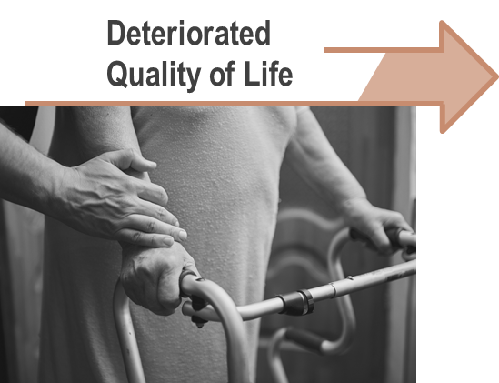
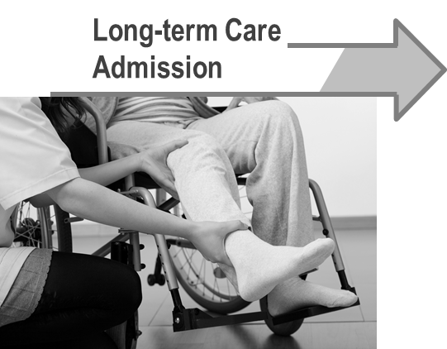

Timeline: Consequences Post Fracture
Lifetime risk of hip fracture in women >50 is 12.1%⁵
In women with hip fracture:
40% had prior
fracture¹
In women with hip fracture:
40% need assistance walking²
In women with hip fracture:
18% enter LTC³
In women with hip fracture:
23% die within 1 year⁴
1. Hajcsar EE, et al. CMAJ 2000, 163:819-822.; 2. Cooper C. Am J Med. 1997:103:12S-19S; 3. Jean et al . JBMR 2013; 28:360-71. 4. Ioannidis G, et al. CMAJ 2009;181: 265-271. 5. Hopkins et al .Osteo Intl 2012; 23:921-927
Notes:
40% of Canadians who experience a fracture have a history of prior fracture¹
40% of women with a hip fracture required assistance walking ²
18% of community dwelling women > 50 years of age who were hospitalized after hip fracture were discharged to long-term care facility.³

Slide 30
The Economic Burden of Fractures in Canada is Growing
2008 Data
2011 Data
Change
(%)
M; Millions
B; Billions
Acute care
$1.3B
18%
$1.5B
Rehabilitation admissions & clinics†
$106M
234%
$353M
Complex Continuing Care
$123M
253%
$434M
Long-term Care
$31M
3,245%
$1.0B
Home care
$266M
3%
$274M
Outpatient physician services
$155M
TOTAL BURDEN OF ILLNESS
63%
$253M
Prescription drugs
$426M
2008:
$2,518,598,262
-19%
$346M
2011:
$4,619,665,079
Wage loss
$126M
143%
$305M
Change (%): 83%
Mobility devices‡
$101M
N/A
0
0.5B
1.0B
1.5B
†2008 data not included for Rehabilitation clinics.
‡2008 Data not included for mobility devices.
Tarride JE, et al. Osteoporos Int. 2012;23:2591-2600.; Hopkins RB, et al. Osteoporos Int.2016; DOI: 10.1007/s00198-016-3631-6.

Slide 31
The Effect of Osteoporosis Treatment on Mortality
30-70%
REDUCTION
Effective medications reduce subsequent fractures by
30% to 70% as early as one year after treatment initiation¹
Fragility fractures cause substantial morbidity and mortality, effective osteoporosis treatment prevents both vertebral and nonvertebral fractures²
40,000 SUBJECTS
Meta-analysis in ~40,000 subjects showed that treatment of osteoporosis with agents with proven vertebral and nonvertebral fracture efficacy reduces overall mortality by ~10%²
1. Papaioannou A, et al. CMAJ. 2010;182(17):1864‐1873.
2. Bolland MJ, et al. J Clin Endocrinol Metab. 2010;95:1174-1181.
.

Slide 32
Which Raises the Question:
Why do 89% of Canadian Patients with Established Vascular Disease vs 15% Post-Fracture Leave the Hospital on Treatment?
A fracture is to osteoporosis what a
heart attack is to cardiovascular disease
89%
How do we shift this paradigm?
Percentage of patients (%)
15%
Osteoporosis Treatment Post Fracture¹
Antiplatelet Therapy Patient with Established Vascular Disease²
Papaioannou A, et al. CMAJ. 2010;182(17):1864‐1873.
Bell A, et al. Can J Cardiol. 2009 Jun;25(6):345-51.

Slide 33
Clinical Question 3
How do we evaluate fracture risk in postmenopausal women with a view to identifying women who would benefit from osteoporosis pharmacotherapy?

Slide 34
Learning Objectives
Upon completion of this module, participants will be better able to:
Identify clinical and diagnostic risk factors which further increase the risk of fractures in post menopausal women
Apply evidence-based management protocols to prevent future fractures in post menopausal women
Assess patients on treatment for occurrence of side effects and select appropriate therapies based on the patient characteristics

Slide 35
Clinical Question 3
How do we evaluate fracture risk in postmenopausal women with a view to identifying women who would benefit from osteoporosis pharmacotherapy?
It is important to consider the routine evaluation of fracture risk in postmenopausal women in order to determine those requiring osteoporosis therapy in addition to calcium, vitamin D, exercise, and lifestyle advice. At age 65, a bone health assessment in a woman without other risks will identify features of peak bone mineral density in addition to declines in the 1.5 decades of postmenopausal life. In a woman with risk factors, evaluation at an earlier stage of her postmenopausal life may be warranted. FRAX incorporates clinical risk factors with femoral neck bone mineral density to identify patients at high 10-year fracture risk who would be candidates for osteoporosis treatment. Cut points of >20% for major osteoporotic fracture risk or >3% for hip fracture risk are aligned with a cost economic approach to osteoporosis therapy.

Slide 36
Several Factors Contribute to Long-Term Fracture Risk
Prior fracture¹⁻⁵
Recent fracture
Any history of fracture
Female sex
Asian or white ethnicity
Family history of hip fracture or osteoporosis
Small frame
Certain comorbid conditions (e.g., RA, COPD, Parkinson’s)
Age⁵
Risk Factors for Future Fracture
Low BMD⁵
Low BMI
Calcium/vitamin D deficiency
Estrogen deficiency
Inadequate physical activity
Excessive alcohol intake
Tobacco smoking
Frequent falling and other fall-related risk factors
Use of certain medications (e.g., glucocorticoids)
Other genetic / nonmodifiable risk factors^{5,6}
Other potentially modifiable risk factors⁵
BMD = bone mineral density; BMI = body mass index; COPD = chronic obstructive pulmonary disease; RA = rheumatoid arthritis
1. Kanis JA, et al. Bone. 2004;35:375-382. 2. Kanis JA, et al. Lancet. 2002;359:1929-1936. 3. Black DM, et al. J Bone Miner Res. 1999;14:821-828. 4. Eisman JA, et al. J Bone Miner Res. 2012;27:2039-2046.
5. Cosman F, et al. Osteoporos Int. 2014;25:2359-2381. 6. US Department of Health and Human Services. Bone health and osteoporosis: a report of the surgeon general. 2004. Rockville, MD.

Slide 37
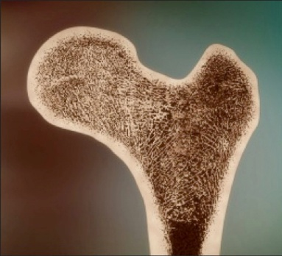
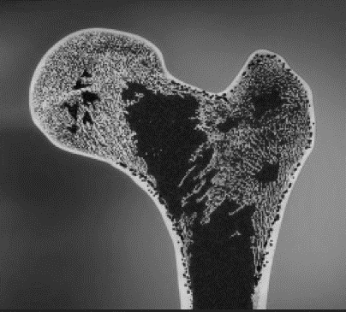
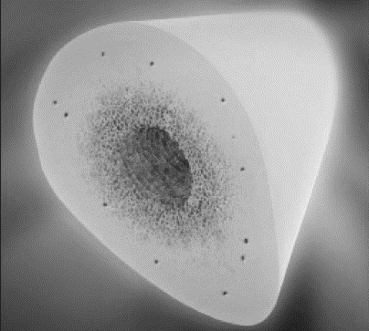
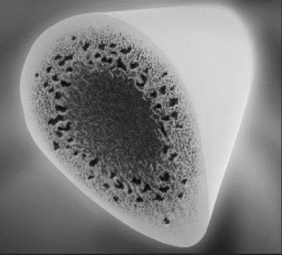
The Impact of Aging and Osteoporosis on Bone
Young
Elderly/OP
Trabecular thickness decreases with age
Cortical porosity increases with age
The result is a decrease in bone strength
Davison SK, et al. Semin Arthritis Rheum 2006;36:22-31; Mosekilde L. Technol Health Care 1998;6:287-297; Seeman E, et al. J Bone Miner Res 2010;25:1886-1894. Image courtesy of David Dempster.
Notes:
Key Point:
Decreases in bone volume has a nonlinear effect on bone strength; extremely low bone volumes (< 15% bone/volume) leads to a large drop in mechanical strength of the bone.¹
Trabecular thickness decreases with aging,² resulting in decreased bone strength (which is proportional to the square of its radius), which ultimately leads to buckling and bending of the trabecular struts.¹
Connectivity is significantly impacted with the loss of each cross tie, since each one leaves two trabecular struts unsupported.¹
Cortical porosity increases with aging, leading to disproportionately large losses in bone strength.¹
In older adults (> 60 years), the pores increase in size through coalescing to reduce the actual number of pores.¹
Microarchitectural changes in the vertebral body have been shown to occur with aging, including decreased bone volume per trabecular volume (BV/TV) and decreased cortical thickness.²
Davison SK, Siminoski K, Adachi JD, et al. Bone strength: the whole is greater than the sum of its parts. Semin Arthritis Rheum. 2006;36:22-31.
Mosekilde L. The effect of modelling and remodelling on human vertebral body architecture. Technol Health Care. 1998;6:287-297.

Slide 38
Frequent Falling is Associated with Serious Injury and a Greater Risk of Fracture
Women with osteoporosis and without a fall*
Fracture risk: 2.8 (95% CI, 0.6-12.8; P<.10)
Women with osteoporosis and a fall*
Fracture risk: 24.8 (95% CI, 6.9-88.6; P<.0001)
*Compared with women without osteoporosis and without a fall, fracture risk age- and BMI-adjusted.
Nevitt MC, et al. J Gerontol Med Sci. 1991;46(5):M164-70; Geusens P, et al. Arch Phys Med Rehabil. 2002; 83(7):903-6.
Notes:
Key Point:

Slide 39
High Alcohol Consumption Decreases Bone Remodeling and Increases Fracture Risk
Consuming > 4 units of alcohol/day can double the risk of hip fracture
Heavy alcohol consumption is associated with:
Decreased BMD
Impaired bone quality
Increased fracture risk
Increased risk of falls
Likely due to a decrease in bone remodelling
Kanis JA, et al. Osteoporos Int. 2005;16:737-42; Gaddini GW, et al. Alcohol Clin Exp Res. 2016;40(4):657-71.
Notes:
Key Point:

Slide 40
Comorbidities Significantly Contribute to Fracture Risk
Global Longitudinal Study of Osteoporosis in Women (GLOW)
Co-morbidities that contributed most to fracture prediction*:
Parkinson's disease
Multiple sclerosis
COPD
Osteoarthritis
Heart disease
Increasing co-morbidity index† associated with increasing fracture risk
*in a Cox regression model with FRAX risk factors as additional predictors.
†weighted value for each co-morbidity based on parameter estimates from the Cox regression model.
COPD: chronic obstructive pulmonary disease.
Dennison EM, et al. Bone. 2012;50(6):1288-93.
Notes:
Key Point:

Slide 41
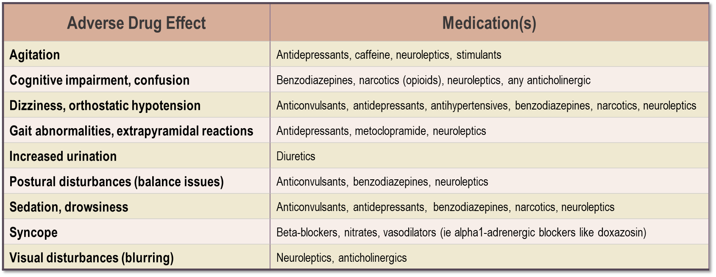
Potential Medications Contributing to Falls or Adverse Events leading to Falls in the Elderly
Ruddock B. DIRC. 2004;137(6):17-18.
Notes:
Key Point:
DIRC 2004 Medications and Falls in the Elderly Brent Ruddock

Slide 42
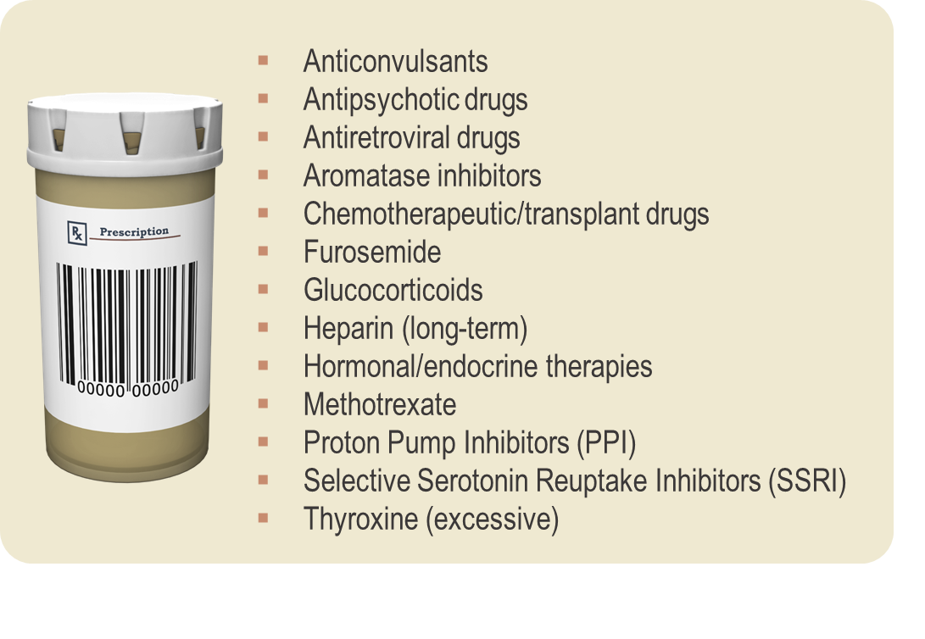
Checklist for Fracture and OP
Risk Factors
Hodgson SF, Watts NB, et al. Endocr Pract 2003;9:544-564; Jacobs-Kosmin D. (2011). Medscape CME. Accessed May 25th 2011. http://emedicine.medscape.com/article/330598-overview
Notes:
Key Point:
Chemotherapeutic/transplant drugs (i.e. cyclosporine, tacrolimus, platinum compounds, cyclophosphamide)
Commonly Used Medications Recently Suggested to Have a Potential Association With Increased Fracture Risk
Proton-pump inhibitors (PPIs)
-Increased risk of hip fracture observed after long-term, high dose therapy³
Selective-serotonin reuptake inhibitors (SSRIs)
2-fold increased risk of clinical fragility fracture observed with daily use⁴
Thiazolidinediones (TZDs)
In postmenopausal women with type 2 diabetes, a significantly increased risk of peripheral fracture was observed with rosiglitazone than with metformin or glyburide⁵
References:
Hodgson SF, Watts NB, et al. American Association of Clinical Endocrinologists medical guidelines for clinical practice for the prevention and treatment of postmenopausal osteoporosis: 2001 edition, with selected updates for 2003. Endocr Pract. 2003;9:544-564.
Jacobs-Kosmin D. Osteoporosis. Medscape CME. 2011. Accessed May 25th 2011. http://emedicine.medscape.com/article/330598-overview
Yang YX, Lewis JD, Epstein S, Metz DC. Long-term Proton Pump Inhibitor Therapy and Risk of Hip Fracture. JAMA. 2006;296:2947-2953.
4. Richards JB, Papaioannou A, Adachi JD, et al. Effect of Selective Serotonin Reuptake Inhibitors on the Risk of Fracture. Arch Intern Med. 2007;167:188-194.
5. Kahn SE, Zinman B, Lachin JM, et al. Rosiglitazone-Associated Fractures in Type 2 Diabetes: An analysis from A Diabetes Outcome Progression Trial (ADOPT). Diabetes Care. 2008;31:845-851.

Slide 43
OC Guideline Recommendations
 | Antiresorptive Therapy |  |  |  | Bone Formation Therapy
 | Bisphosphonates |  |  | Denosumab | Teriparatide
 | Oral Branded | Oral Generic | IV
OC Guideline Recommendations
Vertebral | ✓ | ✓ | ✓ | ✓ | ✓
Hip | ✓ | ✓ | ✓ | ✓ | -
Non-vertebral | ✓ | ✓ | ✓ | ✓ | ✓
OC Guideline Recommendations for Long-Term Care Patients
High Risk | ✓ | ✓ | ✓ | ✓ | Suggested treatment
High Risk with dysphagia |  |  | ✓ | ✓ | Suggested treatment
High Risk with CrCl <30 mL/min |  |  |  | ✓†
†Clinical monitoring of serum calcium levels is recommended because of higher risk of hypocalcemia; consider referral to specialist.
Adapted from: Papaioannou A, et al. CMAJ. 2015;187(15):1135-1144.

Slide 44
BMD Responses to Antiresorptive Therapy at
3 years in Pivotal Clinical Trials
vs. Placebo from Baseline | Antiresorptive Therapy
 | Bisphosphonates |  |  |  | Denosumab (FREEDOM)⁵
 | Alendronate (FIT 1)¹ | Risedronate 5 mg Daily (VERT-MN)² | Risedronate Weekly³ | Zoledronic Acid (HORIZON)⁴
Change in Lumbar Spine BMD | 6.2% | 5.9% | 5.2% at 24 months | 6.7% | 8.8%
Change in femoral neck BMD | 4.1% | 3.1% | N/A | 5.1% | 5.2%
1. Black DM, et al. Lancet. 1996;348:1535-1541 (FIT 1); 2. Reginster J, et al. Osteoporos Int. 2000;11(1):83-91 (VERT-MN); 3. Actonel/Actonel DR (risedronate sodium) Product Monograph. Sanofi-Aventis Canada Inc. Laval, QC. July 15, 2011; 4. Black DM, et al. N Engl J Med. 2007;356:1809-1822. (HORIZON); 5. Cummings SR, et al. N Eng J Med. 2009;361:756-765 (FREEDOM).

Slide 45
Clinical Question 4
How do we evaluate fracture risk in older men, and what are the therapeutic options?

Slide 46
Learning Objectives
Upon completion of this module, participants will be better able to:
Identify social, clinical and diagnostic risk factors which further increase the risk of fractures specific to male patients
Apply evidence-based management protocols to prevent future fractures in male patients
Assess patients on treatment for occurrence of side effects and select appropriate therapies based on the patient characteristics

Slide 47
Clinical Question 4
How do we evaluate fracture risk in older men, and what are the therapeutic options?
Osteoporotic fractures occur in men approximately one third as frequently as women but fractures in men have greater morbidity and mortality compared to women. BMD T-scores in men are calculated from a female reference databases, which can be used in FRAX to determine the 10-year fracture risk and to identify candidates for osteoporosis pharmacotherapy. Treatments include bisphosphonate, denosumab, and teriparatide.

Slide 48
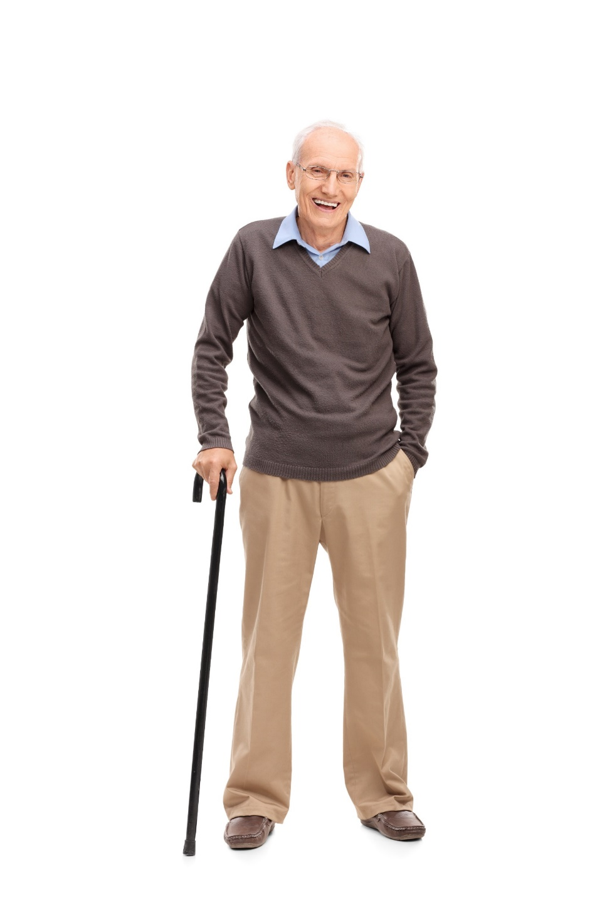
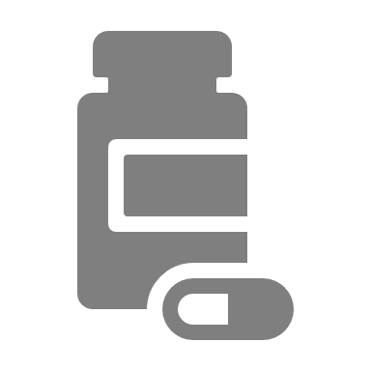
Clinical Vignette
James
75 years old
James’ History
Follow-up visit post recent hip fracture
History of COPD
Previous smoker
Physical Exam & Tests
Noted height loss (3 cm)
Esophageal abnormalities due to GERD
Femoral Neck T-score: -2.4
Medications
Long-acting ß2-agonists (LABAs) and long-acting muscarinic antagonists (LAMAs)
Statin, PPI

Slide 49
Men and Osteoporosis
1 in 5 men will suffer from an osteoporotic fracture during their lifetime
28% of all hip fractures occur in men¹
Lifetime risk of experiencing an osteoporotic fracture in men over the age of 50 is 13.1%^{2,3}
Men have the SAME risk factors for fracture as women
By age 65, men catch up to women and lose bone mass at the same rate⁴
It is estimated that by 2025, the total number of hip fractures in men will be similar to the current number reported in women⁵
Compared to women, men who fracture a hip have an increased risk of mortality, and more comorbid diseases, despite their younger age at the time of fracture⁶
Fracture risk increases with:⁷
Parental history of fracture (especially hip)
Systemic glucocorticoid use (≥3 months)†
Rheumatoid arthritis, or other secondary causes of osteoporosis
Men generally have higher rates of fracture related mortality – 37% of men who suffer a hip fracture will die within the year following that fractured hip.^{1,8}
†≥3 months in the prior year of a prednisone equivalent dose ≥ 7.5mg daily.
1. Crilly RG et al Clin Med Insights Arthritis Musculoskelet Disord. 2016; 9:75-9; 2. Melton LJ, 3rd, et al. J Bone Miner Res. 1992; 7:1005; 3. https://www.cancer.ca/en/cancer-information/cancer-type/prostate/statistics/?region=on; 4.IOF 2017; 5. Seeman E. Am J Med. 1995; 98:76S–88S; 6. Gruber-Baldini et al. J Am Geriatr Soc. 2017;65(3):e64-e69; 7. Papaioannou, A, et al. CMAJ. 2010; 182:1864-1873.
8. https://osteoporosis.ca/about-the-disease/fast-facts/
Notes:
Key Point:
2025 data: Seeman E. The dilemma of osteoporosis in men. Am J Med. 1995; 98:76S–88S
References 5, 6, 6, 7, 8-10 in Gruber-Baldini
pdated with Canadian data in hip fracture in men
form Crilly RG et al Clin Med Insights Arthritis Musculoskelet Disord. 2016 May 3 9 75-9.
In this study mean age for hip fracture:
men 78 ± 11 years
women 82 ± 10 years

Slide 50
High Imminent Vertebral Fracture Risk with COPD AND Previous Vertebral Fracture
Incidence of Vertebral Fractures
by baseline vertebral fracture (y/n)
Incidence of Vertebral Fractures
by number of vertebral fractures at baseline
100
100
**
80
80
HR 4.2
(3.2-5.6)
HR 3.6
(2.9-4.6)
60
60
**
HR 3.1
(2.3-4.2)
Subjects (%) with incident VFs
Subjects (%) with incident VFs
HR 5.1
(3.6-7.4)
HR 6.7
(4.4-10.1)
40
40
HR 3.9
(2.4-6.2)
VFs at baseline:
20
VFs at baseline:
20
No VFs
No
1 VF
Yes
≥ VF
0
One year
Three year
0
**p for trend <0.001
One year
Three year
Incidence of vertebral fractures (VFs) and adjusted hazard ratios within 1 and within 3 years.
ECLIPSE (Evaluation of COPD Longitudinally to Identify Predictive Surrogate Endpoints) study is a non-interventional, observational, multicenter study searching for underlying mechanisms of disease progression in conjunction with COPD.
van Dort, M.J., et al. J Bone Miner Res. 2018 Jul;33(7):1233-1241.
Notes:
Key Point:

Slide 51




Clinical Vignette
James
75 years old
Follow-up visit post recent hip fracture
History of COPD
Previous smoker
What factors would guide your decision to initiate OP therapy for James?
Noted height loss (3 cm)
Esophageal abnormalities due to GERD
Femoral Neck T-score: -2.4
Would you initiate therapy for James?
LABA/LAMA
Statin
PPI

Slide 52
When to do a BMD¹ In Women and Men
Aged ≥ 65 years | Aged 50-64 years | Aged <50 years
Everyone | One or more risk factors for fracture: Fragility fracture after age 40 Parental hip fracture Vertebral fracture or osteopenia identified on radiography Medication with high risk of bone loss (i.e. steroids) Smoking, alcohol (≥3/d) Disorders associated with osteoporosis (i.e. RA) Low weight or major weight loss | 2°causes of osteoporosis (i.e. malabsorption) Prior fragility fracture Medication with high risk of bone loss
Clinical Note:
If you are ordering unrelated imaging (e.g. chest x-ray) for your patient, consider adding “rule out vertebral fracture” on the order²
1. Papaioannou A, et al. CMAJ. 2010;182:1864-1873; 2. Steering Group Communications Feb 9th 2012.
Notes:
Key Point:
Indications for measuring Bone Mineral Density (BMD):
Aged ≥65 years
Everyone
Aged 50-64 years
Clinical risk factors for fracture (menopausal women, men age 50-64 years)
Fragility fracture after age 40 yr
Prolonged use of glucocorticoids (at least 3 months cumulative therapy in the previous year at a prednisone-equivalent dose ≥7.5mg daily)
Use of other high-risk medications (ie. aromatase inhibitors for breast cancer or androgen deprivation therapy for prostate cancer)
Parental hip fracture
Vertebral fracture or osteopenia identified on radiography
Current smoking
High alcohol intake (≥3 units/day)
Low body weight (<60kg) or major weight loss (>10% of body weight at age 25 yr)
Rheumatoid arthritis
Other disorders strongly associated with osteoporosis include: primary hyperparathyroidism, type 1 diabetes, osteogenesis imperfecta, uncontrolled hyperthyroidism, hypogonadism or premature menopause (< 45 years, ), Cushing’s disease, chronic malnutrition or malabsorption, chronic liver disease, COPD and chronic inflammatory conditions (e.g. Inflammatory bowel disease)
Aged <50 years
Fragility fracture
Prolonged use of glucocorticoids (at least 3 months cumulative therapy in the previous year at a prednisone-equivalent dose ≥7.5mg daily)
Use of other high-risk medications (ie. aromatase inhibitors for breast cancer or androgen deprivation therapy for prostate cancer)
Hypogonadism or premature menopause (age <45 yr)
Malabsorption syndrome
Primary hyperthyroidism
Other disorders strongly associated with rapid bone loss and/or fracture
Perform additional biochemical testing to rule out secondary causes of osteoporosis in selected patients.
Reference:
1. Papaioannou A, et al CMAJ 2010;182:1864-1873. 2. Steering Group Communications Feb 9th 2012.

Slide 53








Men Usually have Fractures at a Higher Bone Density than Women
1st Fracture
Normal BMD (T > - 1.0)
Osteopenia (T -1.0 to – 2.5)
2.5%
Osteoporosis (T ≤- 2.5)
2nd Fracture
* Lowest BMD at lumbar spine or hip
Langsetmo L et al. CaMos Res Gr J Bone Miner Res 2009 Sep;24(9):1515-22.

Slide 54
Checklist for Fracture and
OP Risk Factors
DEFINITION OF A FRAGILITY FRACTURE:* A fracture that occurs spontaneously or following a minor trauma such as:
Fall from a standing height (i.e. on the ice)
Fall from a sitting position
Fall from a supine position (bed or reclining deck chair < 1 metre high)
Fall after having missed 1 to 3 steps in a staircase
After a movement outside of the typical plane of motion or coughing
*Fragility fracture includes all bones, except skull and face, patella, hands and feet, cervical spine.
Osteoporosis Canada 2016. Checklist for Risk of Broken Bones and Osteoporosis. Accessed July 8th 2016. http://www.osteoporosis.ca/osteoporosis-and-you/diagnosis/risk-factors/.
Bessette L, et al. Contemp Clin Trials. 2008;29:194-210. Brown J.P, et al. J Bone Miner Res. 2007;23(Suppl 1):M350.
Notes:
Animated Slide
Key Points:
The checklists are an easy way to assess patient risk for osteoporosis. If a patient answers yes to one of more items in each section they should be fully assessed for fracture risk and presence of osteoporosis.
Checklist for Risk of Broken Bones and Osteoporosis
DEFINITION OF A FRAGILITY FRACTURE:
The ROCQ results demonstrated that fragility fractures were often not appropriately recognized and linked to osteoporosis by either patients or their healthcare practitioners
It is important to fully understand the definition of the fragility fracture
Get-up-and-Go-Test:
References:
1. Osteoporosis Canada 2016. Checklist for Risk of Broken Bones and Osteoporosis. Accessed July 8th 2016. http://www.osteoporosis.ca/osteoporosis-and-you/diagnosis/risk-factors/
2. Bessette L, et al. Recognizing osteoporosis and its consequences in Quebec (ROCQ): Background, rationale, and methods of an anti-fracture patient health-management programme. Contemp Clin Trials 2008; 29:194-210.
3. Brown JP, et al. Validation of a clinical definition of fragility fracture. J Bone Miner Res. 2007;23(Suppl 1):M350.

Slide 55
Long-Term Fracture Risk Can Be Quantified Using FRAX® or Other Risk-Assessment Tools
FRAX® provides conservative estimate of 10-year fracture risk but does not necessarily identify patients with shorter-term risk who require urgent intervention (pharmacological) to prevent subsequent fractures¹⁻³
Input¹
Calculator¹
Output¹
Age
Gender
BMD
Fracture History
Other Characteristics
Smoking
Alcohol use
Rheumatoid arthritis
Glucocorticoids use
Etc
In men, absolute BMD value for femoral neck (rather than T-score) should be entered into FRAX because FRAX converts the BMD into a female T-score.
FRAX® is a registered trademark of Professor J.A. Kanis. University of Sheffield.
BMD = bone mineral density; FRAX = fracture risk assessment tool.
1. FRAX. https://www.shef.ac.uk/FRAX/. Accessed March 15, 2018. 2. Kanis JA, et al. Osteoporos Int. 2011;22:2395-2411. 3. Silverman SL, et al. Curr Osteoporos Rep. 2010;8:192-197
.

Slide 56
Male: BMD Responses to
Bisphosphonate Therapy with 24-Month Treatment
from Baseline | Antiresorptive Therapy
 | Bisphosphonates
 | Alendronate¹ | Risedronate Weekly³ | Zoledronic Acid⁴
Change in Lumbar Spine BMD | 5.3% | 4.5% | 6.1%
Change in femoral neck BMD | 2.6%
* vs. placebo; † vs. weekly alendronate
1. Orwoll E, et al. N Engl J Med 2000;343:604-10; 2. Boonen S, et al. J Bone Miner Res 2009;24(4):719-25; 3. Orwoll ES, et al. J Bone Miner Res 2010;25:2239–2250.

Slide 57
Male: ADAMO Continued BMD Increases With 24-Months of Denosumab Treatment at Lumbar Spine
Double-blind
Open-label
8.0†
8
Continued denosumab (n=111)
Cross-over denosumab (n=117) Placebo comparator for months 0-6
5.8*
6
5.7†
4.3*
Mean percentage change from baseline (95% CI)
4
2
0.9*
0.8*
0
0
0
6
12
18
24
Study Month
*p < 0.05 vs double-blind baseline. †p < 0.0001 vs double-blind and open-label baseline. CI = confidence interval.
Adapted from: Langdahl BL, et al. J Clin Endocrin Metab 2015;100(4):1335-134. doi:10.1210/jc.2014-4079
Notes:
OBJECTIVE:
The purpose of this study was to evaluate denosumab therapy in men with low bone mineral density (BMD).
DESIGN:
This was a phase 3 study with 2 treatment periods: a previously reported 12-month double-blind, placebo-controlled phase and a 12-month open-label phase.
SETTING:
This was a multicenter study conducted in North America and Europe.
PARTICIPANTS:
A total of 228 men entered the open-label phase and 219 completed the study.
INTERVENTION:
Men from the original denosumab (long-term) and placebo (crossover) groups received 60 mg of denosumab sc every 6 months.
MAIN OUTCOME MEASURES:
BMD, serum collagen type I C-telopeptide, and safety were measured.
RESULTS:
During the open-label phase, continued BMD increases occurred with long-term denosumab treatment (2.2% lumbar spine, 0.9% total hip, 1.3% femoral neck, 1.3% trochanter, and 0.2% 1/3 radius), resulting in cumulative 24-month gains from baseline of 8.0%, 3.4%, 3.4%, 4.6%, and 0.7%, respectively (all P < .01). The crossover group showed BMD gains after 12 months of denosumab treatment similar to those of the long-term denosumab group during the first treatment year. Significant reductions in serum collagen type I C-teleopeptide were observed after denosumab administration. Adverse event rates were similar between groups, and no new safety signals were identified.
CONCLUSIONS:
In men with low BMD, denosumab treatment for a second year continued to increase BMD, maintained reductions in bone resorption, and was well tolerated. BMD increased in men initiating denosumab during the second year. These effects were similar to those previously seen in postmenopausal women with osteoporosis and in men with prostate cancer receiving androgen deprivation therapy.

Slide 58
Male: Continued BMD Increases with Denosumab at 24 Months: Total Hip, Femoral Neck, Trochanter, 1/3 Radius
Continued denosumab
Cross-over denosumab
Placebo
Total Hip
Femoral Neck
4
3.4†
4
3.4†
3
2.3*
3
2.2*
2
1.6*
2
1.7*
1
0.3
2.0†
1
1.8†
0.1
0.0
–0.1
0
0
–1
–1
Mean percentage change from baseline (95% CI)
0
6
12
18
24
0
6
12
18
24
Trochanter
1/3 Radius
5
4.6†
2
4
3.2*
3
1.8*
1
0.6*
0.7*
2
0.8*
2.7†
0.1
0.6‡
1
0.2
0
0
–0.3
–0.3
–1
–1
0
6
12
18
24
0
6
12
18
24
Study Month
Study Month
Data are least square means.*p < 0.05 vs double-blind baseline; †p < 0.0001 vs double-blind and open-label baseline; ‡p < 0.05 vs double-blind and open-label baseline.
Adapted from Langdahl BL, et al. J Clin Endocrin Metab 2015;100(4):1335-134. DOI:10.1210/jc.2014-4079
Notes:
OBJECTIVE:
The purpose of this study was to evaluate denosumab therapy in men with low bone mineral density (BMD).
DESIGN:
This was a phase 3 study with 2 treatment periods: a previously reported 12-month double-blind, placebo-controlled phase and a 12-month open-label phase.
SETTING:
This was a multicenter study conducted in North America and Europe.
PARTICIPANTS:
A total of 228 men entered the open-label phase and 219 completed the study.
INTERVENTION:
Men from the original denosumab (long-term) and placebo (crossover) groups received 60 mg of denosumab sc every 6 months.
MAIN OUTCOME MEASURES:
BMD, serum collagen type I C-telopeptide, and safety were measured.
RESULTS:
During the open-label phase, continued BMD increases occurred with long-term denosumab treatment (2.2% lumbar spine, 0.9% total hip, 1.3% femoral neck, 1.3% trochanter, and 0.2% 1/3 radius), resulting in cumulative 24-month gains from baseline of 8.0%, 3.4%, 3.4%, 4.6%, and 0.7%, respectively (all P < .01). The crossover group showed BMD gains after 12 months of denosumab treatment similar to those of the long-term denosumab group during the first treatment year. Significant reductions in serum collagen type I C-teleopeptide were observed after denosumab administration. Adverse event rates were similar between groups, and no new safety signals were identified.
CONCLUSIONS:
In men with low BMD, denosumab treatment for a second year continued to increase BMD, maintained reductions in bone resorption, and was well tolerated. BMD increased in men initiating denosumab during the second year. These effects were similar to those previously seen in postmenopausal women with osteoporosis and in men with prostate cancer receiving androgen deprivation therapy.

Slide 59
Teriparatide: BMD Increases in Male OP
Mean Percent Change in BMD from Baseline to Endpoint in Men with Primary Hypogonadal OP Treated for a Median of 10 months
 | Teriparatide (N=151) | Placebo (N=147)
Lumbar spine BMD | 5.9† | 0.5
Femoral Neck BMD | 1.5‡ | 0.3
Total Hip BMD | 1.2 | 0.5
Trochanter BMD | 1.3 | 1.1
Distal 1/3 radius BMD | -0.5 | -0.2
†p<0.001 compared with placebo; ‡p<0.05 compared with placebo.
Forteo-Drug Label Information. DailyMed. February 10, 2015. Accessed on June 1, 2016 at https://dailymed.nlm.nih.gov/dailymed/drugInfo.cfm?setid=aae667c5-381f-4f92-93df-2ed6158d07b0.
Notes:
http://www.ncbi.nlm.nih.gov/pubmedhealth/PMH0041227
Forteo-Drug Label Information. DailyMed. February 10, 2015.
[Accessed on June 1, 2016 https://dailymed.nlm.nih.gov/dailymed/drugInfo.cfm?setid=aae667c5-381f-4f92-93df-2ed6158d07b0]

Slide 60
Clinical Vignette
James
75 years old
Follow-up visit post recent hip fracture
History of COPD
Previous smoker
What factors would guide your choice for OP therapy for James?
Noted height loss (3 cm)
Esophageal abnormalities due to GERD
Femoral Neck T-score: -2.4
How would you address adherence with BPs?
LABA/LAMA
Statin
PPI
What therapy would you start James on?

Slide 61

Discussion: Clinical Takeaways
Men are at high fracture risk, similar to women with the same risk factors
Men have a higher mortality risk than women after hip fracture
Treatment for men is the same as for women
For men we have to think of it!...It is not spontaneous

Slide 62
Clinical Question 5
Do patients on glucocorticoid require osteoporosis pharmacotherapy?

Slide 63
Learning Objectives
Upon completion of this module, participants will be better able to:
Explain the impact of co-morbidities on the risk profile of patients with osteoporosis
Describe why glucocorticoid treatment is associated with bone loss and increased fracture risk
Mitigate the impact of medication-related factors which may increase the risk of bone loss and fragility fractures

Slide 64
Clinical Question 5
Do patients on glucocorticoid require osteoporosis pharmacotherapy?
Patients initiating long-term high dose glucocorticoid therapy (≥ 7.5 mg prednisone or equivalent daily for at least three months cumulative therapy in the previous year*) require osteoporosis prophylaxis of bone loss. FRAX may underestimate fracture risk in patients on high dose glucocorticoid and strong consideration should be given to early initiation of antiresorptive therapy to prevent the initial bone loss which occurs with glucocorticoid therapy.
* 2010 Clinical Practice Guidelines from Osteoporosis Canada.

Slide 65

Clinical Vignette
Ken
70 years old
Recent complaints of severe back pain
Polymyalgia Rheumatica (PMR)
What are your current strategies for assessing fracture risk in patients on glucocorticoid therapy?
Noted height loss (3 cm)
Femoral Neck T-score: -2.8
Would you treat Ken for Glucocorticoid induced bone loss?
Prednisone 15 mg/day for 5 months
PPI

Slide 66
Long-Term GIOP Causes Osteoporotic Fractures in 30% - 50% of Treated Adult Patients¹
GIOP is the most common form of secondary osteoporosis²
An estimated 3.6% of Canadian postmenopausal women currently take oral glucocorticoids³
7-fold higher hip fracture risk^{4*}
17-fold higher vertebral fracture risk^{4*}
Risk independent of underlying disease, age, and gender⁵
Morbidity, mortality, and healthcare costs⁴
Decreased quality of life⁴
*With prednisone equivalent doses of 10–12 mg/day for > 3 months in the past year.
1. Amiche MA et al. Osteoporos Int. 2016;27: 1709–1718; 2. Mazziotti G, et al. Am J Med. 2010;123, 877-884; 3. Diez-Perez A, et al. Bone.2011;49, 493-498; 4. Buehring B, et al. J Allergy Clin Immunol.2013;132, 1019-1030; 5. van Staa TP, et al. Osteoporos Int. 2002;13, 777-787.
Notes:
Key Point:

Slide 67
GIOP Associated with Reduced Bone Formation¹
GIOP causes biphasic bone loss:¹
Rapid bone loss of up to 12% during the first 12 months of GC treatment
Followed by slower bone loss of 2-3% annually
Glucocorticoids induce:
Stimulators of osteoclast differentiation and increasing bone resorption¹
Inhibitors of bone formation and stimulate the differentiation of osteoblast precursors toward adipogenesis²
1. Khosla S. Endocrinology. 2001;142:5050-3.; 2. Amiche MA et al. Osteoporos Int. 2016;27:1709–1718.
Notes:
Key Point:

Slide 68
Glucocorticoid-Induced Osteoporosis Risk of Vertebral Fracture Stratified By Dose
VERTEBRAL
%
1
< 2.5 mg daily
2.5-7.5 mg daily
>7.5 mg daily
0.5
0
1 year before
0-3
3-6
6-9
9-12
Months
van Staa TP. Osteoporos Int. 2002:13;777-787.
Notes:
Key Point: Should be emphasized that vertebral fractures happen very soon after initiating glucocorticoids
In another study van Staa showed that there is an increase in vertebral fracture risk occurs early. To the left, at 1 year prior to commencing CS, the % of those with a fracture is noted. This serves as the baseline prevalence. Within the first 3 months of commencing CS therapy there is an increase in fractures most notably in those on the highest doses of CS therapy. By 6 months there is a sharp rise in the prevalence of fractures.

Slide 69
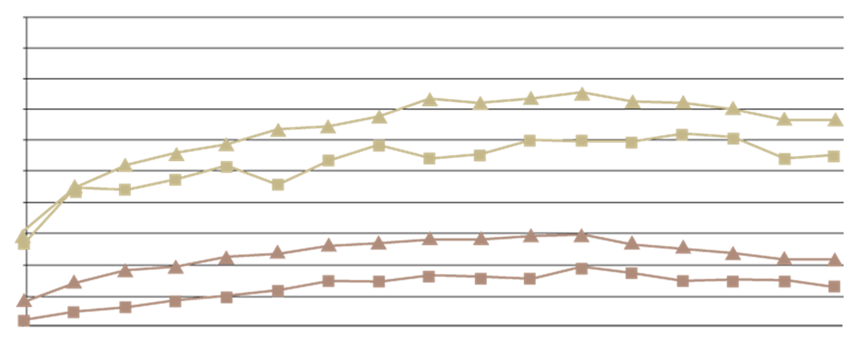
Glucocorticoid-Induced Osteoporosis Management among Seniors, by year, sex, and indication, 1996–2012
72,099 men and 95,975 women starting chronic oral GC therapy (mean age=74.9 years, SD=6.5)
100
90
80
70
60
50
% Receiving Osteoporosis Management
40
30
20
10
0
1996
1997
1998
1999
2000
2001
2002
2003
2004
2005
2006
2007
2008
2009
2010
2011
2012
No History (Men)
No History (Women)
Prior Management (Men)
Prior Management (Woman)
Albaum JM et al Osteoporos Int 2015; 26:2845–2852
Notes:
Key Point: Treatment gap. Most patients who are treated were already identified with and treated for osteoporosis

Slide 70
Approved Pharmacological Interventions for the Management of GIOP
INTERVENTION | DOSING REGIMEN | ROUTE OF ADMINISTRATION
Alendronate | 5 or 10 mg once daily 70 mg once weeklyª | Oral
Etidronate^{b} | 400 mg daily for 2 weeks every 3 months | Oral
Risedronate | 5 mg once daily 35 mg once weeklyª | Oral
Zoledronic acid | 5 mg once yearly | Intravenous infusion
Denosumab | 60 mg every 6 months | Subcutaneous injection
Teriparatide | 20 μg once daily | Subcutaneous injection
ª Only once-daily dosing regimens are approved for GIOP
Adapted form Compston J. Nat Rev Rheumatol 2010;6(2):82-8.
Notes:
Key Point: Message here is that dosing is the same for GIOP than for post-menopausal osteoporosis. We need to add denosumab which is now indicated for GIOP

Slide 71
Cohort Analyses: Effectiveness of Oral BPs in Reducing Fracture Risk Among Glucocorticoid Users
Matched cohort analyses comparing benefit of oral BPs in reducing fracture risk in GIOP in cohort of new oral GC users
 | Hip fracture risk | Vertebral fracture risk | Forearm/ humerus fracture risk
Alendronate | HR = 0.46 95% CI 0.25-0.80 | HR = 0.52 95% CI 0.39-0.68 | No risk reduction
Etidronate | N/A | HR = 0.59 95% CI 0.48-0.73 | No risk reduction
Risedronate | HR = 0.58 95% CI 0.36-0.90 | HR = 0.47 95% CI 0.36-0.60 | No risk reduction
Results were similar between men and women
CI = confidence interval; GC = glucocorticoid; HR = hazard ratio; BP = bisphosphonates
Amiche MA, et al. J Bone Miner Res 2018 Mar;33(3):419-429.

Slide 72
Bisphosphonates for GIOP
Outcomes | Relative effect RR (95% CI) | #Participants (studies) | Quality of evidence (GRADE) | Comments
Incident VFx | 0.57 (0.35 to 0.91) | 1343 (12 RCTs) | High | AR 2% fewer NNTB 31 (20 to 145)
Incident NVFx | 0.79 (0.47 to 1.33) | 1245 (9 RCTs) | Low Risk of bias, imprecision | AR 1% fewer NNTB n/a
Lumbar spine BMD | N/A | 2042 (23 RCTs) | Moderate (indirectness) | + 3.5% (2.9 to 4.1) NNTB 3 (2 to 3)
Femoral Neck BMD | N/A | 1665 (18 RCTs) | Moderate (indirectness) | + 2.06% (1.4 to 2.7) NNTB 5 (4 to 7)
Serious AEs | 0.91 (0.74 to 1.12) | 1703 (15 RCTs) | Low Risk of bias, imprecision | ARH 0% (2% fewer to 2% more)
Withdrawal due to AEs | 1.06 (0.77 to 1.47) | 1790 (15 RCTs) | Low Risk of bias, imprecision | ARH 1% (1% fewer to 3% more)
Allen CS, et al. Cochrane Database of Systematics Reviews 2016. Issue 10 CD 001347.

Slide 73
Phase 3: Effect of Denosumab and Risedronate on Glucocorticoid-treated Patients†: Lumbar Spine BMD
Risedronate
Denosumab
Glucocorticoid-continuing (GC-C)
Glucocorticoid-initiating (GC-I)
*
*
*
*
BMD percentage change
from baseline
BMD percentage change
from baseline
BL
6
12
BL
6
12
Study Month
Study Month
Risedronate n=
227
211
128
126
Denosumab n=
224
209
127
119
n = Number of subjects with observed values at baseline and the time point of interest; *p ≤ 0.002. † glucocorticoids (≥7·5 mg prednisone daily, or equivalent) for at least 3 months (glucocorticoid continuing) or less than 3 months (glucocorticoid initiating) before screening. Adapted from Saag K, et al. American College of Rheumatology. ACR, Washington, DC. November 2016.

Slide 74
Phase 3: Effect of Denosumab and Risedronate on Glucocorticoid-treated Patients†: Total Hip BMD
Risedronate
Denosumab
Glucocorticoid-continuing (GC-C)
Glucocorticoid-initiating (GC-I)
*
*
BMD percentage change
from baseline
BMD percentage change
from baseline
BL
6
12
BL
6
12
Study Month
Study Month
Risedronate n=
215
128
Denosumab n=
217
119
n = Number of subjects with observed values at baseline and the time point of interest; *p ≤ 0.002; †glucocorticoids (≥7·5 mg prednisone daily, or equivalent) for at least 3 months (glucocorticoid continuing) or less than 3 months (glucocorticoid initiating) before screening. Adapted from Saag KG, et al. Lancet Diabetes Endocrinol 2018 Apr 6. pii: S2213-8587(18)30075-5.

Slide 75
Switching of Oral BPs to Denosumab in Chronic Glucocorticoid Users
Switching from oral BP to denosumab* resulted in greater gain of the spinal BMD and suppression of bone turnover markers after 12 months of therapy
Denosumab group at month 12: BMD of the spine increased by +3.4±0.9% (p=0.002) and +1.4±0.6% (p=0.03) at hip
BP group at month12: BMD of spine +1.5±0.4% (p=0.001) and +0.80±0.5% (p=0.12) at hip
*Randomized, controlled trial in 42 women, n=21 participants per group; mean age 54±12.9 years.
Mok CC, et al. Bone 2015;75:222-8.
Notes:
OBJECTIVES:
To evaluate the effect of switching from oral bisphosphonates to denosumab on bone mineral density (BMD) in long-term glucocorticoid users.
METHODS:
Adult patients who were receiving long-term prednisolone (≥2.5 mg/day for ≥1 year) and oral bisphosphonates (≥2 years) were recruited. Participants were randomized to either continue oral bisphosphonates or switch to denosumab (60 mg subcutaneously every 6 months) for 12 months. Serial BMD (lumbar spine, hip) and bone turnover markers (serum osteocalcin, P1NP, β-CTX) were measured.
RESULTS:
42 women were recruited (age 54.7±12.9 years; 21 shifted to denosumab and 21 continued on bisphosphonates). The duration of prednisolone therapy was 101±66.3 months and the daily dose was 4.4±2.1 mg. Baseline demographic data, osteoporosis risk factors, and BMD at various sites were similar between the two groups of patients. At month 12, BMD of the spine and hip increased by +3.4±0.9% (p=0.002) and +1.4±0.6% (p=0.03), respectively, in the denosumab group; whereas the corresponding change was +1.5±0.4% (p=0.001) and +0.80±0.5% (p=0.12) in the bisphosphonate group. The spinal BMD at month 12 was significantly higher in the denosumab than bisphosphonate group after adjustment for baseline BMD and β-CTX values, and other confounding factors (p=0.01). Bone turnover markers (β-CTX and P1NP) were more strongly suppressed by denosumab than the bisphosphonates. Minor infections were more common in denosumab-treated patients while other adverse events occurred at similar frequencies between the two groups.
CONCLUSIONS:
In patients receiving long-term glucocorticoids, switching from oral bisphosphonates to denosumab resulted in greater gain of the spinal BMD and suppression of bone turnover markers after 12 months of therapy. The results have to be confirmed by a larger clinical trial with fracture as endpoint.

Slide 76
Clinical Vignette
Ken
70 years old
Recent complaints of severe back pain
Polymyalgia Rheumatica (PMR)
How do you mitigate GIOP risk in your patients?
Noted height loss (3 cm)
Femoral Neck T-score: -2.8
Which treatment would you select for Ken?
Prednisone 15 mg/day for 5 months
PPI

Slide 77
Discussion: Clinical Takeaways
GIOP is the most common form of secondary osteoporosis.
GIOP causes biphasic bone loss:
Rapid bone loss of up to 12% during the first 12 months of GC treatment
Followed by slower bone loss of 2-3% annually
Vertebral fractures often happen within the first year
All adult patients initiated with long-term glucocorticoids (prednisone
> 7.5 mg/d for > 3 months should be rapidly (< 3 months):
Assessed for bone health (DXA ± Lateral Spine X-Rays, lab. tests)
Initiated on antiresorptive treatment with Ca/vitamin D
Monitored annually (DXA ± Lateral Spine X-Rays, lab. tests)
Patients should be re-assessed periodically to evaluate the need to continue pharmacological treatment.

Slide 78
Clinical Question 6
What is the risk of fracture in patients on aromatase inhibitor therapy?

Slide 79
Learning Objectives
Upon completion of this module, participants will be better able to:
Explain the impact of co-morbidities on the risk profile of patients with osteoporosis
Describe why aromatase inhibitor therapy is associated with bone loss and increased fracture risk
Mitigate the impact of medication-related factors which may increase the risk of bone loss and fragility fractures

Slide 80
Clinical Question 6
What is the risk of fracture in patients on aromatase inhibitor therapy?
With the expanding use and longer therapy duration of aromatase inhibitor in patients with breast cancer, attention to bone health is important. The declines in BMD on aromatase inhibitor contribute to a high long-term risk of fracture. Guidelines would suggest initiating osteoporosis therapy at T-scores of -1.5 or -2.

Slide 81

Clinical Vignette
Margaret
68 years old
Breast Cancer
FRAX MOF: 15%
Femoral Neck T-score: -1.8
HF: 1.8%
Does Margaret require bone protective therapy?
Initiated on letrozole with a plan to continue for 10 years

Slide 82
Cancer Treatment Induced Bone Loss (CTIBL)
2.6% loss in lumbar spine BMD in postmenopausal women receiving AI therapy¹
With concomitant increase in fracture incidence
For postmenopausal patients, aromatase inhibitors (AIs) have emerged as the standard of care because of their superior efficacy compared with tamoxifen¹
However, the reported rate of fractures⁶ was lower with tamoxifen (5.8% vs 8.6%, p<0.001)
Normal and Cancer Treatment Related Bone Loss Rates
10
Naturally occurring bone loss
CTIBL
8
7.0
7.7
6
Bone Loss at 1 Year
4
2.6
2.0
2
0.5
1.0
Normal Men²
PMO Women >55²
Menopausal Women <55²
AI therapy in PMO Women³
AI therapy plus GnHR agonist in premenopausal women⁴
Premature menopause secondary to chemotherapy⁵
1. Hadji P. Breast Care (Basel) 2010;5(5):290-296; 2. Kanis JA. Osteoporosis 1997;22-55; 3. Eastell R. J Bone Mineral Res 2003;18(6):1051-6;
4. Gnant M. (2002). San Antonio Breast Cancer Symposium. 5. Shapiro CL. J Clin Oncol 2001;19(14):3306-3311; 6. Coates AS, et al. J Clin Oncol 2007;25:486-492.
Notes:
1. Hadji P. Guidelines for osteoprotection in breast cancer patients on an aromatase inhibitor. Breast Care (Basel) 2010;5:290–6.
2. Kanis, J.A., (1997). Osteoporosis, 22-55; 3. Eastell, R. Relationship of early changes in bone resorption to the reduction in fracture risk with risedronate. (2003). J Bone Mineral Res. 18(6):1051-6
4. Gnant, M. (2002). San Antonio Breast Cancer Symposium.
5. Shapiro, C.L. Ovarian failure after adjuvant chemotherapy is associated with rapid bone loss in women with early-stage breast cancer.
(2001). J Clin Oncol., 19(14):3306-3311.

Slide 83
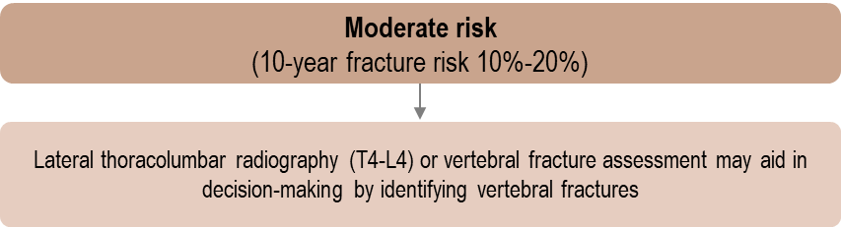
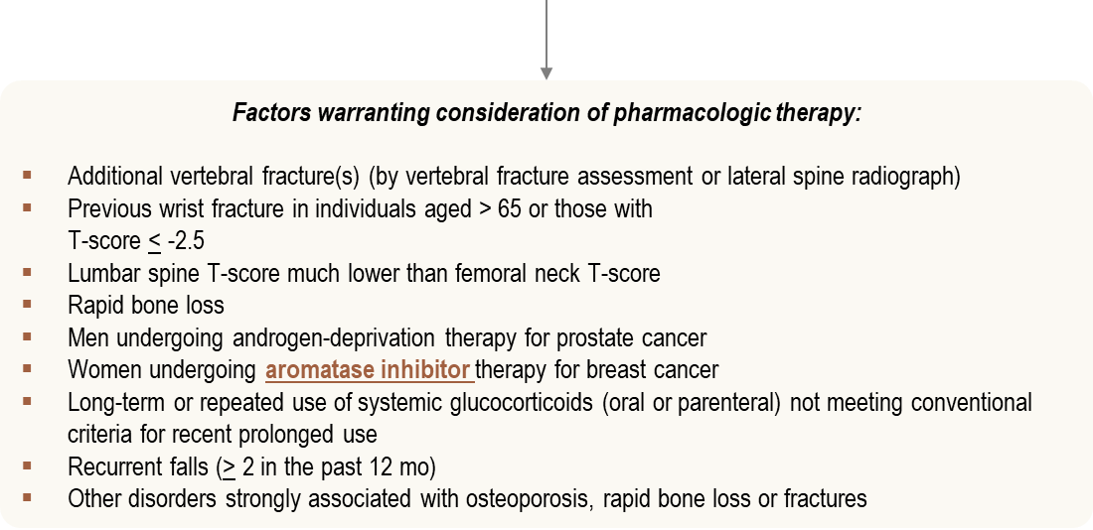
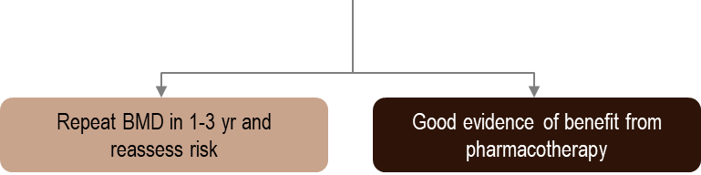
Recommendations for Patients with Moderate Risk
Adapted from Papaioannou A, et al. CMAJ 2010; 182(17):1864-73.
Notes:
On site of Osteoporosis Canada, available to public for download

Slide 84
Management of Aromatase Inhibitor-Associated Bone Loss (AIBL) in postmenopausal women with hormone sensitive breast cancer:
Joint position statement of the IOF, CABS, ECTS, IEG, ESCEO, IMS, and SIOG
Patient with cancer receiving chronic endocrine treatment known to accelerate bone loss
T-score > -2.0 and no additional risk factors
Any 2 of the following risk factors:
Age > 65
T-score < -1.5
Smoking (current and history of)
BMI < 24
Family history of hip fracture Personal history of fragility fracture above age 50
Oral glucocorticoid use for > 6 months
T-score < -2.0 and no additional risk factors
Exercise
Calcium and Vitamin D
Exercise
Calcium and Vitamin D
Bisphosphonate therapy
Monitor risk and
BMD at 1-2-year intervals
Monitor BMD every 2 years Check compliance with oral therapy
Hadji P et al. J Bone Oncology 2017; 7: 1-12.

Slide 85
Cochrane Database Review: CTIBL-Breast Cancer Patients
44 RCTs involving 37,302 women
In early breast cancer, BPs reduce the risk of bone metastases and provide an overall survival benefit compared to placebo or no BPs
Oral Bisphosphonates 9 studies (n=2891) | Denosumab 3 studies (n=2345)
Delayed median time to skeletal related event Median ratio 1.43 (95% CI 1.29 to 1.58; P < 0.00001) Reduced bone pain compared to placebo/no BP | Reduced the risk of developing skeletal related event compared with BPs by 22% (RR 0.78, 0.72 to 0.85; P < 0.001)
Skeletal related event = pathologic fracture, spinal cord compression, necessity for radiation to bone (for pain or impending fracture) or surgery to bone.
O’Carrigan B, et al. Cochrane Database Syst Rev 2017 Oct 30;10:CD003474.
Notes:
Objectives
To assess the effects of bisphosphonates and other bone agents in addition to anti-cancer treatment: (i) in women with early breast
cancer (EBC); (ii) in women with advanced breast cancer without bone metastases (ABC); and (iii) in women with metastatic breast
cancer and bone metastases (BCBM).
Search methods
In this review update, we searched Cochrane Breast Cancer’s Specialised Register, CENTRAL, MEDLINE, Embase, the World Health
Organization’s International Clinical Trials Registry Platform (WHO ICTRP) and ClinicalTrials.gov on 19 September 2016.
Selection criteria
We included randomised controlled trials (RCTs) comparing: (a) one treatment with a bisphosphonate/bone-acting agent with the
same treatment without a bisphosphonate/bone-acting agent; (b) treatment with one bisphosphonate versus treatment with a different
bisphosphonate; (c) treatment with a bisphosphonate versus another bone-acting agent of a different mechanism of action (e.g. deno-
sumab); and (d) immediate treatment with a bisphosphonate/bone-acting agent versus delayed treatment of the same bisphosphonate/
bone-acting agent.
Data collection and analysis
Two review authors independently extracted data, and assessed risk of bias and quality of the evidence. The primary outcome measure
was bone metastases for EBC and ABC, and a skeletal-related event (SRE) for BCBM. We derived risk ratios (RRs) for dichotomous
outcomes and the meta-analyses used random-effects models. Secondary outcomes included overall survival and disease-free survival
for EBC; we derived hazard ratios (HRs) for these time-to-event outcomes where possible. We collected toxicity and quality-of-life
information. GRADE was used to assess the quality of evidence for the most important outcomes in each treatment setting.
Main results
We included 44 RCTs involving 37,302 women.
In women with EBC, bisphosphonates were associated with a reduced risk of bone metastases compared to placebo/no bisphosphonate
(RR 0.86, 95% conﬁdence interval (CI) 0.75 to 0.99; P = 0.03, 11 studies; 15,005 women; moderate-quality evidence with no
signiﬁcant heterogeneity). Bisphosphonates provided an overall survival beneﬁt with time-to-event data (HR 0.91, 95% CI 0.83 to
0.99; P = 0.04; 9 studies; 13,949 women; high-quality evidence with evidence of heterogeneity). Subgroup analysis by menopausal
status showed a survival beneﬁt from bisphosphonates in postmenopausal women (HR 0.77, 95% CI 0.66 to 0.90; P = 0.001; 4
studies; 6048 women; high-quality evidence with no evidence of heterogeneity) but no survival beneﬁt for premenopausal women (HR
1.03, 95% CI 0.86 to 1.22; P = 0.78; 2 studies; 3501 women; high-quality evidence with no heterogeneity). There was evidence of
no effect of bisphosphonates on disease-free survival (HR 0.94, 95% 0.87 to 1.02; P = 0.13; 7 studies; 12,578 women; high-quality
evidence with signiﬁcant heterogeneity present) however subgroup analyses showed a disease-free survival beneﬁt from bisphosphonates
in postmenopausal women only (HR 0.82, 95% CI 0.74 to 0.91; P < 0.001; 7 studies; 8314 women; high-quality evidence with no
heterogeneity). Bisphosphonates did not signiﬁcantly reduce the incidence of fractures when compared to placebo/no bisphosphonates
(RR 0.77, 95% CI 0.54 to 1.08, P = 0.13, 6 studies, 7602 women; moderate-quality evidence due to wide conﬁdence intervals). We
await mature overall survival and disease-free survival results for denosumab trials.
In women with ABC without clinically evident bone metastases, there was no evidence of an effect of bisphosphonates on bone
metastases (RR 0.96, 95% CI 0.65 to 1.43; P = 0.86; 3 studies; 330 women; moderate-quality evidence with no heterogeneity) or overall
survival (RR 0.89, 95% CI 0.73 to 1.09; P = 0.28; 3 studies; 330 women; high-quality evidence with no heterogeneity) compared to
placebo/no bisphosphonates however the conﬁdence intervals were wide. One study reported a trend towards an extended period of
time without a SRE with bisphosphonate compared to placebo (low-quality evidence). One study reported quality of life and there was
no apparent difference in scores between bisphosphonate and placebo (moderate-quality evidence).
In women with BCBM, bisphosphonates reduced the SRE risk by 14% (RR 0.86, 95% CI 0.78 to 0.95; P = 0.003; 9 studies; 2810
women; high-quality evidence with evidence of heterogeneity) compared with placebo/no bisphosphonates. This beneﬁt persisted when
administering either intravenous or oral bisphosphonates versus placebo. Bisphosphonates delayed the median time to a SRE with
a median ratio of 1.43 (95% CI 1.29 to 1.58; P < 0.00001; 9 studies; 2891 women; high-quality evidence with no heterogeneity)
and reduced bone pain (in 6 out of 11 studies; moderate-quality evidence) compared to placebo/no bisphosphonate. Treatment
with bisphosphonates did not appear to affect overall survival (RR 1.01, 95% CI 0.91 to 1.11; P = 0.85; 7 studies; 1935 women;
moderate-quality evidence with signiﬁcant heterogeneity). Quality-of-life scores were slightly better with bisphosphonates than placebo
at comparable time points (in three out of ﬁve studies; moderate-quality evidence) however scores decreased during the course of the
studies. Denosumab reduced the risk of developing a SRE compared with bisphosphonates by 22% (RR 0.78, 0.72 to 0.85; P < 0.001;
3 studies, 2345 women). One study reported data on overall survival and observed no difference in survival between denosumab and
bisphosphonate.
Reported toxicities across all settings were generally mild. Osteonecrosis of the jaw was rare, occurring less than 0.5% in the adjuvant
setting (high-quality evidence).
Authors’ conclusions
For women with EBC, bisphosphonates reduce the risk of bone metastases and provide an overall survival beneﬁt compared to placebo
or no bisphosphonates. There is preliminary evidence suggestive that bisphosphonates provide an overall survival and disease-free
survival beneﬁt in postmenopausal women only when compared to placebo or no bisphosphonate. This was not a planned subgroup
for these early trials, and we await the completion of new large clinical trials assessing beneﬁt for postmenopausal women. For women
with BCBM, bisphosphonates reduce the risk of developing SREs, delay the median time to an SRE, and appear to reduce bone pain
compared to placebo or no bisphosphonate.de Abstract in Speaker Notes

Slide 86
RCT: CTIBL-Breast Cancer Patients: Effect of Zoledronic Acid on Total Hip and Lumbar Spine BMD
At month 61, the adjusted mean difference in LS 8.9% (95% CI: 7,4-10.5) and total hip 6.7% (95% CI: 5.5-8.0) BMDs between the upfront and delayed groups
6
Immediate
Delayed
4
2
4.39
1.89
BMD change (%)
0
-2
-3.52
-4.90
-4
-6
Lumbar Spine
P<0.0001
Hip
P<0.0001
602 PMO with early, hormone receptor-positive BC receiving adjuvant letrozole were randomized to receive upfront or delayed-start zoledronic acid (4 mg intravenously every 6 months) for 5 years.
Adapted from Brufsky AM, et al. Cancer 2012;118(5):1192-201.
Notes:
BACKGROUND:
Postmenopausal breast cancer (BC) patients receiving adjuvant aromatase inhibitor therapy are at risk of progressive bone loss and fractures. Zoledronic acid inhibits osteoclastic bone resorption, is effective in maintaining bone health, and may therefore be beneficial in this setting.
METHODS:
Overall, 602 postmenopausal women with early, hormone receptor-positive BC receiving adjuvant letrozole were randomized (301 each group) to receive upfront or delayed-start zoledronic acid (4 mg intravenously every 6 months) for 5 years. The primary endpoint was the change in lumbar spine (LS) bone mineral density (BMD) at month 12. Secondary endpoints included changes in LS BMD, total hip BMD, and bone turnover markers at 2, 3, and 5 years; fracture incidence at 3 years; and time to disease recurrence.
RESULTS:
At month 61, the adjusted mean difference in LS and total hip BMDs between the upfront and delayed groups was 8.9% and 6.7%, respectively (P < .0001, for both). Approximately 25% of delayed patients received zoledronic acid by month 61. Only 1 patient experienced grade 4 renal dysfunction; no confirmed cases of osteonecrosis of the jaw were reported. Fracture rates (upfront, 28 [9.3%]; delayed, 33 [11%]; P = .3803) and Kaplan-Meier disease recurrence rates (upfront, 9.8 [95% confidence interval (CI), 6.0-10.3]; delayed, 10.5 [95% CI, 6.6-14.4]; P = .6283) were similar at month 61.
CONCLUSIONS:
Upfront zoledronic acid seems to be the preferred treatment strategy versus delayed administration, as it significantly and progressively increases BMD in postmenopausal women with early BC receiving letrozole for 5 years, and long-term coadministration of letrozole and zoledronic acid is well tolerated.

Slide 87
Phase 3: CTIBL-Breast Cancer Patients: Effect of Denosumab on Total Hip and Lumbar Spine BMD
Lumbar Spine
Total Hip
8
*
5
*
4
*
6
*
*
*
3
*
4
*
2
% Change from baseline
(± 95% CI %)
5.5% difference
at Month 12
(Primary endpoint)
7.6% difference
at Month 24
(Exploratory endpoint)
4.7% difference
at month 24
*
% Change from baseline
(± 95% CI %)
2
1
0
0
–1
–2
–2
0
1
3
6
12
18
24
0
1
3
6
12
18
24
Months
Months
Denosumab (n=123)
Placebo (n=122)
*p < 0.0001 vs placebo. CI = confidence interval.
Adapted from Ellis GK, et al. J Clin Oncol 2008;26:4875-4882.
Notes:
Key Point:
The primary endpoint of this study was to determine the change from baseline in lumbar spine BMD after 12 months.¹
At 12 months, the denosumab arm demonstrated a mean percentage increase in lumbar spine BMD of 4.8% compared with –0.7% in the placebo group (p < 0.0001), a 5.5% difference between arms.¹
Denosumab continued to demonstrate a statistically significant increase in BMD at 12 months compared to placebo group when covariates (including age, race, baseline weight, body mass index, prior chemotherapy, prior selective estrogen receptor modulator use, and time from last menstrual period) were added to the primary analysis model.¹
Increases in lumbar spine BMD at 12 months were not influenced by duration of prior aromatase inhibitor therapy.¹
At 24 months, the denosumab arm continued to demonstrate an increase in lumbar spine BMD compared to placebo (7.6% difference).¹
A post hoc analysis assessed the effects on the preservation of lumbar spine BMD at 24 months.¹
A gain (> 6%) or a moderate gain (> 3% to 6%) was reached in 80% of patients in the denosumab group compared with 13% of patients in the placebo group.
A gain (> 6%) was reached in 50% of patients in the denosumab group compared with 3% in the placebo group.
Denosumab demonstrated a greater increase from baseline in total hip BMD compared to placebo.¹
Results are presented as least squares means (two-way analysis of covariance models adjusting for treatment, stratification variable, baseline BMD value, densitometer type, and baseline BMD value-by-densitometer-type interaction).¹
Denosumab demonstrated a greater increase from baseline in BMD at the trochanter and 1/3 radius compared to placebo, resulting in a 5.9% and 6.1% difference at 24 months, respectively.¹
Ellis GK, Bone HG, Chlebowski R, et al. Randomized trial of denosumab in patients receiving adjuvant aromatase inhibitors for nonmetastatic breast cancer. J Clin Oncol. 2008;26:4875-4882.

Slide 88
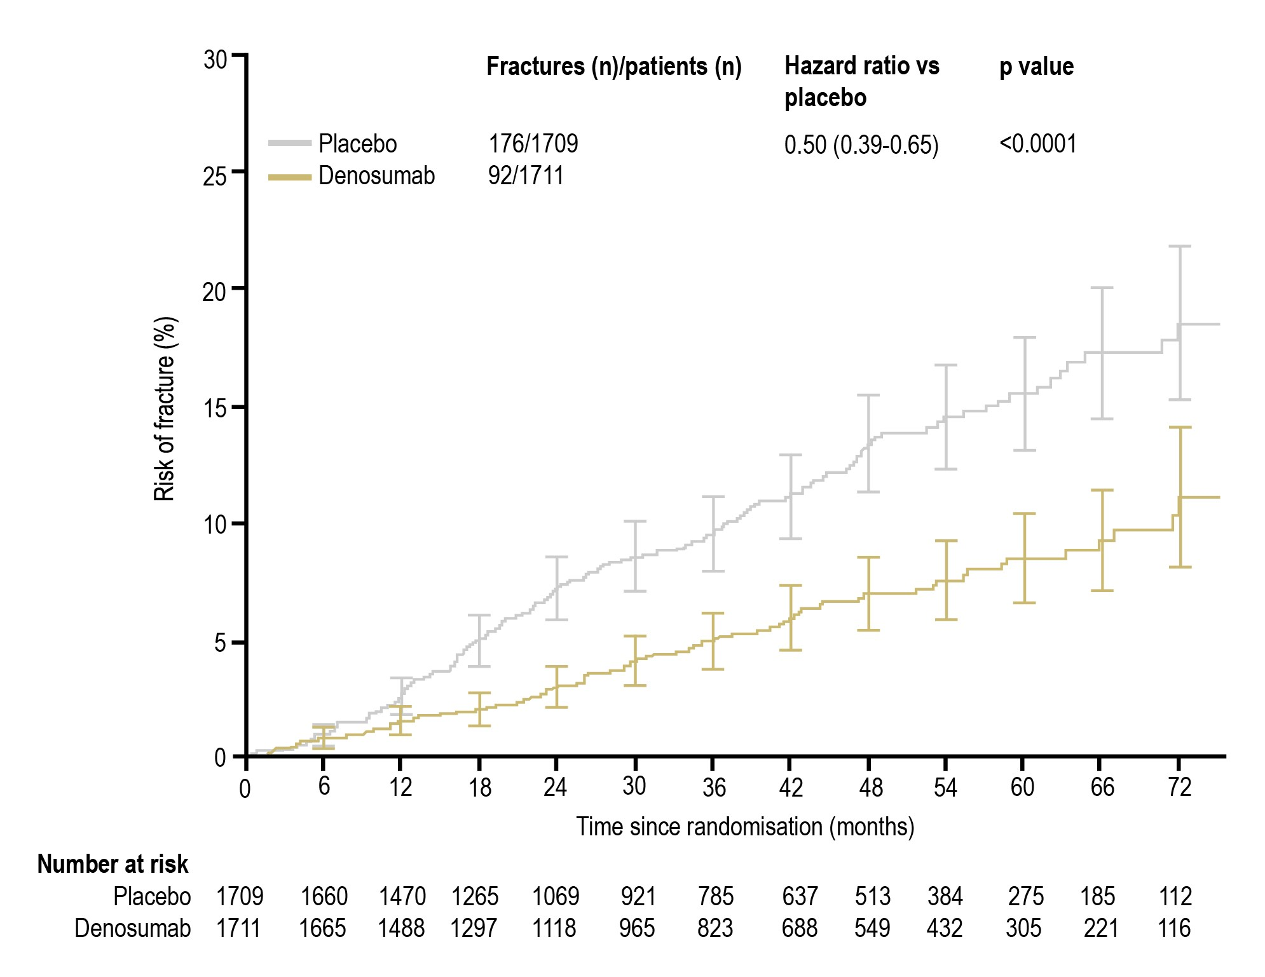
Effect of Denosumab 60 mg q 6 mo on the Occurrence of Clinical Fracture in Postmenopausal, Aromatase Inhibitor-Treated Patients with Early-Stage Hormone Receptor-Positive Breast Cancer (ABCSG-18)
Percentage risk of fracture based on Kaplan-Meier time-to-event analysis within each treatment group at 6-month intervals.
The hazard ratio and p value were calculated from a Cox model including treatment groups as the independent variable and
stratified by the randomisation stratification factors. Error bars are 95% CIs.
Gnant M, Lancet 2015 Aug 1;386(9992):433-43.

Slide 89
20-Year Risks of Breast-Cancer Recurrence after Stopping Endocrine Therapy at 5 Years
After 5 years of adjuvant endocrine therapy, breast-cancer recurrences continued to occur steadily throughout the study period from 5 to 20 years.
In conclusion, even after 5 years of adjuvant endocrine therapy, women with ER-positive, early stage breast cancer still had a persistent risk of recurrence and death from breast cancer for at least 20 years after the original diagnosis.
Recognition of the magnitude of the long-term risks of ER-positive disease can help women and their health care professionals decide whether to extend therapy beyond 5 years and whether to persist if adverse events occur
Pan H et al. N Engl J Med 2017;377:1836-1846

Slide 90
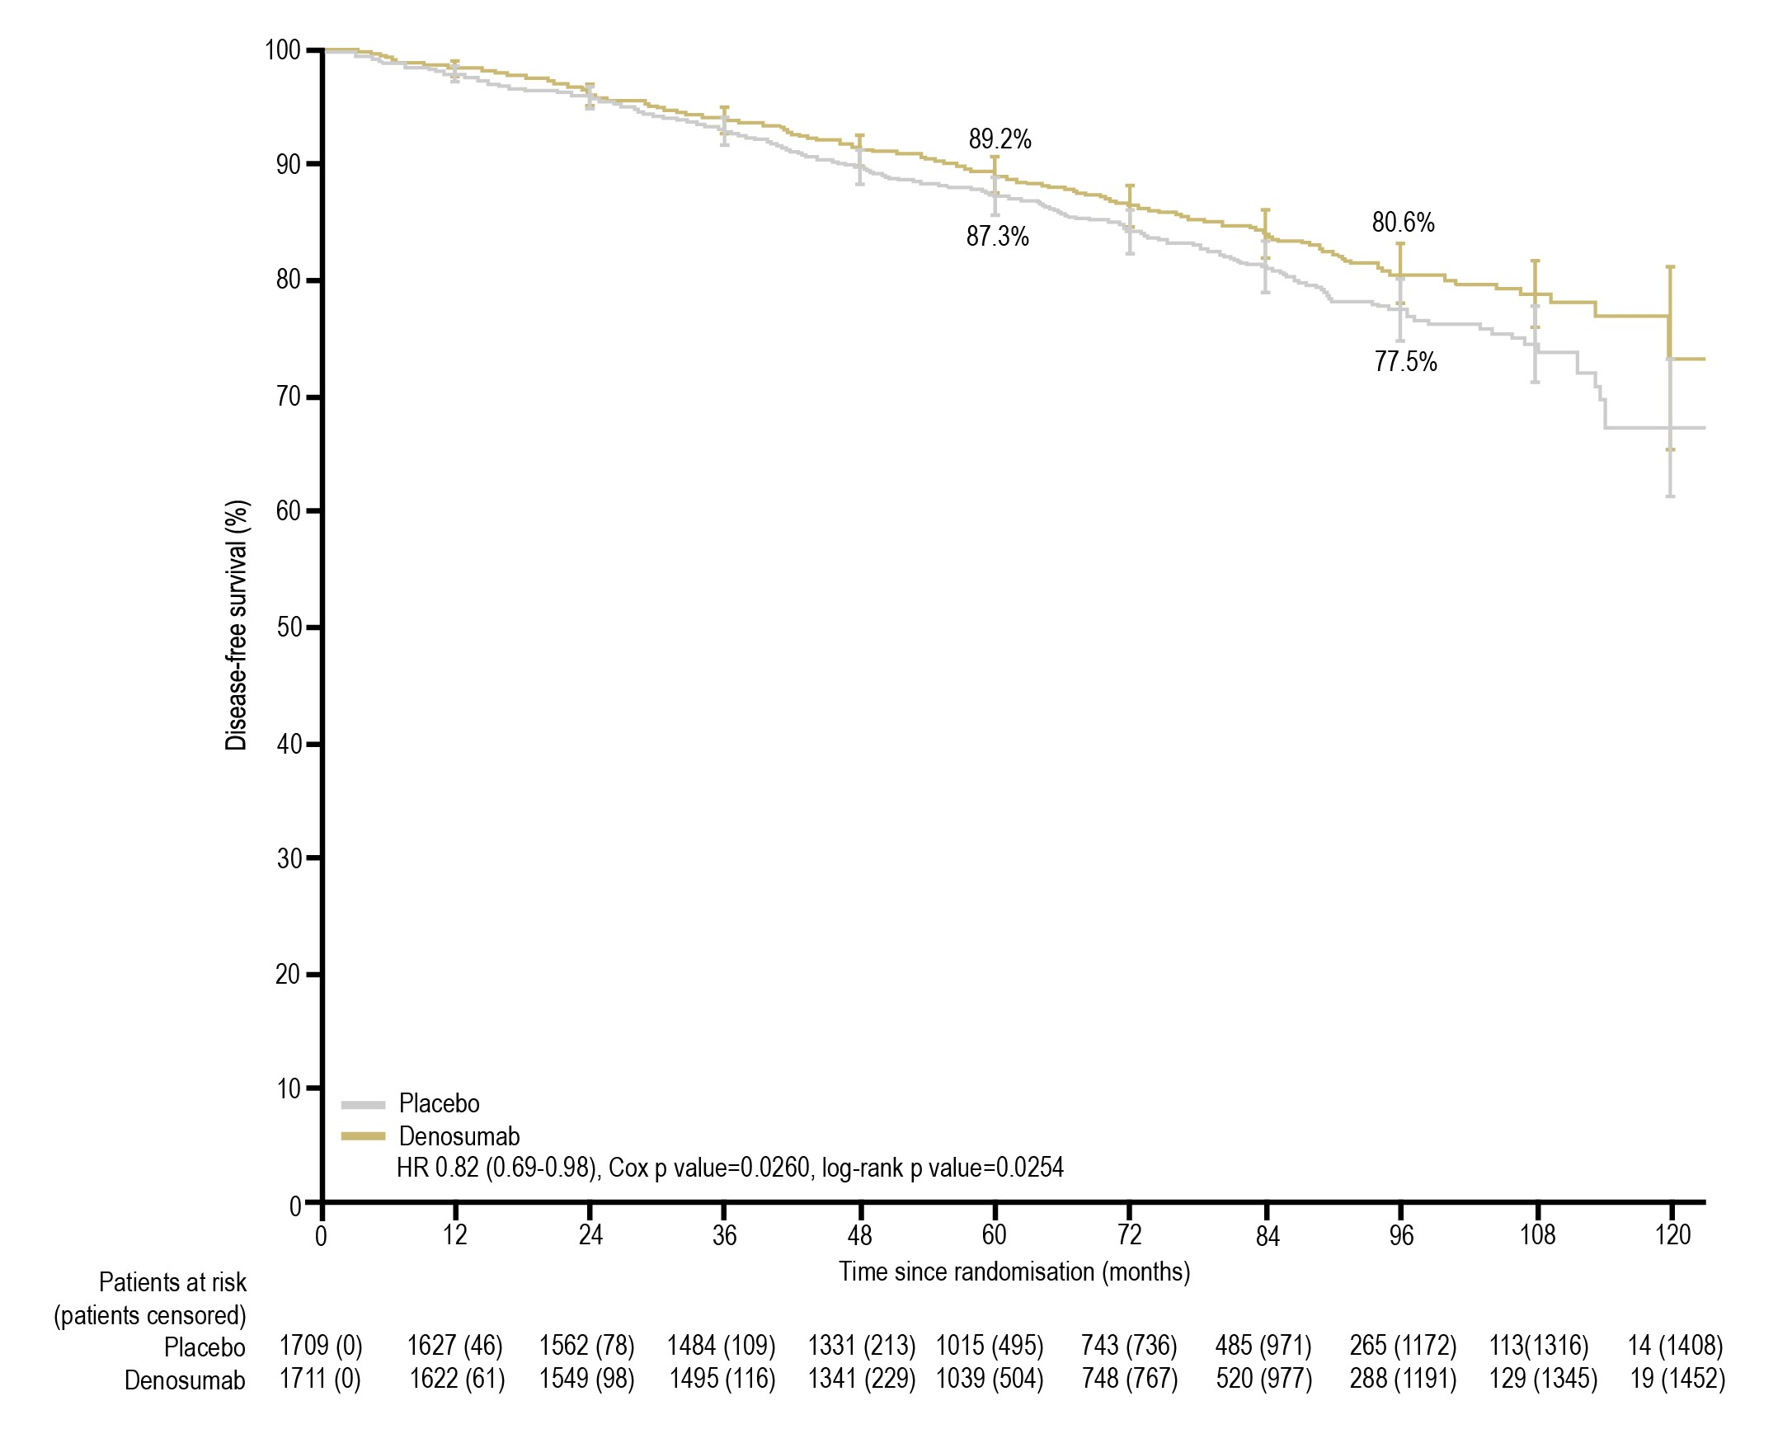
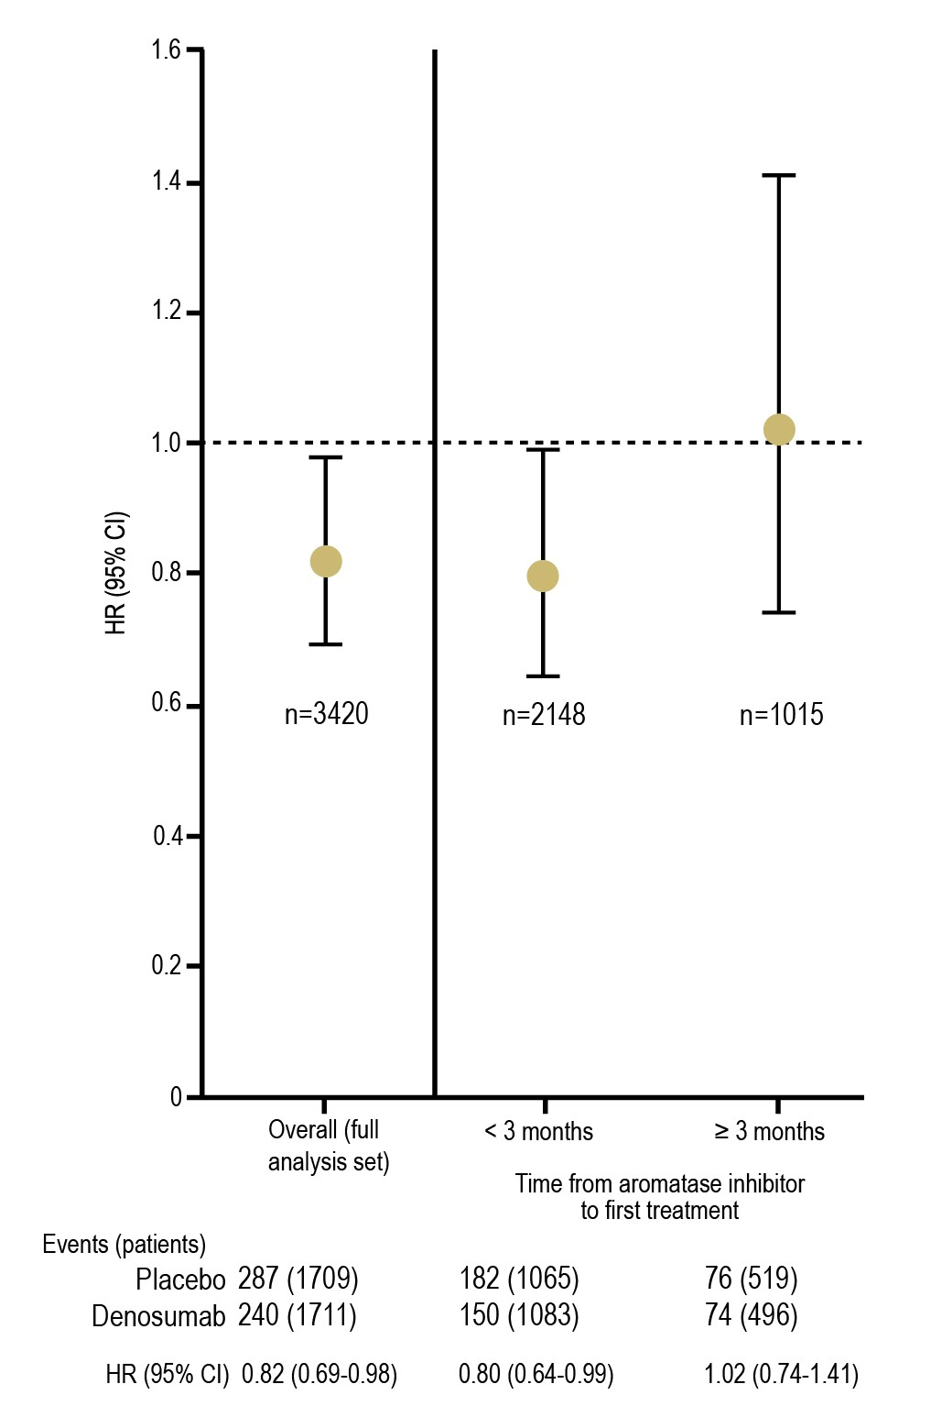
Adjuvant Denosumab in Postmenopausal Patients with Hormone Receptor-Positive Breast Cancer (ABCSG-18): Disease-Free Survival Results from a Randomized, Double-Blind, Placebo-Controlled, Phase 3 Trial
Gnant M et al. The Lancet Oncology 2019;20(3): 339-351.

Slide 91
Discussion: Clinical Takeaways
For postmenopausal patients, aromatase inhibitors (AIs) have emerged as the standard of care for hormone receptor-positive breast cancer because of their superior efficacy compared with tamoxifen.
AIs are associated with a rapid bone loss and a long-term risk of fracture
Good evidence of benefit from pharmacotherapy when FN T score < -1.5
Oral bisphosphonates and denosumab reduce the risk of bone metastases
IV Zoledronic (4 mg) acid given early and every 6 months prevents bone loss
Denosumab 60 mg s.c. q 6 months prevents bone loss, reduces fracture risk and decreases disease-free survival if initiated early (< 3 months)

Slide 92
Clinical Question 7
Do patients on androgen deprivation therapy require osteoporosis pharmacotherapy?

Slide 93
Learning Objectives
Upon completion of this module, participants will be better able to:
Explain the impact of co-morbidities on the risk profile of patients with osteoporosis
Describe why patients on androgen deprivation therapy are at risk for bone loss and will benefit from pharmacotherapy to prevent osteoporotic fractures
Mitigate the impact of medication-related factors which may increase the risk of bone loss and fragility fractures

Slide 94
Clinical Question 7
Do patients on androgen deprivation therapy require osteoporosis pharmacotherapy?
Intermittent androgen deprivation therapy is being used more frequently in the management of prostate cancer in men and has known harmful effects on bone. Clinical trials indicate both the prevention of bone loss and prevention of osteoporotic fractures in men treated with denosumab.

Slide 95
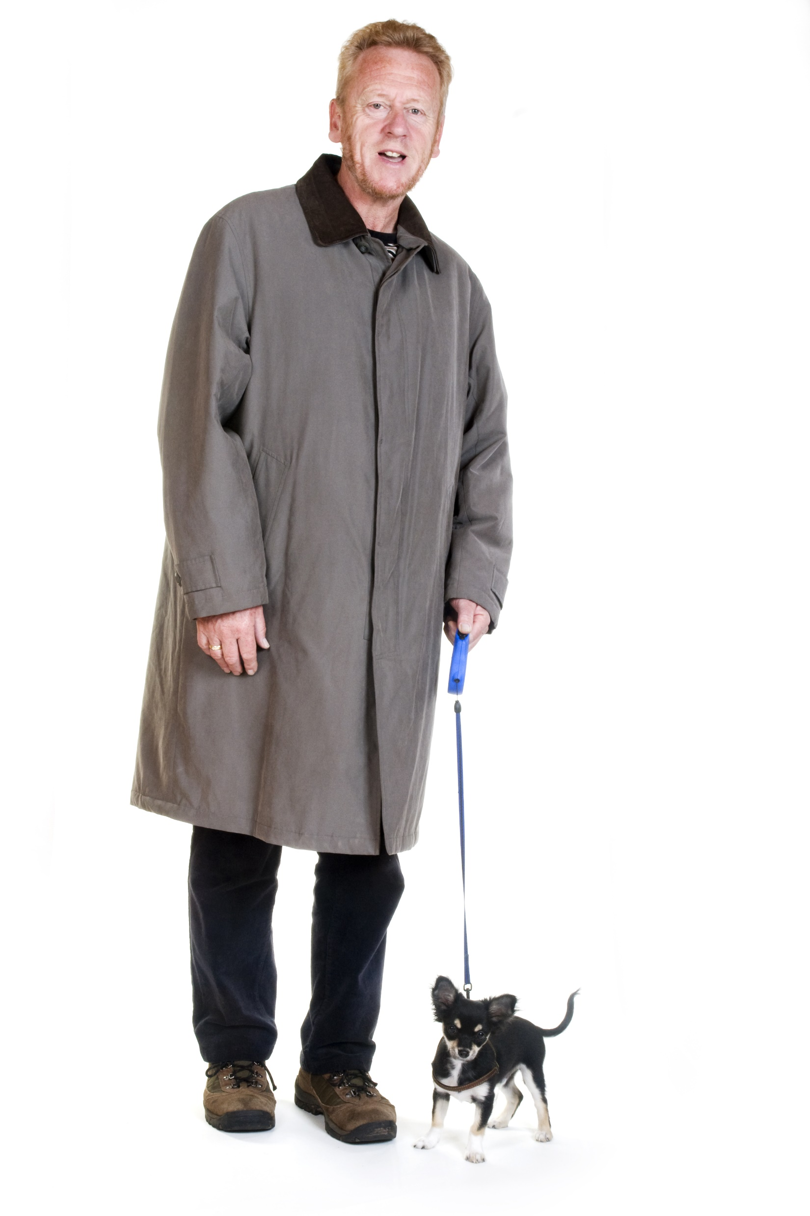
Clinical Vignette
Frank
66 years old
Frank’s History
5-year history of prostate cancer
Recently fractured his radius after tripping over the family dog
Today’s visit is to discuss his BMD results
Physical Exam & Tests
Femoral neck BMD T-score now: -2.7
Medications
Androgen Deprivation Therapy (ADT)

Slide 96
Clinical Vignette
Frank
66 years old
5-year history of prostate cancer
Recently fractured his radius after tripping over the family dog
Today’s visit is to discuss his BMD results
Femoral neck BMD T-score now: -2.7
What is Frank’s risk of osteoporotic fracture?
Low
Moderate
High
Not sure
Androgen Deprivation Therapy (ADT)
Notes:
Correct Answer: 2 Moderate

Slide 97
Clinical Vignette
Frank
66 years old
5-year history of prostate cancer
Recently fractured his radius after tripping over the family dog
Today’s visit is to discuss his BMD results
What osteoporosis treatment advice would you discuss with Frank?
Simply ensure that he has an adequate daily intake of calcium and vitamin D and tell him that he does not require anything more for his bones
Tell him to take some saw palmetto
Start him on a bisphosphonate or denosumab
Both A & B
Stop androgen deprivation therapy
Femoral neck BMD T-score now: -2.7
Androgen Deprivation Therapy (ADT)
Notes:
Correct Answer: (3) Start him on a bisphosphonate or denosumab

Slide 98
Androgen Deprivation Therapy (ADT)
Despite therapy, up to 40% of men with prostate cancer develop metastases with a high propensity for bone, leading to skeletal related events²
ADT is the standard of care in the management of advanced prostate cancer or as an adjunct therapy¹
ADT is associated with a well-known deleterious effect on bone health, resulting in a decrease in BMD and increased risk for fracture²
Men undergoing ADT are 4x times more likely to develop significant bone deficiency²
Proportion of Men with Fractures 1-5 Years After Cancer Diagnosis¹
+6.8%; P<0.001
21
18
ADT (n=6650)
15
No ADT (n=20,035)
12
Frequency (%)
9
+2.8%; P<0.001
6
3
0
Any Fracture
Fracture Resulting in Hospitalization
1. Shahinian, V.B., et al. N Engl J Med. 2005;352(2):154-64; 2. Bienz, M., Saad, F. BONEKEy Reports. 2015 24;4:716.

Slide 99
Androgen Deprivation Therapy (ADT)
Prostate cancer is promoted by androgens and is often sensitive to androgen-deprivation treatments such as GnRH agonists.¹
Result of ADT is to reduce circulating testosterone and other androgens. This also reduces estradiol levels and BMD.¹
BMD declines up to 8.5% per year in men receiving ADT.^{2,3}
A retrospective study of 50,163 prostate cancer patients found significantly higher rates of fracture in patients treated with ADT vs. untreated (19.4% vs. 12.6%, p<0.001).⁴
BMD = bone mineral density; GnRH = gonadotropin releasing hormone
1. D’Oronzo S, et al. Cancer treatment-induced bone loss (CTIBL): Pathogenesis and clinical implications. Cancer Treat Rev. 2015;41:798-808.
2. Lipton A, Smith MR, Ellis GK, et al Treatment-induced bone loss and fractures in cancer patients undergoing hormone ablation therapy: efficacy and safety of denosumab. Clin Med Insights Oncol. 2012;6:287-303
3. Diamond TH, Higano CS, Smith MR, et al. Osteoporosis in men with prostate carcinoma receiving androgen-deprivation therapy: recommendations for diagnosis and therapies. Cancer. 2004;100:892-899.
4. Shahinian VB, et al Risk of fracture after androgen deprivation for prostate cancer. N Engl J Med. 2005; 352:3154-164.
Notes:
Key Points:
BMD declines up to 8.5% per year in men receiving ADT compared to 0.5%-1% (Lipton A et al, 2012).
Lipton recites Diamond TH et al 2004 to support this statement. Diamond reports that “rates of bone loss ranged from 2% to 8% in the lumbar spine and from 1.8% to 6.5% in the femoral neck during the initial 12 months of continuous ADT. Retrospective data indicated an increased risk of fracture in men with prostate carcinoma who were treated with ADT.” Diamond then discusses that “in longitudinal studies, 5.7–8.5% decreases in lumbar spine cancellous bone mineral (using QCT) and 1.8–2.3% decreases in femoral neck BMD (using DXA) were recorded after 12 months of ADT”
Reference:
1. D’Oronzo S, et al. Cancer treatment-induced bone loss (CTIBL): Pathogenesis and clinical implications. Cancer Treat Rev. 2015;41:798-808.
2. Lipton A, Smith MR, Ellis GK, et al Treatment-induced bone loss and fractures in cancer patients undergoing hormone ablation therapy: efficacy and safety of denosumab. Clin Med Insights Oncol. 2012;6:287-303
3. Diamond TH, Higano CS, Smith MR, et al. Osteoporosis in men with prostate carcinoma receiving androgen-deprivation therapy: recommendations for diagnosis and therapies. Cancer. 2004;100:892-899.
4. Shahinian VB, et al Risk of fracture after androgen deprivation for prostate cancer. N Engl J Med. 2005; 352:3154-164.

Slide 100
Meta-Analysis: Androgen Deprivation Therapy: All Evaluated PMO Treatments Are Effective In Improving BMD
Zoledronic acid was found to have a greater improvement in BMD compared to other active treatments at all three studied site^{1*}
All drugs (bisphosphonates, denosumab, and raloxifene) appeared to be effective in reducing the rate of bone loss¹
In ADT treated nonmetastatic prostate cancer, BPs were effective in increasing BMD, but no trial was sufficiently powered to detect reduction in fractures
Denosumab improved BMD and reduced the incidence of new radiographic vertebral fractures in 1 high-quality trial²
*Except for risedronate, which had better BMD improvement compared to ZA at the femoral neck site in one small study. BP= bisphosphonates
1. Poon, Y., et al. BJU Int. 2018;121(1):17-28. 2. Alibhai, S.M.H., et al. Ann Intern Med. 2017:5;167(5):341-350.

Slide 101
RCT: Androgen Deprivation Therapy: Effect of Denosumab on BMD and New Vertebral Fractures
234 diagnosed OP patients on ADT for prostate cancer
Denosumab 60 mg subcutaneously every 6 months or alendronate (70 mg/week) for 2 years
Both drugs provided significant improvements in back pain and general health conditions
Mean changes in BMD at final follow-up differed significantly between two groups
New vertebral fractures over 24 months: Denosumab 18 [15.38 %] vs. alendronate 24 [20.51 %] P=0.10 (not significant)
BMD changes at the lumbar spine at 24 months were 5.6% with denosumab vs. -1.1% with alendronate (P<0.001)
OP = osteoporosis
Doria C, et al. Minerva Urol Nefrol. 2017;69(3):271-277.

Slide 102
Retrospective Studies Have Also Found Increased Fracture Risk with GnRH Agonists in Non-Metastatic Prostate Cancer
Medical claims data from 16 large US companies¹
(N=12,120; n=3,779)
Medical claims data from random sample of US Medicare beneficiaries²
(N=11,661; n=3,887)
1.76*
1.18
1.45*
1.21*
1.30*
1.21*
Relative Risk (95% CI)
Relative Risk (95% CI)
Any Fx
Vert Fx
Hip/femur
Fx
Any Fx
Vert Fx
Hip/femur
Fx
*p < 0.05. Fx = fracture; Vert = vertebral
1. Smith MR, et al. (2006) J Urol. 175, 136-139. 2. Smith MR, et al. (2005) J Clin Oncol. 23, 7897-7903.
Notes:
Relative risk (95% CI) (n=12,120)¹
Relative risk (95% CI) (n=11,661)²
Any fracture
1.21 (1.09, 1.34)
1.21 (1.14, 1.29)
Vertebral
1.18 (0.94,1.48)
1.45 (1.19, 1.75)
Hip/femur
1.76 (1.33, 2.33)
1.30 (1.10, 1.53)
References
1. Smith MR, et al. Risk of clinical fractures after gonadotropin-releasing hormone agonist therapy for prostate cancer. J Urol. 2006;175:136-139.
2. Smith MR, et al Gonadotropin-Releasing Hormone Agonists and Fracture Risk: A Claims-Based Cohort Study of Men With Nonmetastatic Prostate Cancer. J Clin Oncol. 2005;23:7897-7903.

Slide 103
Cumulative Incidence of New Vertebral Fracture at 12, 24, and 36 Months, Denosumab HALT Prostate Cancer Study Group
Placebo
Denosumab
New Vertebral Fracture (%)
P=0.004
P=0.004
P=0.006
6
4
3.9
3.3
2
1.9
1.5
1.0
0.3
0
24
12
36
Month
No. of Patients
13
2
22
7
26
10
Smith MR et al. (2009) N Engl J Med., 361, 745-755.
Notes:
Cumulative Incidence of New Vertebral Fracture at 12, 24, and 36 Months, According to Study Group.
The relative risk for vertebral fracture among 679 patients in the denosumab group as compared with 673 patients in the placebo group was 0.15 at 12 months, 0.31 at 24 months, and 0.38 at 36 months.

Slide 104
Guidelines Recommend Considering Treatment to Prevent Bone Loss in Patients on ADT
US Endocrine Society Clinical Practice Guideline:
Osteoporosis in Men (2012)
We recommend pharmacological treatment for osteoporosis for men with prostate cancer receiving ADT who have a high risk of fracture based on low bone mineral density and/or clinical risk factors [Strong recommendation, moderate quality evidence].
All evaluated PMO therapies are improving bone mineral density in men receiving Androgen Deprivation Therapy (ADT) but denosumab is the only treatment option that also reduced the occurrence of new vertebral fracture in that population.
Watts NB, et al. (2012) J Clin Endocrinol Metab., 97(6), 1802-1822.
Notes:
Key Point:
I would also say in the summary that one of the issues for Family Medicine is “who is in charge” when the patient has cancer. The oncologist makes the call re androgen dep therapy, but it is often the FP who is following the “other” issues for the patient. And BMD, #s and the overall care end up as a FP issue. So here is where we stress communication and collaboration with oncology to help keep track of the patient, the BMD and the need for OP RX. You can’t presume that someone else is following or making these decisions as it falls through the cracks in healthcare
Watts NB, et al. Osteoporosis in Men: An Endocrine Society Clinical Practice Guideline. J Clin Endocrinol Metab 2012;97(6):1802-1822.

Slide 105
Discussion: Clinical Takeaways
AIs are anti-estrogen agents used in the treatment of estrogen receptor positive breast cancer in postmenopausal women¹
AIs decrease aromatase activity and inhibit the conversion of adrenal androgens to estrogen, which reduces circulating and tissue levels of estrogen²
Lack of estrogen leads to increased RANK ligand activity and an overall increase of mature osteoclasts, which results in increased bone resorption²
AI users are at an increased risk for fracture and bone loss^{3,4}
Patients treated with ADT have an increased risk of fracture and need to be treated⁵
1. Rinaldi RZ. (2013) Curr Osteoporos Rep.,11, 61–64. 2. Michaud LB, Goodin S. (2006) Am J Health Syst Pharm., 63, 419-430. 3. Gaillard and Stearns. (2011) Breast Cancer Research, 13, 205-216. 4. Brufsky et al. (2008) The Oncologist, 13, 187-195. 5. Shahinian VB, et al (2005) N Engl J Med., 352, 3154-164.

Slide 106
Clinical Question 8
Do proton pump inhibitors cause bone loss?

Slide 107
Learning Objectives
Upon completion of this module, participants will be better able to:
Explain the impact of co-morbidities on the risk profile of patients with osteoporosis
Describe why treatment with proton pump inhibitors may be associated with bone loss and increased fracture risk
Mitigate the impact of medication-related factors which may increase the risk of bone loss and fragility fractures

Slide 108
Clinical Question 8
Do proton pump inhibitors cause bone loss?
Proton pump inhibitors are widely used in older patients. Some but not all studies recognize risk for declines in BMD and increases in fracture risk.

Slide 109

Clinical Vignette
Maria
63 years old
Femoral neck BMD T-score is -3.6
Currently on oral bisphosphonate (risedronate 35 mg weekly) for the past 2 years
On a PPI for GERD for the last 4 years. (Gastroscopy showed mild gastritis and esophagitis). Her friends in Florida told her that they heard that her stomach pill is horrible for bones. She stopped and now is unable to sleep at night due to severe heartburn but is concerned about potential long-term side effects of PPI drug therapy
H2 blocker is not able to control her symptoms
What is Maria’s risk of osteoporotic fracture?
Low
Moderate
High
Notes:
NOTE: Ranitidine has been taken off the shelves and we should acknowledge the Health Canada action, so it is not a good choice.
Correct Answer 3: High

Slide 110
Clinical Vignette
Maria
63 years old
Femoral neck BMD T-score is -3.6
Currently on oral bisphosphonate (risedronate 35 mg weekly) for the past 2 years
On a PPI for GERD for the last 4 years. (Gastroscopy showed mild gastritis and esophagitis). Her friends in Florida told her that they heard that her stomach pill is horrible for bones. She stopped and now is unable to sleep at night due to severe heartburn but is concerned about potential long-term side effects of PPI drug therapy
H2 blocker is not able to control her symptoms
What treatment advice would you discuss with Maria?
Ignore her friends’ advice
Restart PPI and continue risedronate
Restart PPI and change OP therapy to denosumab
Stop all OP therapy and just take Vit D and Calcium
Notes:
NOTE: Ranitidine has been taken off the shelves and we should acknowledge the Health Canada action, so it is not a good choice.
Correct Answer 3: Restart PPI and change OP therapy to denosumab

Slide 111
Proton Pump Inhibitors (PPIs)
PPIs are potent acid suppressing medications used to treat gastro-intestinal (GI) conditions:
PPIs may potentially reduce absorption of calcium carbonate^{1,2}
Some retrospective studies have shown long-term PPI is associated with increased risk of hip fractures,^{2,3} particularly at high doses; other studies have found no association^{4,5}
For patients with osteoporosis using PPIs:
Ensure optimal calcium and vitamin D supplementation
Prescribe the lowest effective PPI dose, review indication periodically
Consider alternate formulation of calcium (e.g., calcium citrate)
Common uses of Proton Pump Inhibitors
Prevent recurrent GERD symptoms | Complications of Barrett’s esophagus
Complications of peptic stricture | Complications related to NSAIDs
1. O’Connel, MB, et al. (2005) Am J Med 118, 778-781. 2. Targownik LE, et al. (2008) CMAJ 179, 319-326. 3. Yang YX, et al. (2006) JAMA 296, 2947-2953. 4. Pouwels S. et al. (2011) Osteoporosis Int. 22, 903-910 5. Grey SL, et al. (2010) Arch Intern Med 170, 765-771.
Notes:
Key Points:
Proton pump inhibitors (PPIs) have been widely used in treating acid-related conditions (GERD, Barrett’s esophagus, etc) since the late 1980s
PPIs are one of the most commonly prescribed classes of medication and have a high prevalence of chronic use that continues to escalate
Some epidemiological studies have suggested a positive association between PPI therapy and the risk of osteoporotic fractures, potentially due to the effects of chronic acid suppression on calcium metabolism, although other studies have failed to demonstrate effect

Slide 112
Proton Pump Inhibitors
Potent suppressors of gastric acid
Meta analysis of 12 observational studies total of 1,521,062 pts
OR 1.2 (95% CI 1.11-1.3 p<0.001)
Kwok et al 2011
No difference in fracture risk seen with H2 Blockers
Risk appears dependent on duration of therapy, decreases following D/C
MOA – not known
May be due to impaired absorption of calcium carbonate in presence of higher gastric
Calcium carbonate best absorbed in acidic pH
Long term PPI use associated with increase in fall risk – Lewis 2014
May have direct action on OC proton pump
Need prospective RCT data – Only observational data present
OR = odds ratio; pts = patients; D/C = discontinuation; MOA = mode of action; OC = osteoclasts; RCT = randomized clinical trial

Slide 113
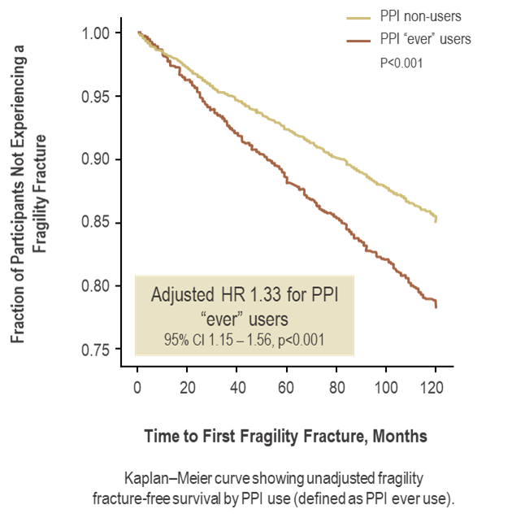
PPI Use is Associated with Increased Fracture
Potential mechanisms by which PPI therapy causes an increase in fracture risk include†:
Interference with Ca²⁺ absorption
Direct action of PPI in skeletal cells (osteoclasts)
PPI = proton pump inhibitor. P-value from the log rank test.
†Exact mechanism is not understood
Fraser LA, et al. (2013) Osteoporosis Int. 24,1161-1168.
Notes:
With adjusted HR 1.33
(1.15 – 1.56, p<0.001)
Key Points:
9,347 subjects who were never treated with SSRIs, GCs, PPIs, estrogen or AOM
At baseline: 2,715 subjects were on PPIs; 5,304 were on GCs; 1,149 were on SSRIs
Reference:
Fraser LA, et al. The effect of proton pump inhibitors on fracture risk: report from the Canadian Multicentre Osteoporosis Study. Osteoporos Int. 2013;24:1161-1168.

Slide 114
Meta-Analysis Demonstrates Increased Risk of Fracture Associated with PPI Use
Meta-analysis of 18 international observational case-control and cohort studies (n = 244,109 fracture cases)
1.58*
1.33*
1.26*
Relative Risk (95% CI)
* Statistically significant
Zhou B et al. (2016) Osteoporos Int 27, 339-347.
Notes:
Key Points:
This international meta-analysis evaluated the association between proton pump inhibitor and risk of fractures.
A systematic search of published literature (up to Feb 2015) was performed in PubMed. 17 publications reporting 18 studies were considered eligible for analysis.
All studies were observational case-control or cohort studies mostly in older adults.
The authors combined RRs for fractures using random-effects models and conducted sub-group and stratified analyses
The summary effect estimate for risk of hip fracture increased modestly among individuals taking proton pump inhibitors (relative risk [RR] 1.26, 95% confidence interval [CI], 1.16-1.36). There also was an increase in spine (RR 1.58, 95% CI, 1.38-1.82) and any-site fractures (RR 1.33, 95% CI, 1.15-1.54) among proton pump inhibitor users.
No evidence of duration effect in subgroup analysis (i.e. similar findings after stratification for short vs. long-term use).
Reference:
Zhou B et al. Proton Pump Inhibitors and Risk of Fractures: An Update Meta-Analylsis. Osteoporos Int 2016;27:339-347.

Slide 115
PPI Use Associated with Numerically Higher Risk of Overall, Clinical Spine and Non-Hip/Non-Vertebral Fractures
Global Longitudinal Study of Osteoporosis in Women (GLOW)
Multivariable regression model predicting Year 3/Year 5 fracture.
(n=2,715)
1.43*
1.16*
1.19*
Odds Ratio (95% CI)
0.57*
NHNV = non-hip-non-vertebral; * statistically significant
Adachi JD, et al. (2013) ASBMR, Oral presentation, OP 1049.
Notes:
Key Points:
In this study, subject from the Global Longitudinal Study of Osteoporosis in Women (GLOW) study were used to examine fracture patterns with use of SSRIs, PPIs and glucocorticoids over 5 years.
GLOW comprises women:
≥55 years of age,
615 primary care practices (17 sites, 10 countries).
Self-administered surveys, mailed at baseline, 12, 24, 36 and 60 months
Patient characteristics, risk factors for fracture, and use of estrogens, SSRIs, PPIs, GCs and anti-osteoporosis medication (AOM)
Multivariable regression calculated odds ratios (ORs) and 95% confidence intervals (CIs) are shown for PPIs. Models were adjusted for age, fracture between age 45 and enrollment into the study (baseline), and baseline use of anti-osteoporosis medication.
N=2,715 women were on PPIs at some point between baseline and year 2
Overall fractures=self-reported fracture of any of the following bones: collar bone or clavicle, upper arm, wrist, spine, rib, hip, pelvis, ankle, upper leg or lower leg
NHNV fractures=self-reported fracture of any of the following bones: collar bone or clavicle, upper arm, wrist, rib, pelvis, ankle, upper leg, or lower leg
Reference:
Adachi JD, et al. Fracture Patterns with use of Selective Serotonin Receptor Inhibitors, Proton Pump Inhibitors and Glucocorticoids in a Large International Observational Study: GLOW. ASBMR 2013. Oral presentation; OP 1049.

Slide 116
Proposed Mechanism of PPI on Bone Metabolism
PPI Treatment
Profound Acid Suppression
Hypergastrinemia
↓ Ca²⁺ Absorption
(-) Ca²⁺ Balance
Parathyroid Hyperplasia
↓ Plasma Ca²⁺
1° Hyperparathyroidism
2° Hyperparathyroidism
↑ PTH
↑ Bone Resorption
↓ Bone Strength
Adapted from: Yang YX. (2012) Curr Gastroentrol Rep., 14, 473 – 479.
Notes:
Key Points:
Yang YX presents a potential mechanistic link between PPI therapy and decreased bone strength, suggesting that chronic acid suppression associated with PPI treatment impacts calcium metabolism, which ultimately affects bone metabolism and bone strength
The model suggests chronic hypergastrinemia induced by PPI use may lead to parathyroid hyperplasia, resulting in increased loss of calcium from bone (left)
Gastric acid suppression may also reduce the bioavailability of calcium for intestinal absorption (right)
References:
Yang YX. Chronic proton pump inhibitor therapy and calcium metabolism. Curr Gastroenterol Rep. 2012; 14: 473 – 479.

Slide 117
Risk of Fracture with PPI Use: Health Canada Statement – April 4, 2013
PPI Treatment May be Associated With a Small: | OP-related Risk Factors that May Contribute to Increased Risk:
↑ risk of OP-related hip fracture | Age
↑ risk of OP-related wrist fracture | Gender
↑ risk of OP-related spine fracture | Presence of health conditions
The risk of fracture was higher in patients who received multiple daily doses of PPIs and therapy for a year or longer
Health Canada Alert April 2013. Proton Pump Inhibitors: Risk of Bone Fractures. Available at:
http://healthycanadians.gc.ca/recall-alert-rappel-avis/hc-sc/2013/26523a-eng.php. Last accessed March 17, 2017.
Notes:
Key Points:
In April 2013, Health Canada issued an alert informing Canadians and Canadian HCPs of the potential risk of bone fractures associated with PPI use
The Health Canada alert notes the following key points:
Several scientific studies suggest that PPI therapy may be associated with a small increased risk for fracture of the hip, wrist, or spine related to osteoporosis, a disease resulting in the weakening of bones
The risk of fracture was higher in patients who received multiple daily doses of PPIs and therapy for a year or longer
Additional risk factors for OP, such as age, gender and the presence of other health conditions, may also contribute to the increased risk of fractures
The alert also notes that the following proton pump inhibitors are available in Canada:
Dexlansoprazole (brand name Dexilant)
Esomeprazole (brand name Nexium and its generic equivalent)
Omeprazole (brand name Losec and its generic equivalents)
Lansoprazole (brand name Prevacid and its generic equivalents)
Pantoprazole (brand names Pantoloc and Panto IV, and their generic equivalents)
Pantoprazole/magnesium (brand name Tecta)
Rabeprazole (brand name Pariet and its generic equivalents
Reference:
Health Canada Alert April 2013. Proton Pump Inhibtors: Risk of Bone Fractures. Available at:
http://healthycanadians.gc.ca/recall-alert-rappel-avis/hc-sc/2013/26523a-eng.php. Last accessed 12/10/2013.

Slide 118
PPI Product Monographs Continue to Reflect Health Canada Guidance*
Several observational studies suggest PPI therapy may be associated with an increased risk for osteoporosis-related fractures of the hip, wrist, or spine.
The risk of fracture was increased in patients who received high-dose, defined as multiple daily doses, and long-term PPI therapy (>1 year).
Patients should use the lowest dose and shortest duration of PPI therapy appropriate to the condition being treated.
Accessed March 17, 2017.
Product Monographs of Losec (omeprazole magnesium), Nexium® (esomeprazole magnesium trihydrate), Tecta® (pantoprazole magnesium), Pantoloc® (pantoprazole sodium), Pariet® (rabeprazole sodium), Prevacid® (lansoprazole), Dexilant® (dexlansoprazole)

Slide 119
Discussion: Clinical Takeaways
PPIs are potent acid suppressing medications used to treat gastrointestinal (GI) conditions¹
Chronic hypergastrinemia induced by PPI use may lead to parathyroid hyperplasia, resulting in increased loss of calcium from bone and increased bone resorption¹
Gastric acid suppression may also reduce the bioavailability of calcium for intestinal absorption leading to increased bone resorption¹
PPI use is associated with a modest risk of fragility fracture^{2,3}
Health Canada suggests physicians monitor patients with risk factors for osteoporosis who use PPIs³
1. Yang YX. (2012) Curr Gastroenterol Rep 14, 473–479. 2. CAG Position Statement: Hip Fracture and Proton Pump Inhibitor Therapy – A 2013 update. 3. Health Canada Alert April 2013. Proton Pump Inhibtors: Risk of Bone Fractures. Available at: http://healthycanadians.gc.ca/recall-alert-rappel-avis/hc-sc/2013/26523a-eng.php.
Notes:
References:
Yang YX. Chronic proton pump inhibitor therapy and calcium metabolism. Curr Gastroenterol Rep. 2012;14:473–479.
CAG Position Statement: Hip Fracture and Proton Pump Inhibitor Therapy – A 2013 update. Available at: http://www.cag-acg.org/uploads/position/cag_position_ppi_hip_fracture_2013_rev.pdf Last accessed 12/10/2013.
Health Canada Alert April 2013. Proton Pump Inhibitors: Risk of Bone Fractures. Available at: http://healthycanadians.gc.ca/recall-alert-rappel-avis/hc-sc/2013/26523a-eng.php. Last accessed 12/10/2013.

Slide 120
Clinical Question 9
When patients are treated with Selective Serotonin Receptor Inhibitors, do they have an increase in the risk of fracture?

Slide 121
Learning Objectives
Upon completion of this module, participants will be better able to:
Explain the impact of co-morbidities on the risk profile of patients with osteoporosis
Describe why chronic SSRI treatment is associated with increased fragility fracture risk
Mitigate the impact of medication-related factors which may increase the risk of bone loss and fragility fractures

Slide 122
Clinical Question 9
When patients are treated with SSRI, do they have an increase in the risk of fracture?
Patients on chronic SSRI have increases in fragility fracture risk from numerous studies and are a potent risk factor; patients on SSRI are appropriate candidates for bone health evaluation and follow-up.
SSRI = Selective Serotonin Receptor Inhibitors

Slide 123

Clinical Vignette
Sue
66 years old
Sue has been on an SSRI for depression for the last 11 years (2 previous episodes of depression)
Femoral neck BMD T-score now -2.9
Visits your office to discuss results of BMD testing
Comes in for renewal of her medication
Concerned about potential side effects of drug therapy
What is Anna’s risk of osteoporotic fracture?
Low
Moderate
High
Notes:
Correct answer (2) Moderate

Slide 124
Clinical Vignette
Sue
66 years old
Sue has been on an SSRI for depression for the last 11 years (2 previous episodes of depression)
Femoral neck BMD T-score now -2.9
Visits your office to discuss results of BMD testing
Comes in for renewal of her medication
Concerned about potential side effects of drug therapy
What would you discuss with her regarding her BMD results and current meds?
Discuss her bone density results and fracture risk
Ensure she is taking adequate calcium and vitamin D
Explain to her that the SSRI has increased her risk of fragility fracture and start her on a bisphosphonate or denosumab
Explain to her that the SSRI has increased her risk of fragility fracture and wean her off of it
1, 2 & 3
Notes:
Correct answer (5) 1, 2 & 3
Discuss her bone density results and fracture risk
Ensure she is taking adequate calcium and vitamin D
Explain to her that the SSRI has increased her risk of fragility fracture and start her on a bisphosphonate or denosumab

Slide 125
Selective Serotonin Reuptake Inhibitors (SSRIs)
A class of commonly used antidepressants
First-line treatment for major depressive disorder in Canada¹
~69% of all antidepressants prescribed in Canada in 2013 were SSRIs/SNRIs²
SSRIs selectively block the serotonin transporter (5-HTT) in the CNS to increase extracellular levels of serotonin (5-HT) and relieve symptoms of depression³
SSRIs also act on 5-HT receptors, thus modulating the release of 5-HT directly⁴
Serotonin (5-HT) receptors have been identified on osteoclast, osteoblast and osteocyte cell lines⁴
SNRI = Serotonin-Norepinephrine Reuptake Inhibitor
1. Kennedy SH et al. (2016) Can J Psychiatry, 61(9), 540-560.; 2. IMSB, Compuscript (Feb'14). 3. Chau K et al. (2012) J Osteoporos, 2012, 323061. 4. Tsapakis EM et al. (2012) Eur Psychiatry, 7, 156-169.
Notes:
Key Points:
This slide outlines key points related to the use of selective serotonin reuptake inhibitors (SSRIs) and the potential impact on bone health¹⁻³
Although SSRIs have a direct impact on serotonin signalling in the central nervous system, recent evidence has suggested a potential association between antidepressant use and bone health, which is in part supported by evidence that serotonin and serotonin signalling pathways are present in bone cells³
Serotonin (5-HT) receptors have been identified on osteoclast, osteoblast and osteocyte cell lines. Effects on bone formation and resorption may be governed by the activation of a number of 5-HT receptors on osteoblasts and osteoclasts via endocrine, autocrine/paracrine and neuronal pathways⁴
Reference:
Kennedy SH et al. Canadian Network for Mood and Anxiety Treatments (CANMAT) 2016 Clinical Guidelines for the Management of Adults with Major Depressive Disorder. Section 3. Pharmacological Treatments. Can J Psychiatry. 2016;61(9):540-560.
IMSB, Compuscript (Feb'14)
Chau K et al. Are selective serotonin reuptake inhibitors a secondary cause of low bone density? J Osteoporos. 2012;2012:323061
Tsapakis et al. The adverse skeletal effects of selective serotonin reuptake inhibitors. European Psychiatry. 2012;27:156-169.

Slide 126
Selective Serotonin Reuptake Inhibitors and Serotonin- Norepinephrine Reuptake Inhibitors
Serotonin – monoamine produced by duodenal cells, synthesized in brainstem neurons
Serotonin receptors present on bone cells
Effect on bone complex- poorly understood
Gut derived serotonin can inhibit OB
Brain derived serotonin +OB, - OC
SSRI increase RR of any fracture
16 trial meta-analysis
RR 1.61(CI 1.49-1.74) – Rabenda 2013

Slide 127



Selective Serotonin Reuptake Inhibitors and Serotonin- Norepinephrine Reuptake Inhibitors
BONE
Activation of serotonin receptors
Osteoblasts
??? Apoptosis
??? Proliferation
? Differentiation
⬇ Bone formation
Osteoclasts
??? Apoptosis
⬆ Resorption
(early, transient)
Osteocytes
??? Apoptosis
⬇ Bone formation
⬇ Bone Mass
⬇ Bone Strength
Serotonin (5-HT) receptors have been identified on osteoclast, osteoblast and osteocyte cell lines²
Effects on bone formation and resorption may be governed by the activation of a number of 5-HT receptors on osteoblasts and osteoclasts via endocrine, autocrine/paracrine and neuronal pathways²
Adapted from: 1. Bliziotes, M. (2010) J Clin Endocrinol Metab. 95(9), 4124-4132. 2. Tsapakis EM, et al. (2012) Eur Psychiatry, 27, 156–169.
Notes:
Key Points:
The specific biochemical nature of serotonergic pathways and their direct and/or indirect effects on bone metabolism are still unclear, although the effect of SSRIs on bone formation and resorption appears to be governed by activation of 5-HT receptors on osteoblasts and osteoclasts via endocrine, autocrine/paracrine and neuronal pathways^{1,2}
Stimulation of the 5-HTR1a,b and d receptor inhibits cAMP mediated inhibition of protein kinase A (PKA) dependent phosphorylation pathways. This reduces the phosphorylation of the transcription factor CREB, therefore decreasing osteoblast proliferation (figure in above slide)
5HTR_{1B,4} receptors have been shown to play a role in osteoclast differentiation, although the exact mechanism remains unknown.
Vortioxetine is an agonist of 5-HTR1a, partial agonist of 5-HTR1b, and antagonist of 5-HTR 1d, 3a, 7.
.

Slide 128
SSRI Use Associated with an Increased Risk of Overall, Clinical Spine and Non-Hip/Non-Vertebral Fractures
Global Longitudinal Study of Osteoporosis in Women (GLOW)
Multivariable regression model predicting Year 3/Year 5 fracture.
(n=1,149)
2.18
1.66
1.66
0.65*
Odds Ratio (95% CI)
NHNV = non-hip-non-vertebral; *not statistically significant
Adachi JD, et al. (2013) ASBMR, Oral presentation; OP 1049.
Notes:
Key Points:
In this study, subject from the Global Longitudinal Study of Osteoporosis in Women (GLOW) study were used to examine fracture patterns with use of SSRIs, PPIs and glucocorticoids over 5 years.
GLOW comprises women:
≥55 years of age,
615 primary care practices (17 sites, 10 countries).
Self-administered surveys, mailed at baseline, 12, 24, 36 and 60 months
Patient characteristics, risk factors for fracture, and use of estrogens, SSRIs, PPIs, GCs and anti-osteoporosis medication (AOM)
Multivariable regression calculated odds ratios (ORs) and 95% confidence intervals (CIs) are shown for SSRIs. Models were adjusted for age, fracture between age 45 and enrollment into the study (baseline), and baseline use of anti-osteoporosis medication.
N=1149 women were on SSRIs at some point between baseline and year 2
Overall fractures=self-reported fracture of any of the following bones: collar bone or clavicle, upper arm, wrist, spine, rib, hip, pelvis, ankle, upper leg or lower leg
NHNV fractures=self-reported fracture of any of the following bones: collar bone or clavicle, upper arm, wrist, rib, pelvis, ankle, upper leg, or lower leg
Reference:
Adachi JD, et al. Fracture Patterns with use of Selective Serotonin Receptor Inhibitors, Proton Pump Inhibitors and Glucocorticoids in a Large International Observational Study: GLOW. ASBMR 2013. Oral presentation; OP 1049.

Slide 129
SSRI/SNRI Use Associated with Increased Fragility Fracture Risk Over 10 Years
Canadian Multicentre Osteoporosis Study (CaMos)
Prospective cohort study (N=6,645, n=192)
Among the 6,645 CaMos subjects included,
2.9%
(192) were USING SSRIs OR/AND SNRIs at baseline
SSRI/SNRI use was associated with increased risk of fragility fracture: HR, 1.88; 95% CI, 1.48–2.39
After controlling for multiple risk factors, the adjusted HR for current SSRI/SNRI use remained elevated: HR, 1.68; 95% CI, 1.32–2.14
Moura C et al. (2014) Osteoporos Int., 25, 1473–1481.
Notes:
Key Points:
In Moura et al,² the CaMos cohort was used to determine whether the use of SSRIs and SNRIs were associated with increased risk of fragility fracture in adults 50+
N=6,645 men and women; 192 (2.9%) were using SSRIs and/or SNRIs at baseline. 011 (60%) completed the full 10 years of follow up.
During the 10-year study period, 978 (14.7%) participants experienced at least one fragility fracture.
Hazard ratio adjusted for Charlson score, age, sex, education level, fall in previous month, physical activity, depressive symptoms (MCS scale), BMD hip and lumbar, thiazolidinedione use, vitamin D, and previous vertebral deformity (Genant grade $≥$2).
SSRI/SNRI was associated with a ~70% increased risk of fragility fracture
SSRI included citalopram, fluoxetine, fluvoxamine, paroxetine, sertraline. SNRIs included venlafaxine.
Univariate and multivariable Cox models were performed using alternative approaches to SSRI/SNRI exposure. See reference for details.
“We adopted two alternative assumptions for defining time dependent drug exposure (Fig. 1). For both approaches, if the participant reported being on use of SSRI/SNRI at two adjacent time points (y0 and y5, or y5 and y10), he/she was considered a current user during the entire 5-year period between these two years. In the first approach, drug use was further assumed to be constant for the period covered by each interview; if, for example, a participant reported being on SSRI/SNRI at y0 but neither at y5 nor y10, then he/she was considered current SSRI/SNRI from year 1 to year 4 and a non-user from year 5 to year 10. Using the second approach, if a participant reported being on SSRI/SNRI therapy at the beginning of the 5-year period but not 5 years later, then he/she was considered a user only in the first year of the period and a non-user in the following 4 years. As part of the second approach, if drug use was reported only at the end of the period but not 5 years earlier, the participant was assumed to be exposed only the last (fifth) year of the corresponding
period.”
An example: A patient reports use at baseline and year 5 but reports no longer using during their year 10 interview. In definition 1 they would be coded as a current user for baseline to year 9. In definition 2 they would be coded as current for baseline to year 5. Stepwise means they are coded as current for baseline to year 5, then use decreases in increments of 0.2/year in a stepwise function.
Reference:
Moura C et al. Antidepressant use and 10-year incident fracture risk: the population-based Canadian Multicentre Osteoporosis Study (CaMos) Osteoporos Int . 2014;25:1473–1481.

Slide 130
SSRI/SNRI Product Monographs Warn about Fracture Risk*
Epidemiological studies show an increased risk of bone fractures following exposure to some antidepressants, including SSRIs/SNRIs.
Elderly patients and patients with important risk factors for bone fractures should be advised of possible adverse events which increase the risk of falls, such as dizziness and orthostatic hypotension, especially at the early stages of treatment but also soon after withdrawal.
Until further information becomes available, a possible effect on bone mineral density with long-term treatment with SSRIs/SNRIs cannot be excluded and may be a potential concern for patients with osteoporosis or major risk factors for bone fractures.
*Accessed March 17, 2017.
Product Monographs of Prozac ® (fluoxetine), Zoloft® (sertraline), Celexa® (citalopram), Cipralex® (escitalopram), Paxil® (paroxetine), Effexor XR® (venlafaxine), Cymbalta® (duloxetine), Pristiq® (desvenlafaxine), Trintellix® (vortioxetine)

Slide 131
Discussion: Clinical Takeaways
SSRI/SNRIs are a first-line treatment for major depressive disorders in Canada¹
Serotonin (5-HT) receptors have been identified on osteoclast, osteoblast and osteocyte cell lines²
Effects on bone formation and resorption may be governed by the activation of a number of 5-HT receptors on osteoblasts and osteoclasts via endocrine, autocrine/paracrine and neuronal pathways²
SSRI/SNRI use is associated with an increased risk of hip, spine and non-vertebral fractures³
1. Kennedy SH et al. (2016) Can J Psychiatry, 61(9), 540-560. 2. Tsapakis EM, et al. (2012) Eur Psychiatry, 27, 156–169. 3. Rabenda V et al. (2013) Osteoporos Int., 24, 121-137.

Slide 132
General Recommendations
Reassess ongoing need for medication
Use lowest dosage and shortest duration needed
Counsel patients on lifestyle changes: encourage weight bearing exercise, cessation of tobacco use, and limiting alcohol use
Supplement calcium and vitamin D
Consider screening and monitoring bone density with dual-energy absorptiometry (DXA)
Initiate osteoporosis treatment if indicated
Adapted from: Hant FN and Bolster MB. (2016) Cleve Clin J Med., 83, 281-288.
Notes:
Note: Empowering for the GP to make the choice, CT RX for someone who is depressed/needs ADT, but pay attention to the lifestyle/medical options that may be of benefit. Again, take control and work to decrease risk

Slide 133
Clinical Question 10
How long do osteoporosis patients need to be treated?

Slide 134
Learning Objectives
Upon completion of this module, participants will be better able to:
Incorporate the history of prior fractures in determining future risk
Assess the risk of falls as a major and independent risk for fractures
Consider patient preference when selecting long term treatment
Explain the importance of adherence including avoidance of drug holidays in high risk individuals

Slide 135
Clinical Question 10
How long do osteoporosis patients need to be treated?
Osteoporosis is a chronic disease requiring a long-term strategic approach to maintain protection from fragility fractures which otherwise increases with aging. Sequential therapy with consideration of all available anabolic and antiresorptive therapies should be planned at the time patients are first diagnosed. Osteoporosis therapy should not be discontinued after an arbitrary length of time but rather continued as long as patients remain at risk of fragility fractures. Clinical trials confirm the long-term efficacy and safety of osteoporosis treatments.

Slide 136
Osteoporosis is a Chronic Disease Requiring Life-long Strategies to Reduce Fracture Risk
Oral BP: up to 10 years of treatment maintains fracture risk reduction similar to the 3-year registration trials
Increasing but low risk of atypical femoral fractures (AFF) with increasing duration of BP therapy
Risk of AFF increases to about 11.3/ per 10,000 patients after 8-10 yrs of treatment
Denosumab: 10 years of therapy provides fracture risk reduction similar to or better than that observed in the 3-year registration trial
Antifracture benefits of long-term therapy with BPs and denosumab in appropriately selected patients outweigh the risk of rare side effects
BP = bisphosphonate
Hanley DA, Writing Group for the Western Osteoporosis Alliance. Am J Med. 2017;130(7):862.

Slide 137
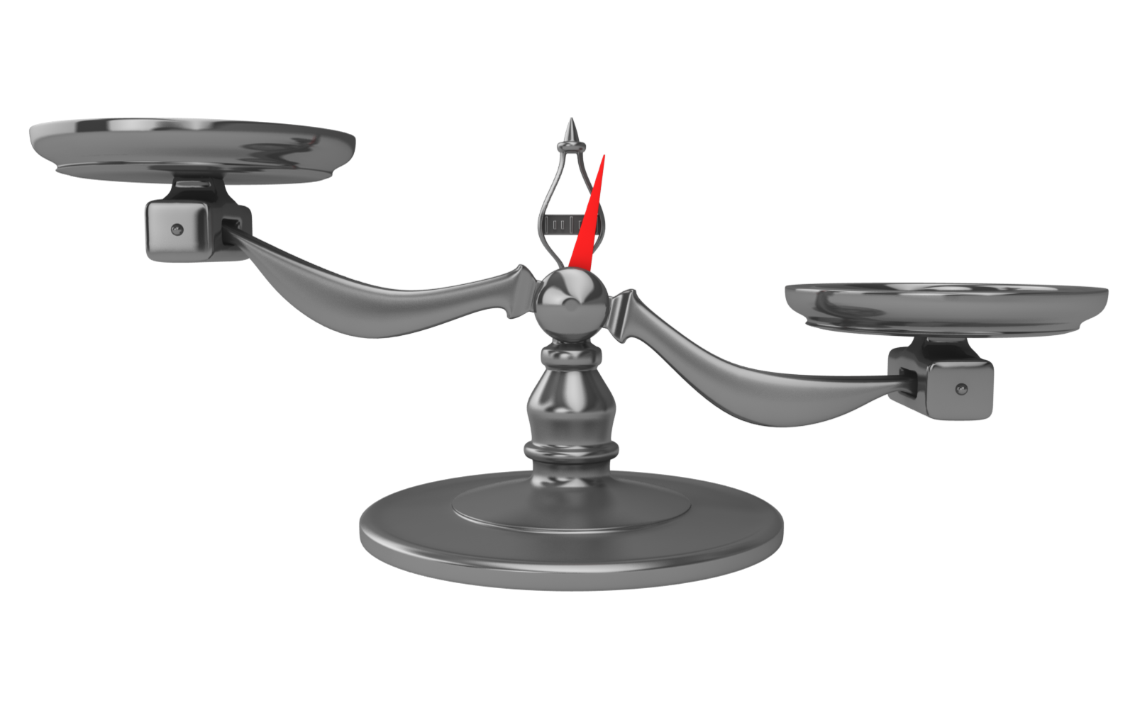
Weighing the Benefits of OP Therapy
BENEFIT
Reduces vertebral fracture risk by
30-70%²
RISK
Risk of ONJ from BP use: 1.03*¹
Fraction Risk Reduction
ONJ
In women with hip fracture: 24% enter LTC³
Risk of atypical fracture from BP use:
2 (2 yrs of use^{)**1,}
78 (8 yrs of use)**¹
Independent Living
Atypical Femoral Fracture
Decreased Morbidity/Mortality
Prevent nonvertebral and/or hip fractures and reduce mortality among individuals at high risk by 11%^{2,4}
Decreased Healthcare Costs
Acute Care
Costs associated with fracture
$1.5 billion⁵
Fracture Risk
*Incidence per 100,000 people **Incidence per 100,000 patient-years 1. Brown J.P., et al Can Fam Physician. 2014;60(April):324-333.; 2. Papaioannou, A., et al. CMAJ. 2010;182:1864-1873.; 3. Nikitovic, M., et al. Osteoporos Int. 2013;24:659-669.; 4. Bolland, M.J., et al. J Clin Endocrinol Metab. 2010;95:1174–1181.; 5. Hopkins, R.B., et al. Osteoporos Int. 2016;DOI: 10.1007/s00198-016-3631-6.

Slide 138
Long-term Reduction in Bone Remodeling with Denosumab: Associated with Continued Low Fracture Incidence¹
Yearly Non-vertebral Fracture Incidence With Denosumab Treatment for Up to 10 Years¹
Placebo
Long-term DMAb
Cross-over DMAb
FREEDOM
EXTENSION
Long-term
DMAb
Treatment
Yearly incidence of
non-vertebral fractures (%)
n
46
43
47
34
Years of DMAb Treatment
N
2343
2343
2343
2343
27
34
28
14
16
27
2244
2067
1867
1743
1585
1451
FREEDOM
EXTENSION
Cross-over
Pbo to DMAb
Treatment
Yearly incidence of
non-vertebral fractures (%)
1
2
3
1
2
3
4
5
6
7
n
116
Years of Placebo Treatment
Years of DMAb Treatment
N
3906
103
83
55
41
46
20
28
22
23
3688
3454
2207
2105
1965
1756
1646
1515
1394
n = number of subjects who have ≥ 1 nonvertebral fracture. N = number of enrolled subjects who remained in the study at the beginning of each year. Percentages for nonvertebral fractures are Kaplan-Meier estimates.
1. Ferrari S, et al. ASBMR (oral presentation). 2017; Abstract 1073; 2. Bone, H.G., et al. Lancet Diabetes Endocrinol. 2017;5(7);513-523.
Notes:
The arrows on this slide illustrates the progressive reduction in NV fracture risk with longer DMAb therapy. The importance of this is that it illustrates that longer therapy gives greater benefit (different from BP).

Slide 139
Comparison of Nonvertebral Fracture Rates with up to 10 Years of Denosumab Treatment
Nonvertebral Fracture Rate Ratios: All Denosumab-treated Subjects (Long-term + Cross-over)
Nonvertebral Fracture Rate Ratios: Long-term Denosumab Subjects
Rate Ratio (95% CI) = 0.74 (0.60–0.93)
P = 0.008
Rate Ratio (95% CI) = 0.72 (0.61–0.86)
P < 0.001
Rate Ratio (95% CI) = 0.79 (0.62–1.00)
P = 0.046
Fracture rate per 100 subject-years (95% CI)
Fracture rate per 100 subject-years (95% CI)
Denosumab Treatment
Denosumab Treatment
Fractures n =
263
217
Fractures n =
140
126
184
N = 4074
N = 2343
N = number of subjects who did not miss > 1 dose of DMAb during the first 3 years of FREEDOM or the extension.
Ferrari S, et al. ASBMR (oral presentation). 2017; Abstract 1073.

Slide 140
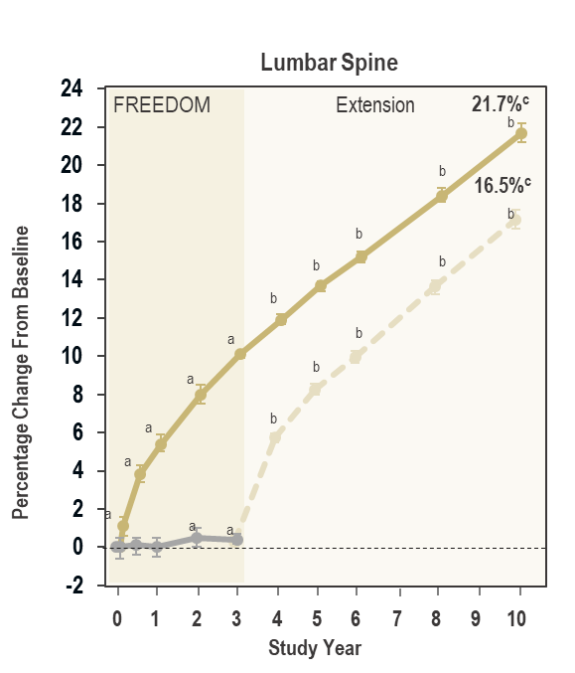
Effects of Denosumab Treatment on Lumbar Spine BMD and New Vertebral Fractures Through
10 Years
Placebo
Long-term Denosumab
Cross-over Denosumab
FREEDOM
Extension
Extension
Yearly Incidence of
New Vertebral Fractures (%)
1
2
3
4/5^{d}
6
7/8^{d}
9/10^{d}
b
Years of Denosumab Treatment
b
b
FREEDOM
Extension
b
Percentage Change From Baseline
ª
b
ª
b
Yearly Incidence of
New Vertebral Fractures (%)
ª
b
ª
ª
ª
ª
1/2^{d}
3
4/5^{d}
6/7^{d}
Years of Denosumab Treatment
0
1
2
3
4
5
6
7
8
9
10
BMD data are LS means and 95% confidence intervals. ªP < 0.05 vs FREEDOM baseline. ^{b}P < 0.05 vs FREEDOM and Extension baselines. ^{c}Percentage change while on denosumab treatment. ^{d}Annualized incidence: (2-year incidence) / 2. Lateral radiographs (lumbar and thoracic) were not obtained at years 4, 7, and 9 (years 1, 4, and 6 of the Extension).
Study Year
Adapted from Bone HG, et al. (2017). Lancet Diabetes Endocrinol . Published Online May 22, 2017 http://dx.doi.org/10.1016/ S2213-8587(17)30138-9.

Slide 141
Long-Term Use of BP Therapy Prevents Bone Loss and Reduces Vertebral Fractures
Long-term BP therapy (ALN 10 years, ZOL 6 years) prevented bone loss at multiple skeletal sites and reduced vertebral fractures compared with stopping ALN after 5 years or ZOL after 3 years
Greatest benefit with long-term ALN or ZOL therapy were high risk patients with:
Persistent low T-score at hip (≤ -2.5 for total hip or femoral neck T-score (HORIZON) and > -2.5 to ≤ -2 for femoral neck (FLEX)
Incident fracture during the core study
Prevalent vertebral fracture (at entrance to HORIZON extension)
Continued ALN resulted in a lower risk of clinical vertebral fractures; ZOL resulted in a lower risk of morphometric vertebral fractures
ALN = alendronate; ZOL = zoledronic
Adler RA, et al. J Bone Miner Res. 2016;31(1):16-35.

Slide 142
BMD is Sustained With Long-Term Bisphosphonate Therapy
Alendronate
Lumbar spine
Total hip
Alendronate pooled
Placebo
18
FIT
FLEX
10
FIT
FLEX
16
8
14
Mean % difference at 10 years,
2.57%, P<0.001
12
6
10
Mean %
Difference at 10 years,
3.81% (95% CI, 2.64%-4.97%), P<0.001
Change in BMD %
8
4
6
4
2
2
0
0
-2
-2
0
1
2
3
4
5
6
7
8
9
10
0
1
2
3
4
5
6
7
8
9
10
Year
Year
Zoledronic Acid
Lumbar spine
Z6
Z3
P3
Total Hip
Z9
Z6
P3
18
8
Z9
+4.6%
16
HORIZON
Z6
+12.1%
HORIZON
14
6
12
10
4
Mean %
Difference at 9 years,
0.96% (-1.07, 2.98), P=0.351
Change in BMD %
8
Z3P3
+10.1%
6
Mean %
Difference at 6 years,
2.06% (-1.05, 5.17), P=0.19
2
Z6P3
+3.7%
4
2
0
0
-2
-2
0
1
2
3
4
5
6
0
1
2
3
4
5
6
7
8
9
Year
Year
Adapted from: Black, D.M., et al. JAMA. 2006;296:2927-2938.; Black, D.M., et al. J Bone Miner Res. 2012;27:243-254.; Black, D.M., et al. J Bone Miner Res. 2014;30(5):934-44. DOI: 10.1002/jbmr.2442.

Slide 143
No Significant Difference in Risk of Fracture Between Year 6 and 9 on Zoledronic Acid
Results show continued efficacy in both groups, yet did not provide evidence of benefit from continuing ZOL infusions for more than 6 years
% Event Rate
6 years Zol then 3 years placebo (N=95)
9 years Zol (N=95)
NS: not significant
Black, D.M., et al. J Bone Miner Res. 2015;30(5):934-44.
Notes:
Key Points:
In years 3 to 6, femoral neck-BMD remained constant in Z6 and dropped slightly in Z3P3 (between-treatment difference = 1.04%; 95% CI: 0.4 to 1.7; p = 0.0009) but remained above pretreatment levels.
Small differences in bone density in those who continued vs. those who stopped treatment suggest residual effects, and therefore, after 3 years of annual ZOL, many patients may discontinue therapy up to 3 years.
After treatment from three to 6 years: Morphometric vertebral fracture risk was significantly lower (after 6 years) in Z6 ( n = 14) versus Z3P3 ( n = 30; 3.0% versus 6.2%, odds ratio [OR] = 0.51, 95% CICI: 0.26 to 0.95; p = 0.035). However, there was no significant difference in fracture incidence for nonvertebral (HR = 0.99, 95% CI 0.7 to 1.5), clinical vertebral (HR = 1.81, 95% CI 0.53 to 6.2), hip (HR = 0.9, 95% CI 0.33 to 2.49), or all clinical fractures (HR = 1.04, 95% CI 0.71 to 1.54).
In year 6 to 9, the results suggest that almost all patients who have received six annual ZOL infusions can stop medication for up to three years with apparent maintenance of benefit.
From year 6 to 9, the mean change in total hip BMD was −0.54% in Z9 vs. −1.31% in Z6P3 (difference 0.78%; 95% confidence interval [CI]: 0.37%, 1.93%; p=0.183). BTMs showed small, non-significant increases in those who discontinued after 6 years compared with those who continued for 9 years. The small sample size and limited number of fractures made identification of trends difficult to impossible; The number of fractures was low and did not significantly differ by treatment.
N Values:
Morphometric vertebral fractures
Z6P3: 5/69
Z9: 3/68
Non-veretebral / All fractures
Z6P3: 9/95
Z9: 10/95
References:
Black DM, et al. The effect of 3 versus 6 years of zoledronic acid treatment of osteoporosis: a randomized extension to the HORIZON-Pivotal Fracture Trial (PFT). J Bone Miner Res. 2012;27(2):243-54.
Black DM, et al. J Bone Miner Res DOI 10.1002/jbmr.2442

Slide 144
Management of Postmenopausal Women on Long-Term Bisphosphonate Therapy
Post-menopausal women treated with oral (≥ 5 yrs) or IV (≥ 3 yrs) BPs
Hip, spine or multiple other osteoporotic fractures before or during therapy
YES
NO
Continue BP¹ or change to alternative anti-fracture therapy² (e.g. teriperatide or denosumab) Reassess every 2-3 years
Hip BMD T-Score ≤ -2.5³ OR High Fracture Risk
YES
NO
Decision to stop therapy should be made on individual basis, based on informed choice of benefits/risks
Continue BP for up to 10 yrs¹ or change to alternative anti-fracture therapy² (e.g. teriparatide or denosumab)
Consider BP drug holiday
Reassess every 2-3 years
1. Brown, J.P., et al. Can Fam Physician. 2014;60:324-333.; 2. Silverman, S.L., et al. Osteoporos Int. 2016;27:849-852.; 3. McClung, M., et al. Am J Med. 2013;126:13-20.

Slide 145
Risks of Major Osteoporotic Fracture and Other Rare Events
EVENTS
INCIDENCE PER 100 000 PERSON-YEARS
Brown, J.P., et al. Can Fam Physician. 2014;60:324-333
Notes:
Bis-AFF—bisphosphonate-associated atypical subtrochanteric and diaphyseal femur fracture, Bis-ONJ—bisphosphonate-associated osteonecrosis of the jaw, BMD—bone mineral density, FN—femoral neck, FRAX—Fracture Risk Assessment Tool, MVA—motor vehicle accident. *Data from Khan et al33 (Canadian data). †Data from Dell et al38 (American data). ‡Data from Statistics Canada77 (Canadian data). §Data from Transport Canada78 (Canadian data). ||The 10-year risk of major osteoporotic fracture in a low-risk woman by Canadian FRAX (65-year-old woman, weighing 60 kg with a height of 168 cm; BMD FN T-score -1.2). ¶ The 10-year risk of major osteoporotic fracture in a moderate-risk woman by Canadian FRAX (65-year-old woman weighing 60 kg with a height of 168 cm; parent hip fracture history; BMD FN T-score -2.0). # The10-year risk of major osteoporotic fracture in a high-risk woman by Canadian FRAX (65-year-old woman weighing 60 kg with a height of 168 cm; parent hip fracture history; previous fracture; BMD FN T-score -2.6).
Figure 1 provides a comparison of the absolute risks of bisphosphonate-related ONJ or AFF compared with the risk of suffering major osteoporotic fracture in untreated postmenopausal women of low, moderate, and high fracture risk.

Slide 146
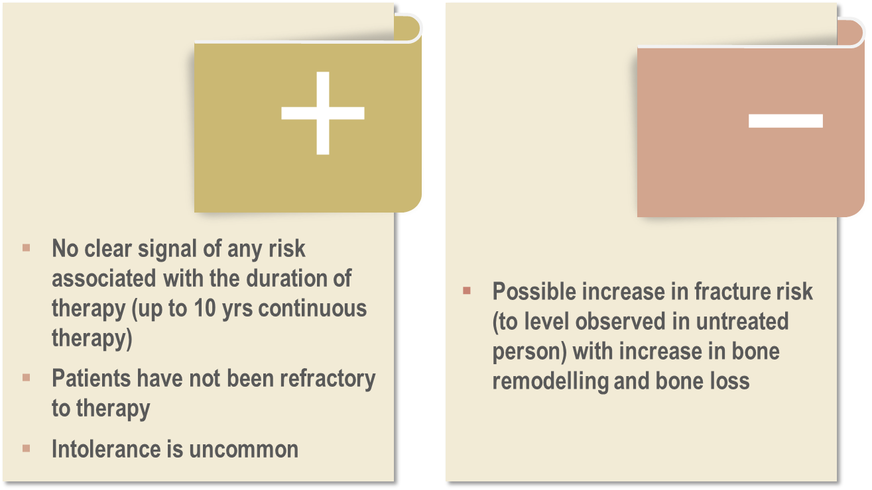
No Holiday with Denosumab Loss of benefit and increased risk of vertebral fractures
If denosumab is discontinued, steps must be taken to prevent rapid bone loss; biologic therapies (due to half-life) only control the disease process for as long as drug taken.
McClung, M.R. Osteoporos Int. 2016;27(5):1677-82. DOI: 10.1007/s00198-016-3553-3; Cummings, S.R., et al. J Bone Miner Res. 2018;33(2):190-198.

Slide 147
Effect of Denosumab Discontinuation DEFEND
Placebo (n = 128)
Denosumab (n = 128)
Discontinued denosumab
Serum CTx
Lumbar Spine BMD
1.2
Discontinued Treatment
60 mg Q6M
Discontinued Treatment
60 mg Q6M
8
1.0
6
0.8
4
Median ng/mL (interquartile range)
Percent Change (LS mean, ± SE)
0.6
2
0.4
0
0.2
-2
0
0
6
12
18
24
30
36
42
48
0
6
12
18
24
30
36
42
48
Month
Month
Last dose
Last dose
Results from a follow-up to a 2-year phase 3 trial of denosumab in postmenopausal women with low bone mass (DEFEND, N = 332). Off-treatment phase of the trial included 256 women.
Adapted from Bone HG, et al. J Clin Endocrinol Metab. 2011;96;972-980.
Notes:
Key Points:
Limited data are available that evaluate the effect of denosumab discontinuation
In an extension study of a phase 3 prevention trial in postmenopausal women with low bone mass, denosumab demonstrated reversibility of bone turnover markers and BMD upon discontinuation following 24 months of treatment (last dose at month 18).¹
Following denosumab discontinuation, levels of serum CTx increased to levels 40-60% above pretreatment values but returned to baseline levels within 12 months.²
After denosumab discontinuation, BMD returned to approximately baseline levels within 12 months.²
Supplemental Information
The phase 3 prevention study was a randomized, double-blind, placebo-controlled study that included 332 postmenopausal women with low bone mass and a mean age of 59.4 years.^{1,3}
Subjects were randomized to 24 months of treatment with denosumab 60 mg Q6M (n = 166) or placebo (n = 166).³
The primary endpoint was percent change in lumbar spine BMD at 24 months.³
Secondary endpoints included the change in BMD at the total hip, femoral neck, one-third radius; and the change in levels of the BTM serum CTx.³
Please note that denosumab is not indicated for the prevention of osteoporosis. The FDA has requested a new clinical program in order to consider denosumab for the prevention of postmenopausal osteoporosis.
A 2-year extension of the phase 3 prevention study was undertaken to determine the effects of Prolia® discontinuation (placebo, n = 128; discontinued denosumab, n = 128).¹
Fractures in this study were reported as adverse events. This study was not powered to evaluate fracture rates. The incidence of nonvertebral fractures during the off-treatment period was placebo, 4 (3.1%); denosumab, 4 (3.1%). These included fractures of the foot, fibula, radius, femur, and humerus. One vertebral fracture was observed in the denosumab group.¹
1. Bone HG, et al. J Bone Miner Res. 2009;24(Suppl 1). http://www.asbmr.org. Accessed September 17, 2009. Abstract A09001485 and oral presentation.
2. Prolia® (denosumab) prescribing information, Amgen.
3. Bone HG, et al. J Clin Endocrinol Metab. 2008;93:2149-2157.

Slide 148
On- vs Off-Treatment Vertebral Fracture Rate: All Patients FREEDOM and Extension Study – Analysis of MVF
During treatment, the rate of new vertebral fractures was lower in patients receiving denosumab compared to placebo (1.2 versus 7.0 per 100 patient-years)
After discontinuation of denosumab, the rate of vertebral fractures increased relative to the on-treatment period and became similar to that of patients discontinuing placebo (7.1 versus 8.5 per 100 patient-years)
The rate of multiple vertebral fracture was slightly higher in patients discontinuing denosumab compared to discontinuing placebo (4.2 versus 3.2 per 100 patient-years)
Any Vertebral Fracture¹
Multiple Vertebral Fractures¹
25
25
20
95% CI: 5.5–11.5
20
95% CI: 5.2–8.7
95% CI: 5.2–9.0
15
15
8.5
Rate of Vertebral Fracture,
Per 100 PY
Rate of Vertebral Fracture,
Per 100 PY
7.1
95% CI: 1.4–5.1
95% CI: 2.87–5.7
10
7.0
10
95% CI: 1.0-2.8
95% CI: 0.9–1.6
3.2
95% CI: 0.2-0.6
4.2
5
1.2
5
1.9
0.4
0
Placebo
Denosumab
0
Placebo
Denosumab
PY =
832.5
363.8
4,033.3
786.7
PY =
860.6
369.5
4,081.3
800.3
N =
470
1,001
N =
470
1,001
On-Treatment
Off-Treatment
*PY = patient-years; CI = confidence interval
Adapted from: Cummings SR, et al. J Bone Miner Res. 2017; [Published only ahead of print November 4, 2017]. 10.1002/jbmr.3337. 1. Data on File, Amgen.

Slide 149
Significant Predictors of Off-Treatment MVF
Prior vertebral fracture is the strongest predictor of off-treatment vertebral fractures
Other predictors of MVF were time off-treatment and rate of off-treatment total hip BMD loss
Significant Covariates | 772 Patients Included† OR (95% CI) | 1,471 Patients Included* OR (95% CI)
Prior VFx‡ (yes vs no) | 3.6 (1.8–7.1) | 3.9 (2.1–7.2)
Off-treatment duration (per year) | 1.4 (1.1–1.7) | 1.6 (1.3–1.9)
Annualized off-treatment total hip BMD loss§ (per 1%) | 1.2 (1.1–1.3) | NA
*1,471 patients included 470 patients who discontinued placebo and 1,001 patients who discontinued denosumab; †772 patients included 307 patients who discontinued placebo and 465 patients who discontinued denosumab, and had available off-treatment annualized total hip BMD change assessments; ‡“Prior VFx” includes any VFx sustained before or during treatment; §“Off-treatment annualized total hip BMD loss” was defined as annualized percent change in total hip BMD after treatment discontinuation, ie, between the last on- and off-treatment BMD assessments.
BMD = bone mineral density; CI = confidence interval; NA = not applicable; OR = odds ratio; VFx = vertebral fracture
Adapted from: Cummings SR, et al. J Bone Miner Res. 2017; [Published only ahead of print November 4, 2017]. 10.1002/jbmr.3337.

Slide 150
Discussion: Clinical Takeaways
There is no arbitrary time limit to osteoporosis therapy¹
In high risk patients, switching therapy from bisphosphonate to non-bisphosphonate antiresorptive or anabolic therapy may be rational¹
No drug holiday for HRT, SERMs, teriparatide and denosumab^{1,2}
Drug holiday (not retirement) is feasible with ALN, RIS and ZOL after 3-5 years if patient at moderate or low risk³
If bisphosphonate interrupted, reassess risk (and BMD) after:^{2,3}
1 yr for risedronate, 2 yrs for alendronate, 3 yrs for zoledronic acid
Long-term adverse effects of osteoporosis therapies are offset in high risk patients by the benefits of long-term reduction in fractures^{1,3}
HRT: hormone replacement therapy; SERMs: selective estrogen receptor modulators.
1. Papaioannou, A., et al. CMAJ. 2010;182:1864-1873.; 2. Silverman, S.L., et al. Osteoporos Int. 2016;27:849-852.; 3. Brown, J.P., et al. Can Fam Physician. 2014;60:325-333.

